Slide 1
FRIDAY
December 6, 2019
Notes:
Hello, and welcome, everybody, to the new national trends in disability employment, or nTIDE lunch & learn series. On the first Friday of every month, corresponding with the Bureau of Labor Statistics jobs report, we'll be offering this live broadcast via Zoom webinar to share the results of the latest nTIDE findings. In addition, we will provide news and updates from the field on disability employment, as well as host an invited panelist who will discuss current disability related findings and events.
Just a few housekeeping items before we begin.

Slide 2
FRIDAY
December 6, 2019
Notes:
Hello, and welcome, everybody, to the new national trends in disability employment, or nTIDE lunch & learn series. On the first Friday of every month, corresponding with the Bureau of Labor Statistics jobs report, we'll be offering this live broadcast via Zoom webinar to share the results of the latest nTIDE findings. In addition, we will provide news and updates from the field on disability employment, as well as host an invited panelist who will discuss current disability related findings and events.
Just a few housekeeping items before we begin.

Slide 3
Up Front Matters
#nTIDELearn
This webinar is being recorded. We will post an archive of each webinar, each month, on our website at www.researchondisability.org/nTIDE. This site will also provide copies of the presentations, the speakers’ bios, full transcripts, and other valuable resources.
As an attendee of this webinar, you are a viewer. To ask questions of the speakers, click on the Q & A box on your webinar screen and type your questions into the box. Speakers will review these questions and provide answers during the last section of the webinar. Some questions may be answered directly in the Q & A box.
Notes:
This webinar is being recorded. We will post an archive of each webinar, each month, on our Web site at www.researchondisability.org/nTIDE. This site will also provide copies of the presentations, the panelist bios, full transcripts and other valuable resources.
As an attendee of this webinar, you are a viewer and no sound is enabled. To ask questions of the panelists, simply click on the Q & A box on your webinar screen and type your questions into the box. Panelists will review these questions during the assigned question and answer periods.

Slide 4
Up Front Matters
#nTIDELearn
If you have any questions following this recording, please contact us at disability.statistics@unh.edu, or toll free at 866-538-9521 for more information. Thanks for joining us. Enjoy today's webinar!
Notes:
This webinar is being recorded. We will post an archive of each webinar, each month, on our Web site at www.researchondisability.org/nTIDE. This site will also provide copies of the presentations, the panelist bios, full transcripts and other valuable resources.
As an attendee of this webinar, you are a viewer and no sound is enabled. To ask questions of the panelists, simply click on the Q & A box on your webinar screen and type your questions into the box. Panelists will review these questions during the assigned question and answer periods.

Slide 5
Welcome Andrew Houtenville University of New Hampshire
#nTIDELearn

Slide 6
Welcome
#nTIDELearn
nTIDE Lunch & Learn:
A joint effort of the University of New Hampshire, Kessler Foundation, and the Association of University Centers on Disability (AUCD).
Occurs at noon Eastern-time on the first Friday day of each month, with the release of the nTIDE Report.
A part of the Rehabilitation and Research Training Center on Employment Policy and Measurement, which is funded by the National Institute on Disability, Independent Living and Rehabilitation Research (NIDILRR).

Slide 7
Today’s Program
#nTIDELearn
Part 1: nTIDE Report … “The Numbers”
John O’Neill, Kessler Foundation
Andrew Houtenville, University of New Hampshire
Part 2: nTIDE News
Denise Rozell, Association of University Centers on Disabilities (AUCD)
Part 3: Guest Speaker
Jennifer Mathis, Director of Policy and Legal Advocacy, Bazelon Center for Mental Health Law
Part 4: Q&A … for Parts 1-3

Slide 8
Part 1 The nTIDE Report John O’Neill Kessler Foundation
#nTIDELearn

Slide 9
The Monthly nTIDE Report
#nTIDELearn
The monthly nTIDE Report is a press release and infographic, looking at the latest employment statistics.
Uses data from the “jobs report” released by the U.S. Bureau of Labor Statistics, on the 1st Friday of each month.

Slide 10
Source of the Data
#nTIDELearn
U.S. BLS, Current Population Survey (CPS).
Source of the “official” unemployment rate.
Civilians, ages 16-64, not living in institutions.
Available September 2008 onward.
Not yet seasonally adjusted.
which is why we compare to the same month last year.

Slide 11
The Numbers Andrew Houtenville University of New Hampshire
#nTIDELearn

Slide 12
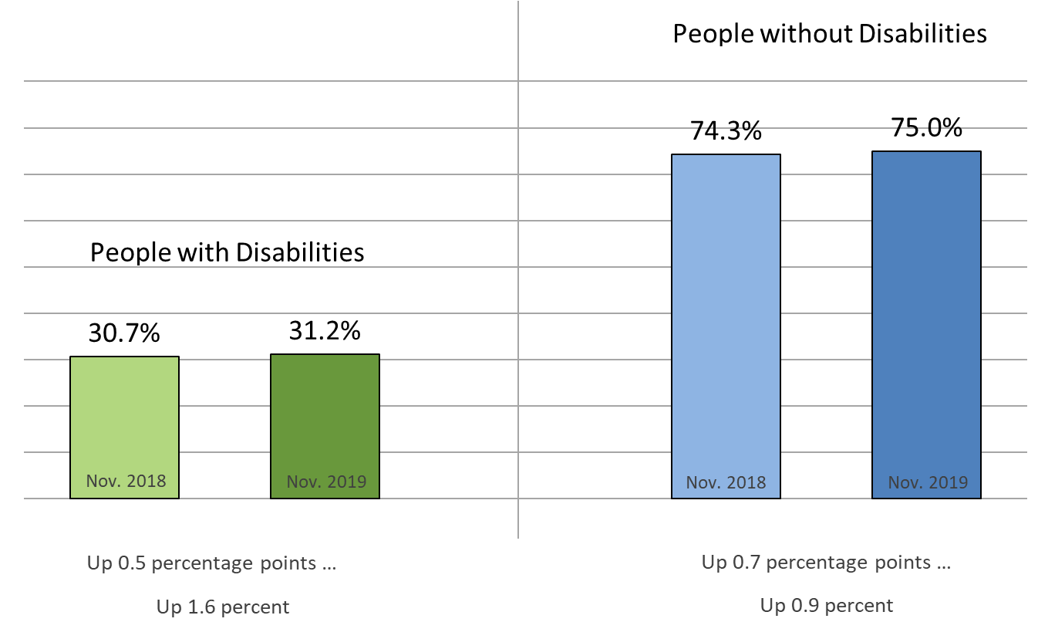
Employment-to-Population Ratio
#nTIDELearn

Slide 13
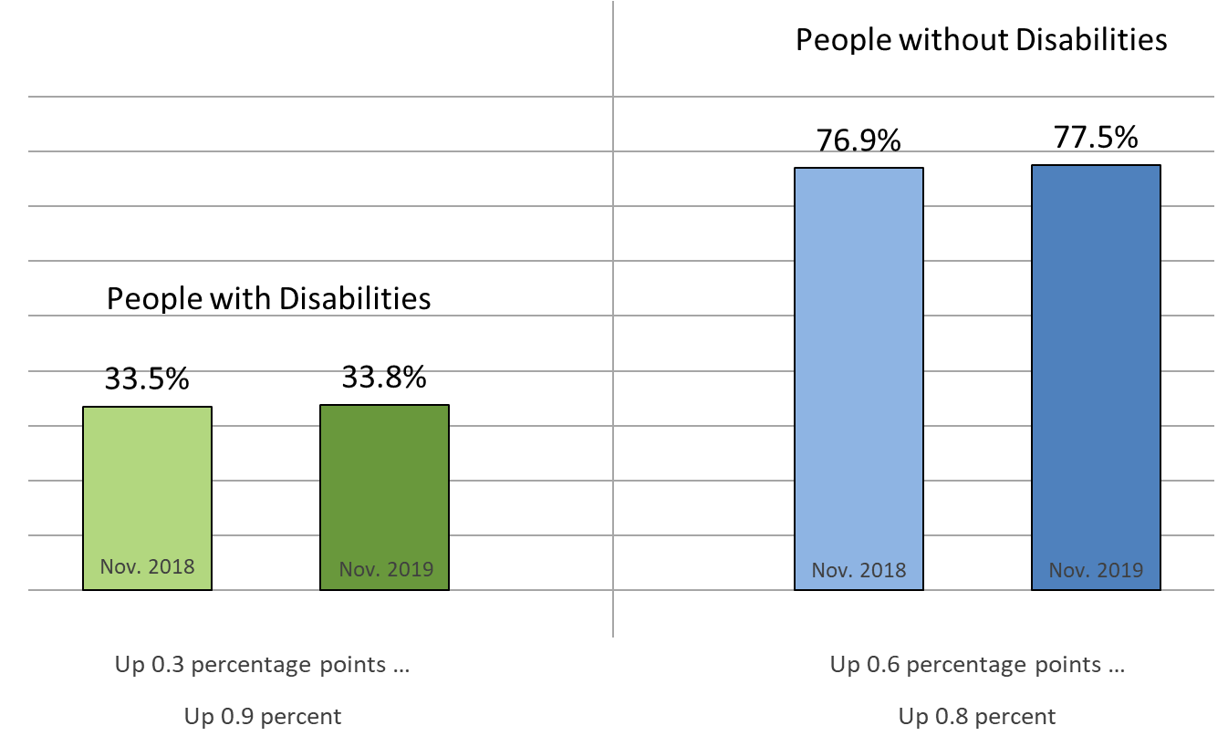
Labor Force Participation Rate
#nTIDELearn

Slide 14
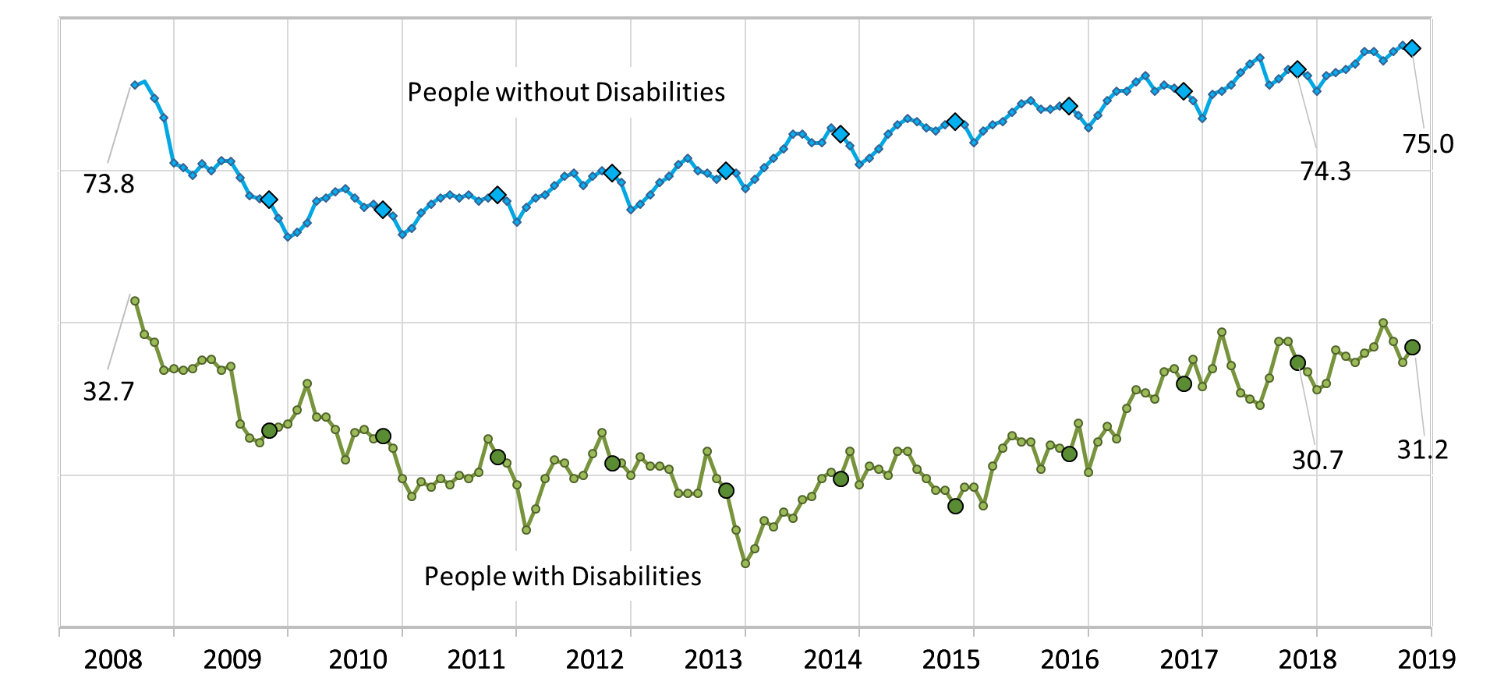
Employment-to-Population Ratio
#nTIDELearn

Slide 15
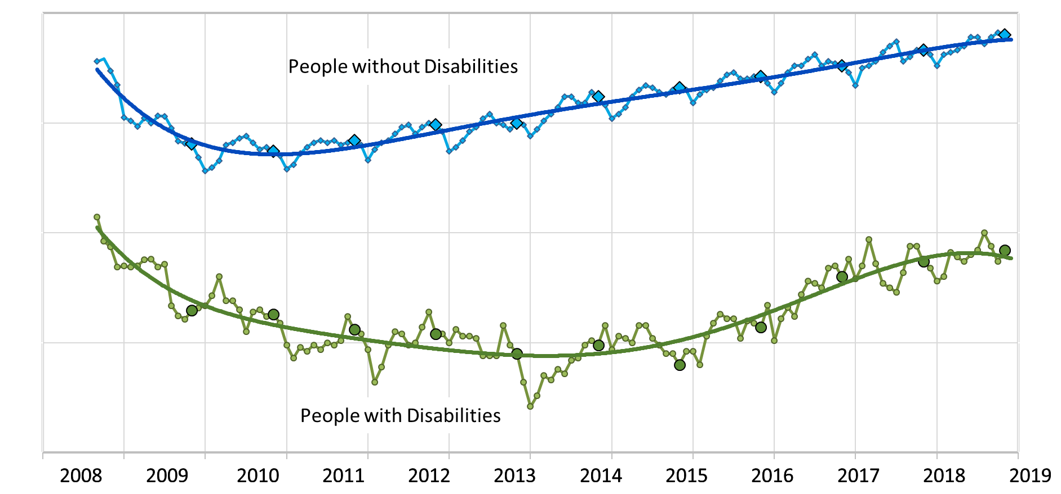
Employment-to-Population Ratio
#nTIDELearn

Slide 16
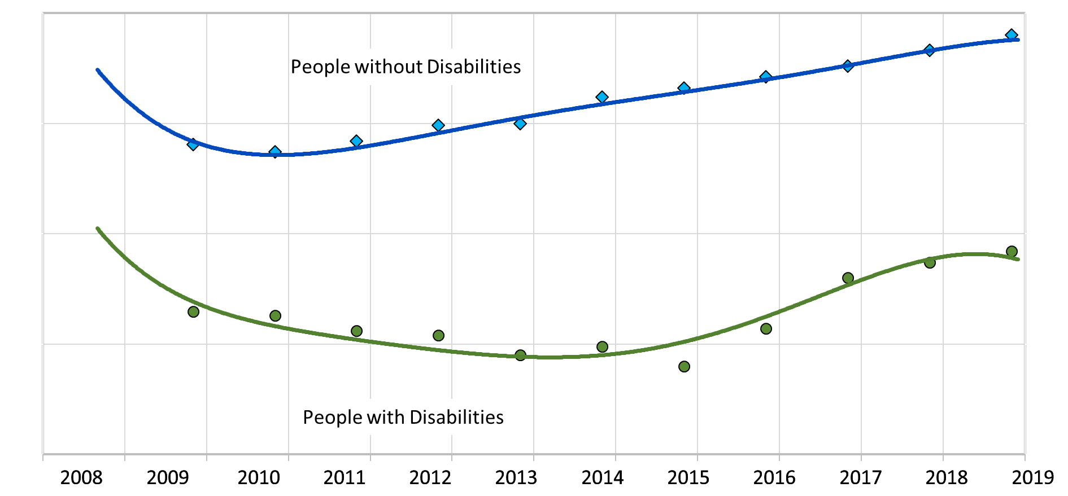
Employment-to-Population Ratio
#nTIDELearn

Slide 17
#nTIDELearn
Part 2 nTIDE News
Denise Rozell Association of University Centers on Disabilities (AUCD)

Slide 18
Federal Policy Update
#nTIDELearn
Appropriations CR through 12.20.19
House
Senate
Congress’s new reality…
Transformation to Competitive Employment (S 260/HR 873)
ABLE Age Adjustment Act (S 651/HR 1814)
College Affordability Act (HR 4674)

Slide 19
ReThink VR Performance Plan
#nTIDELearn
Federal agencies within education “ReThinking”
ReThink VR presented at CSAVR in October
Different way of looking at VR performance, improving results, high expectations
How RSA will foster strategies for continuous improvement , collaboration, high-quality employment opportunities
Opportunities for us???

Slide 20
JAN: Accommodation and Compliance Survey Update
#nTIDELearn
Annual update on the cost and benefits of providing workplace accommodations
2,744 employers have been interviewed since 2004
58% of accommodations cost $0 and rest typically $500
Providing accommodations resulted in:
retaining valuable employees (89%),
improving productivity of e’ee (70%) and overall (55%)
Improved companywide morale (61%),
reducing workers' compensation (36%)
improving company diversity (40%).

Slide 21
Employment and Unemployment Rates of People who are BVI
#nTIDELearn
Journal of Visual Impairment and Blindness,11/18/19
McDonnall and Sui; RRTC on Blindness and Low Vision at Mississippi State
Data from ACS, and 3 other nationally representative surveys
Unemployment ranged from 4% (‘94-’95) to 19.8% (‘11)
Employment ranged from 36.3% (‘11) to 44.2% (‘17)
No significant increase over time

Slide 22
Employment Policy and Autism
#nTIDELearn
Employment policy and autism: Analysis of state Workforce Innovation and Opportunity Act (WIOA) implementation plans; Journal of Vocational Rehabilitation; Roux, Garfield, Shattuck
Examined how the needs of transition-age youth and adults with autism are addressed in state WIOA plans
Of the 51 state plans, 44 had references to autism; 19 explicitly identified autism as underserved by VR; within states who so defined, 10 provided comprehensive plans which defined goals and strategies to address

Slide 23
Access to Justice: Reducing Jail Incarceration
#nTIDELearn
Access Living with funding from John D. and Catherine T. MacArthur Foundation's Safety and Justice Challenge
How pwd experience the criminal justice system
National Inmate Survey = 40% of people in jail report at least 1 disability
Despite innovative strategies to reduce incarceration, many missed opportunities to reduce incarceration
Significant work still needed: research, analysis, review of policy and practices plus evaluation and continued public dialogue

Slide 24
Access Living Report on Jails and People with Disabilities (con.)
#nTIDELearn
Policy Recommendations:
Increase storytelling and advocacy opportunities for pwd who have had contact with the criminal justice system.
Clear cross-disability accommodation policies/protocols
Staff and professional training on a cross-disability framework to identify and support pwd
Internal employee ADA accommodation guides/training
Meaningful alternatives to a police response to crisis
Continued cross-disability work to reduce incarceration
Invest in affordable accessible housing options

Slide 25
GPS - Entrepreneurship
#nTIDELearn
WIOA provides for support for youth and adults gain the entrepreneurial skills necessary to engage in work as an entrepreneur. Can include:
skills and education training;
career awareness and counseling; and
services providing labor market and employment information about in-demand industry sectors.
Communities of practice – Self-Employment Assistance Center and Youth Connections
Resources, examples, case studies

Slide 26
Inclusive Supported Employment: International Learning Series
#nTIDELearn
The National Competence Center on Developmental Disabilities (NAKU) of Norway and the North Dakota Center for Persons with Disabilities (NDCPD) of North Dakota, USA
Inclusive Supported Employment (also known as Customized Employment).
4 online webinars, 12/5/19, 3/18/20, + 2 more dates TBD
Focused pre-conference on Inclusive Supported Employment in Washington, DC in the fall of 2020
Basics, international perspectives on legal and policy measures, international implementation

Slide 27
Webinar: Transportation and Transition for Students with Autism
#nTIDELearn
Transportation and Mobility Options to Support Postschool Transition for Youth with Autism
Wednesday, December 11; 3-4 Eastern; The National Center for Mobility Management and FTA at DOT
Youth with autism transitioning out of high school
Leverage mobility resources and develop connections with transportation providers

Slide 28
Make It Work Video Series
#nTIDELearn
Employment Empowerment video series
8 videos; each captioned and audio described; transcripts available
Instructional topics on fundamental skills development, to prepare for competitive employment
Plain language addressing stereotypes, discrimination, as well as job skills, hiring, how to find a job skills, pathways and planning.
WID web site, Facebook and YouTube

Slide 29
Save the Date!
#nTIDELearn
The Release of the Annual Disability Statistics Compendium is coming in 2020.
February 11, 2020
Holiday Inn Washington – Capitol
Washington, DC
Participate in person or online. Watch for a link to register soon!

Slide 30
Part 3 nTIDE Guest Speaker Jennifer Mathis Director of Policy and Legal Advocacy Bazelon Center for Mental Health Law
#nTIDELearn

Slide 31
Misperceptions About Mental Health and Gun Violence: Implications for Employment
Jennifer Mathis
Director of Policy and Legal Advocacy
Bazelon Center for Mental Health Law
Dec. 6, 2019

Slide 32
Employment Rates of People with Significant Psychiatric Disabilities
Employment rates for people receiving public mental health services have remained around 20% nationally
Only about 10% work full time
This is despite the fact that most have prior work experience and most want to work
Fear and prejudice are a significant factor

Slide 33
Understanding the Fear and Prejudice
In addition to stereotypes about incapacity, there is widespread public perception associating psychiatric disability with violence
Origins: pharmaceutical industry ads
Fueled by: efforts to deflect from gun violence prevention
Also: desires to “do something” when gun regulation presents significant challenges – easy target

Slide 34
Understanding the Fear and Prejudice
Consistent calls for:
“Mental Health Reform”
(expanding institutionalization, lowering commitment standards, forced treatment in the community, reducing privacy rights)
Expanding reporting of people with psychiatric
disabilities to gun databases

Slide 35
THE FACTS
Psychiatric diagnoses do not make individuals more likely to engage in violence
People with psychiatric disabilities account for only 3-5% of violence (same for gun violence)
People with psychiatric disabilities are far more likely to be victims rather than perpetrators of violence
We have little ability to predict violence but to the extent that we do, other factors are much better predictors: violence history, domestic violence

Slide 36
WHY DO THESE FALSE NARRATIVES PERSIST?
Play into existing fears
Association of irrational acts with mental illness
Simpler than the facts?

Slide 37
WHAT CAN WE DO TO CHANGE IT?
Disseminate the facts, research
Stories
Educate policymakers
Educate gun violence prevention advocates

Slide 38
Questions and Answers
#nTIDELearn
Zoom’s Q&A button
Take our survey and tell us what you think! www.researchondisability.org/ntide/ntide-survey
Thanks to our partners: Institute on Disability www.ResearchOnDisability.org Kessler Foundation www.KesslerFoundation.org AUCD www.AUCD.org
Contact us: Email: Disability.Statistics@unh.edu Call: 866-538-9521 (toll free)
Twitter at #nTIDELearn

Slide 39
So Long Everyone
#nTIDELearn
Thanks to our partners: Institute on Disability www.ResearchOnDisability.org Kessler Foundation www.KesslerFoundation.org AUCD www.AUCD.org
Contact us: Email: Disability.Statistics@unh.edu Call: 866-538-9521 (toll free)
Twitter at #nTIDELearn

