Slide 1
nTIDE Lunch & Learn Webinar Series
Kessler Foundation, UNH, and AUCD
nTIDE Deeper Dive
Date: September 22, 2023

Slide 2

nTIDE Lunch & Learn Webinar Series
Kessler Foundation, UNH, and AUCD
nTIDE Deeper Dive
Date: September 22, 2023
Notes:
X`

Slide 3
Up Front Matters
This webinar is being recorded. We will post an archive of along side the Monthly nTIDE broadcast on our webinar, each month, on our website at www.researchondisability.org/nTIDE. This site will also provide copies of the presentations, the speakers’ bios, full transcripts, and other valuable resources.
As an attendee of this webinar, you are a viewer. To ask questions of the speakers, click on the Q & A box on your webinar screen and type your questions into the box. Speakers will review these questions and provide answers during the last section of the webinar. Some questions may be answered directly in the Q & A box.

Slide 4
Up Front Matters Continued
If you have any questions following this recording, please contact us at disability.statistics@unh.edu, or toll free at 866-538-9521 for more information. Thanks for joining us. Enjoy today's webinar!

Slide 5
ASL Interpreter & Closed Captioning
To see interpreter and the gallery of speakers at the same time, we recommend using a computer or laptop, rather than a phone or tablet.
For closed captioning, click on the Closed Caption button and select Show Subtitle or View Full Transcript.

Slide 6
About the nTIDE Deeper Dive
  Occurs at noon Eastern-time on two weeks after the first Friday day of each month (when nTIDE Report is released).
  A joint effort of the University of New Hampshire, Kessler Foundation, and the Association of University Centers on Disabilities (AUCD).
  Each month, the nTIDE Deeper Dive focuses on specific sub-populations within the population with disabilities.
  Brings in a guest speaker to provide greater context.

Slide 7
Today’s Agenda
● 12:00 pm: Welcome and Introduction
● 12:05 pm: Moderator: Andrew Houtenville
 Reviews the nTIDE (First Friday) statistics
12:20 pm: Guest Speaker: Andrew Karhan, San Diego State University
● 12:35 pm: Open Q&A Period

Slide 8
The Numbers
From “First Friday” nTIDE

Slide 9
Employment
-to-
Population
Ratio

Slide 10
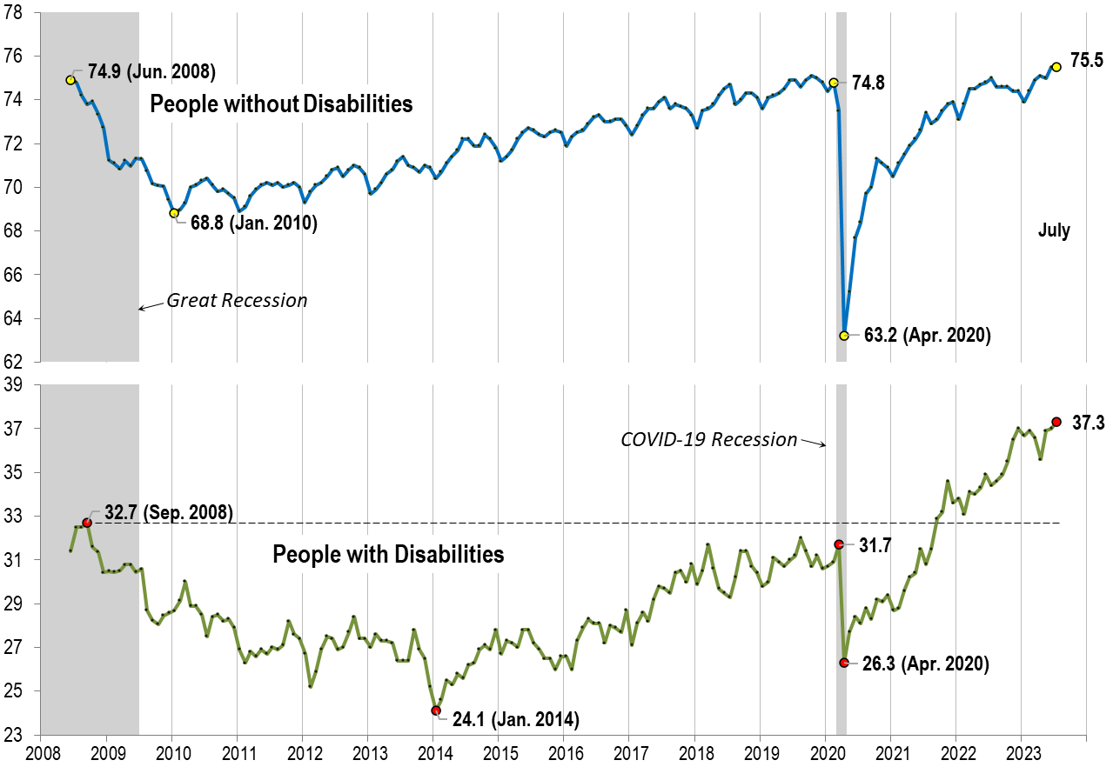
Employment
-to-
Population
Ratio:
July

Slide 11
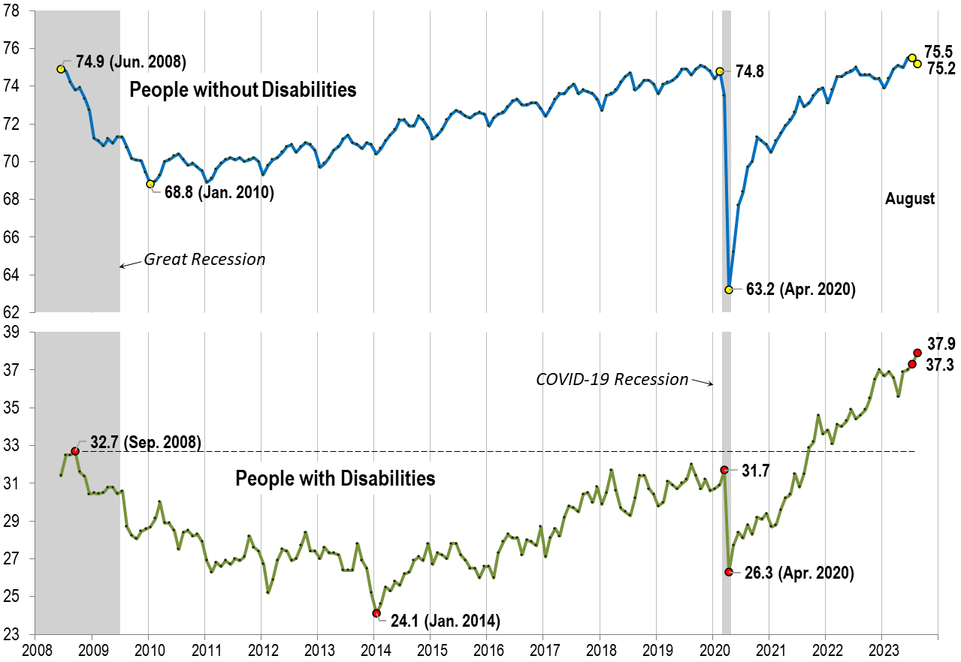
Employment
-to-
Population
Ratio:
August

Slide 12
Consider Young Adults
All data in the following charts may be found in Tables 1-4 in this PowerPoint.

Slide 13
Employment-
Population
Ratio
12-Month Avg.
April to March

Slide 14
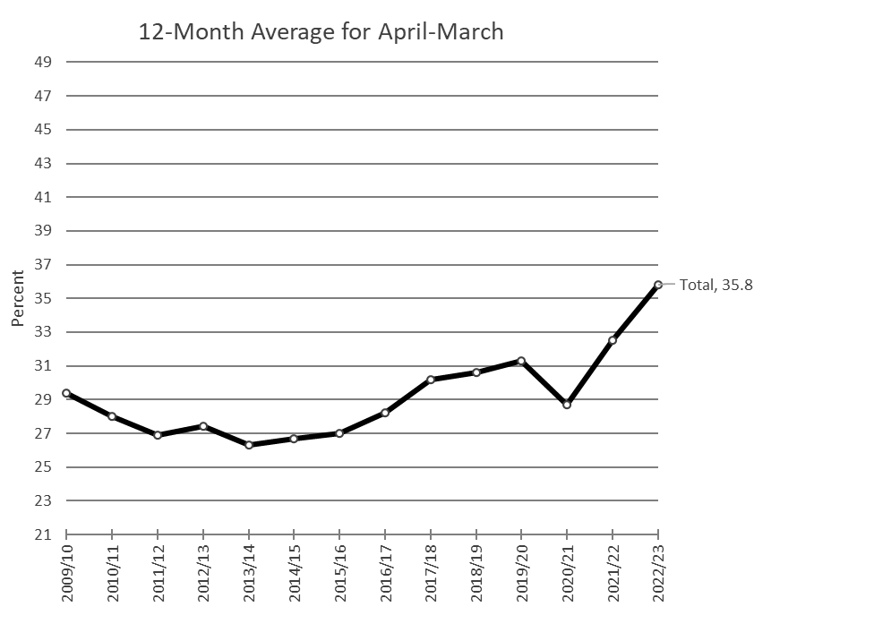
Employment-
Population
Ratio
12-Month Avg.
April to March
People with Disabilities (PWD)
Total (Ages 16-64)

Slide 15
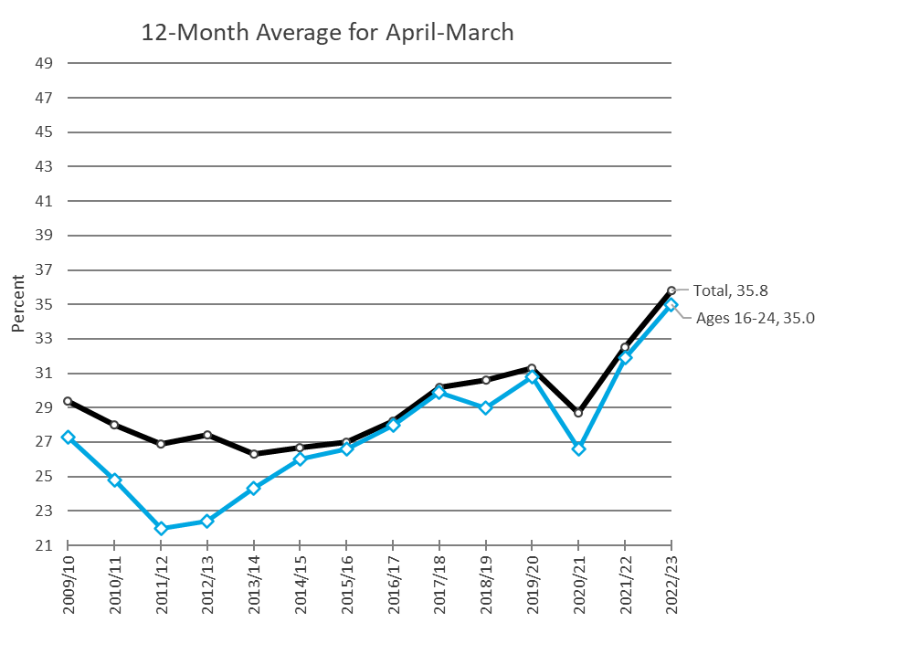
Employment-
Population
Ratio
12-Month Avg.
April to March
Total (Ages 16-64)
Ages 16-24

Slide 16
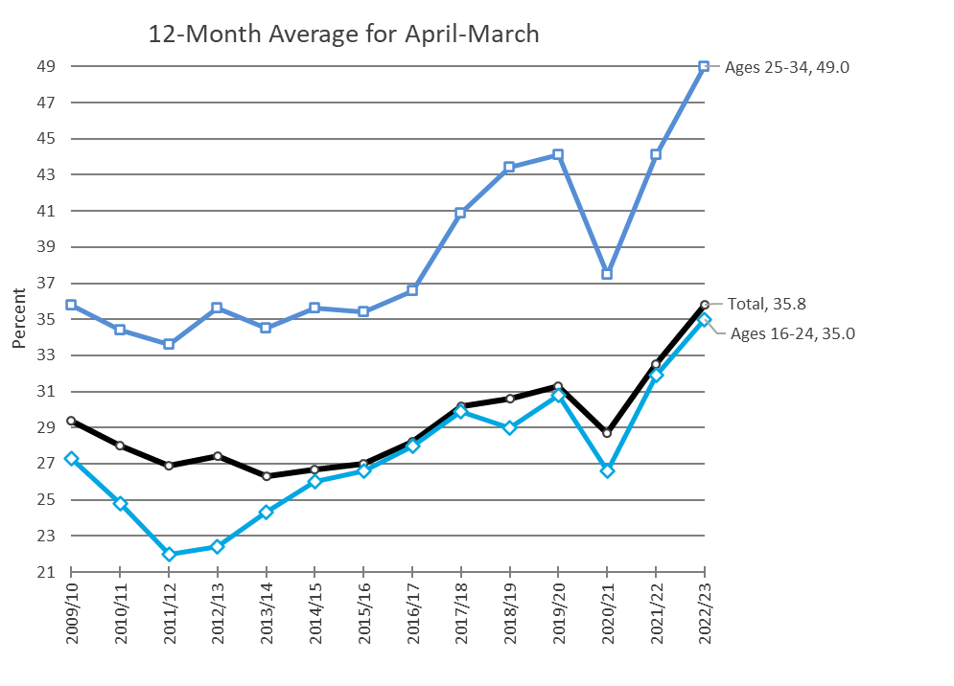
Employment-
Population
Ratio
12-Month Avg.
April to March
Total (Ages 16-64)
Ages 16-24
Ages 25-34

Slide 17
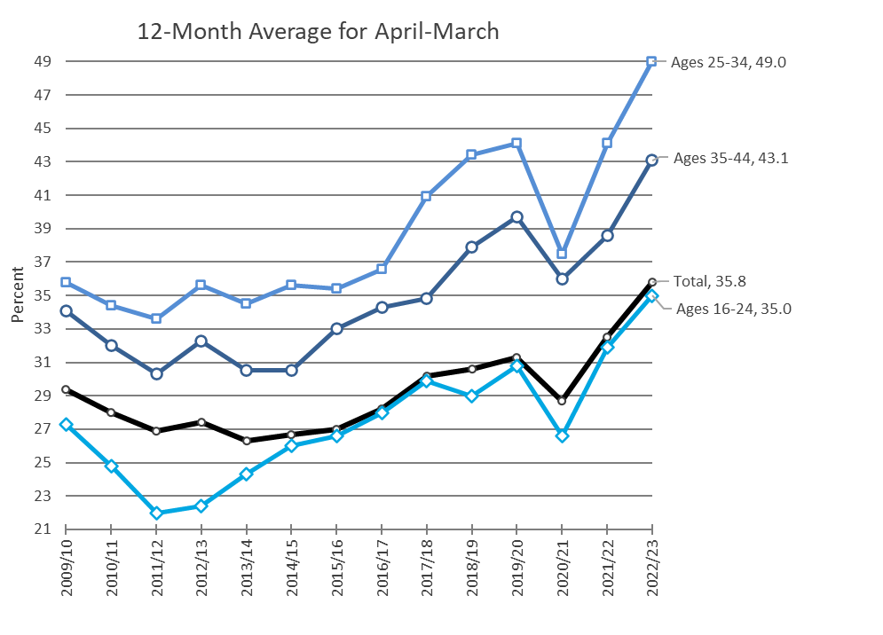
Employment-
Population
Ratio
12-Month Avg.
April to March
Total (Ages 16-64)
Ages 16-24
Ages 25-34
Ages 35-44

Slide 18
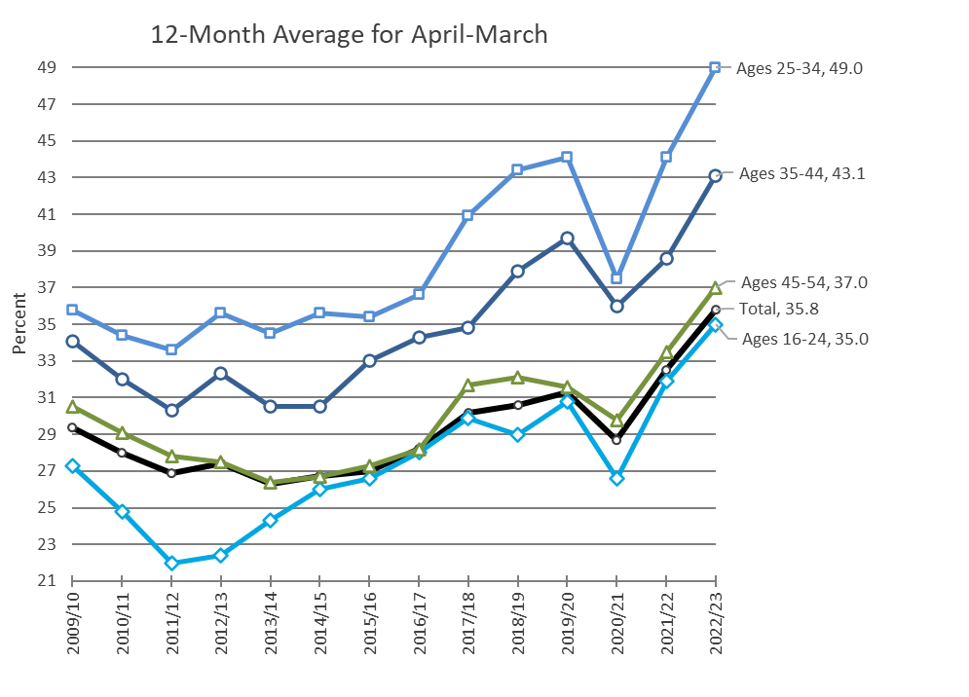
Employment-
Population
Ratio
12-Month Avg.
April to March
Total (Ages 16-64)
Ages 16-24
Ages 25-34
Ages 35-44
Ages 45-54

Slide 19
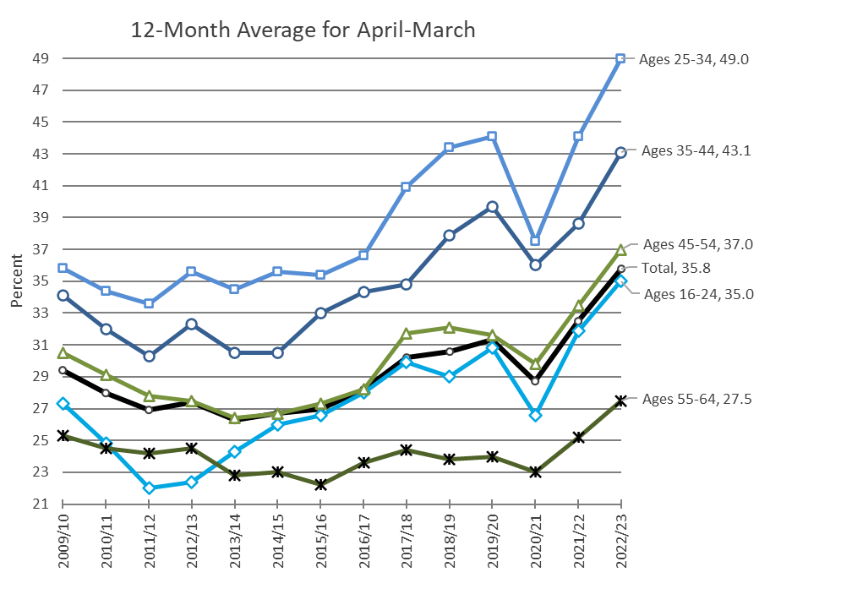
Employment-
Population
Ratio
12-Month Avg.
April to March
Total (Ages 16-64)
Ages 16-24
Ages 25-34
Ages 35-44
Ages 45-54
Ages 55-64

Slide 20
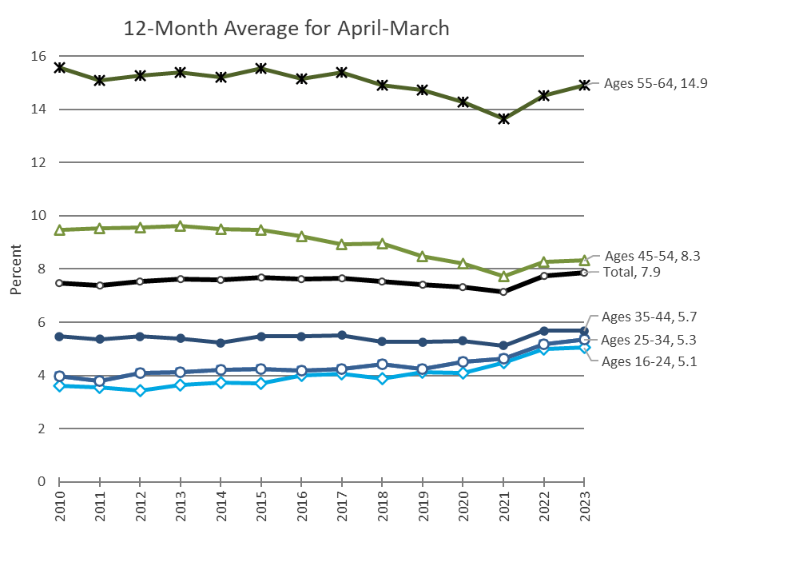
Prevalence Rate
12-Month Avg.
April to March
Total (Ages 16-64)
Ages 16-24
Ages 25-34
Ages 35-44
Ages 45-54
Ages 55-64

Slide 21
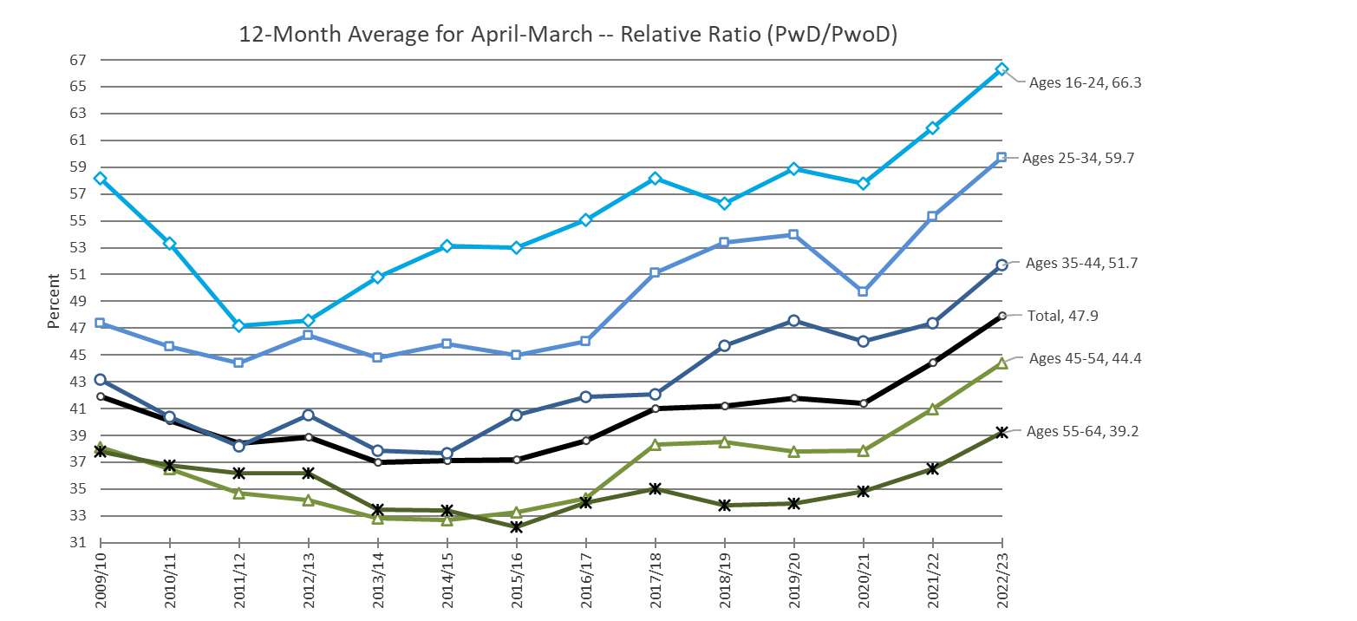
Relative Employment-
Population
Ratios (PwD/PwoD)
12-Month Avg.
April to March
Total (Ages 16-64)
Ages 16-24
Ages 25-34
Ages 35-44
Ages 45-54
Ages 55-64

Slide 22
Table 1. Monthly Employment-Population Ratios of Civilians with
Disabilities, Averaged over a 12-Month April-March Period, 2009/2010-2022-2023, by Age Group
Year | Ages 16-64 | Ages 16-24 | Ages 25-34 | Ages 35-44 | Ages 45-54 | Ages 55-64
2009/10 | 29.4 | 27.3 | 35.8 | 34.1 | 30.5 | 25.3
2010/11 | 28.0 | 24.8 | 34.4 | 32.0 | 29.1 | 24.5
2011/12 | 26.9 | 22.0 | 33.6 | 30.3 | 27.8 | 24.2
2012/13 | 27.4 | 22.4 | 35.6 | 32.3 | 27.5 | 24.5
2013/14 | 26.3 | 24.3 | 34.5 | 30.5 | 26.4 | 22.8
2014/15 | 26.7 | 26.0 | 35.6 | 30.5 | 26.7 | 23.0
2015/16 | 27.0 | 26.6 | 35.4 | 33.0 | 27.3 | 22.2
2016/17 | 28.2 | 28.0 | 36.6 | 34.3 | 28.2 | 23.6
2017/18 | 30.2 | 29.9 | 40.9 | 34.8 | 31.7 | 24.4
2018/19 | 30.6 | 29.0 | 43.4 | 37.9 | 32.1 | 23.8
2019/20 | 31.3 | 30.8 | 44.1 | 39.7 | 31.6 | 24.0
2020/21 | 28.7 | 26.6 | 37.5 | 36.0 | 29.8 | 23.0
2021/22 | 32.5 | 31.9 | 44.1 | 38.6 | 33.5 | 25.2
2022/23 | 35.8 | 35.0 | 49.0 | 43.1 | 37.0 | 27.5

Slide 23
Table 2. Monthly Employment-Population Ratios of Civilians without Disabilities, Averaged over a 12-Month April-March Period, 2009/2010-2022-2023, by Age Group
Year | Ages 16-64 | Ages 16-24 | Ages 25-34 | Ages 35-44 | Ages 45-54 | Ages 55-64
2009/10 | 70.2 | 46.9 | 75.6 | 79.0 | 80.1 | 67.0
2010/11 | 69.9 | 46.5 | 75.4 | 79.2 | 79.7 | 66.6
2011/12 | 70.0 | 46.6 | 75.6 | 79.4 | 80.1 | 66.9
2012/13 | 70.5 | 47.1 | 76.6 | 79.7 | 80.3 | 67.7
2013/14 | 71.0 | 47.8 | 77.0 | 80.4 | 80.6 | 68.0
2014/15 | 71.9 | 49.0 | 77.8 | 80.9 | 81.7 | 68.9
2015/16 | 72.5 | 50.2 | 78.6 | 81.5 | 82.0 | 68.9
2016/17 | 73.1 | 50.8 | 79.5 | 81.9 | 82.2 | 69.4
2017/18 | 73.7 | 51.4 | 80.1 | 82.7 | 82.8 | 69.7
2018/19 | 74.3 | 51.5 | 81.2 | 83.0 | 83.3 | 70.5
2019/20 | 74.8 | 52.3 | 81.7 | 83.4 | 83.7 | 70.7
2020/21 | 69.3 | 46.0 | 75.4 | 78.3 | 78.7 | 66.1
2021/22 | 73.2 | 51.5 | 79.8 | 81.5 | 81.8 | 69.1
2022/23 | 74.8 | 52.8 | 82.1 | 83.3 | 83.4 | 70.1

Slide 24
Table 3. Disability Prevalence Rates,
Averaged over 12-Month April-March Periods, by Age Group
Year | Ages 16-64 | Ages 16-24 | Ages 25-34 | Ages 35-44 | Ages 45-54 | Ages 55-64
2009/10 | 7.5 | 3.6 | 4.0 | 5.5 | 9.5 | 15.6
2010/11 | 7.4 | 3.6 | 3.8 | 5.4 | 9.5 | 15.1
2011/12 | 7.5 | 3.4 | 4.1 | 5.5 | 9.6 | 15.3
2012/13 | 7.6 | 3.7 | 4.1 | 5.4 | 9.6 | 15.4
2013/14 | 7.6 | 3.7 | 4.2 | 5.2 | 9.5 | 15.2
2014/15 | 7.7 | 3.7 | 4.2 | 5.5 | 9.5 | 15.5
2015/16 | 7.6 | 4.0 | 4.2 | 5.5 | 9.2 | 15.1
2016/17 | 7.7 | 4.1 | 4.2 | 5.5 | 8.9 | 15.4
2017/18 | 7.5 | 3.9 | 4.4 | 5.3 | 9.0 | 14.9
2018/19 | 7.4 | 4.1 | 4.2 | 5.3 | 8.5 | 14.7
2019/20 | 7.3 | 4.1 | 4.5 | 5.3 | 8.2 | 14.3
2020/21 | 7.2 | 4.5 | 4.6 | 5.1 | 7.7 | 13.7
2021/22 | 7.7 | 5.0 | 5.2 | 5.7 | 8.3 | 14.5
2022/23 | 7.9 | 5.1 | 5.3 | 5.7 | 8.3 | 14.9

Slide 25
Table 4. Relative Employment-Population Ratio (PwD/PwoD):
Ratio of Monthly Employment-Population Ratio,
Averaged over 12-Month April-March Periods, by Age Group
Year | Ages 16-64 | Ages 16-24 | Ages 25-34 | Ages 35-44 | Ages 45-54 | Ages 55-64
2009/10 | 41.9 | 58.2 | 47.4 | 43.2 | 38.1 | 37.8
2010/11 | 40.1 | 53.3 | 45.6 | 40.4 | 36.5 | 36.8
2011/12 | 38.4 | 47.2 | 44.4 | 38.2 | 34.7 | 36.2
2012/13 | 38.9 | 47.6 | 46.5 | 40.5 | 34.2 | 36.2
2013/14 | 37.0 | 50.8 | 44.8 | 37.9 | 32.8 | 33.5
2014/15 | 37.1 | 53.1 | 45.8 | 37.7 | 32.7 | 33.4
2015/16 | 37.2 | 53.0 | 45.0 | 40.5 | 33.3 | 32.2
2016/17 | 38.6 | 55.1 | 46.0 | 41.9 | 34.3 | 34.0
2017/18 | 41.0 | 58.2 | 51.1 | 42.1 | 38.3 | 35.0
2018/19 | 41.2 | 56.3 | 53.4 | 45.7 | 38.5 | 33.8
2019/20 | 41.8 | 58.9 | 54.0 | 47.6 | 37.8 | 33.9
2020/21 | 41.4 | 57.8 | 49.7 | 46.0 | 37.9 | 34.8
2021/22 | 44.4 | 61.9 | 55.3 | 47.4 | 41.0 | 36.5
2022/23 | 47.9 | 66.3 | 59.7 | 51.7 | 44.4 | 39.2

Slide 26

Introducing our Guest Speaker
Elaine Katz
Kessler Foundation

Slide 27

nTIDE Guest Speaker
Andrew Karhan
San Diego State University’s
Research Foundation

Slide 28

CAPE-Youth – WIOA State Plan Considerations
Notes:
Hello,
Introductions.

Slide 29
The Center for Advancing Policy on Employment for Youth
The Center for Advancing Policy on Employment for Youth (CAPE-Youth) seeks to improve employment outcomes for youth and young adults with disabilities (Y&YAD) by helping states build capacity in their youth service delivery and workforce systems.
Notes:
The Center for Advancing Policy on Employment for Youth – also known as CAPE-Youth – seeks to improve employment outcomes for youth and young adults with disabilities by helping states build capacity in their youth service delivery and workforce systems.
CAPE-Youth was formerly the NCWD Youth Center.

Slide 30
Overview
CAPE-Youth:
    Conducts research on new and existing innovative policy and practice.
    Develops strategic partnerships.
    Shares best practices among key stakeholders.
    Helps states identify opportunities for new programs and services.
Notes:
CAPE-Youth pursues its mission in number of ways:
It conducts research on innovative policy and programmatic approaches to improve transition and employment-related outcomes for youth and young adults with disabilities;
It develops strategic partnerships between national, state and local workforce systems;
It shares best practices with key stakeholders, including individuals with disabilities, their families, state legislators, and practitioners; and
It helps states identify opportunities to deepen their support of youth and young adults, by expanding career pathways, work-based learning opportunities, strategic partnerships, systems coordination, and professional development for service providers.

Slide 31
CAPE-Youth Strands of Work
CAPE-Youth is dedicated to assisting states in identifying new opportunities to increase capacity by improving:
    Strategic partnerships and system coordination.
    Work-based learning.
    Professional development.

Slide 32



Partners
CAPE-Youth is a collaboration between the U.S. Department of Labor’s Office of Disability Employment Policy and:
The center is fully funded by the U.S. Department of Labor’s Office of Disability Employment Policy in the amount of $5 million under Cooperative Agreement No. OD-33982-19-75-4-21.
Notes:
CAPE-Youth is a collaboration between:
The Department of Labor’s Office of Disability Employment Policy.
The Council of State Governments;
The K. Lisa Yang and Hock E. Tan Institute on Employment and Disability at Cornell University; and
The center is fully funded by the United States Department of Labor’s Office of Disability Employment Policy in the amount of $5 million under Cooperative Agreement No. OD-33982-19-75-4-21

Slide 33

EVIDENCED-BASED POLICY
Research from the Field

Slide 34
Unlocking Potential in WIOA Title I
Leveraging other federal initiatives across state workforce agencies to initiate innovation at the local level.
Enhancing collaboration among state and local workforce, education and non-traditional WIOA partners to prioritize Y&YADs.
Building specific blended service approaches with VR agencies to enhance access to services for Y&YADs.
Supporting inclusive approaches in programs like Job Corps or YouthBuild to expand access to Y&YADs.

Slide 35
States Engaging Employers through Policy - WIOA
Educating employers about the advantages of, and supporting them in, engaging Y&YADs in work preparation programs – particularly those funded under WIOA.
Assembling tools guided and developed in partnership with national centers and employer organizations and disseminating them at the state and local level.
Enhancing existing state workforce systems to foster equitable access.

Slide 36
Financial Literacy & WIOA
Broaden access to financial literacy tools and resources.​
Enhancing existing models to improve the effectiveness in reaching Y&YADs with marginalized identities.​
Utilizing partnerships with education systems.​
Leveraging the Community Reinvestment Act.
Notes:
As some on the call may be familiar, in 2005 ODEP released the Guideposts of Success. The guideposts were a first of its kind tool which sought to answer the central question, “What do all youth need to make a successful transition to adulthood. While them initial Guideposts for Success did not address how states could engage employers; a subsequent framework, "Guideposts for Employer Success," did address this. However, given the changing landscape in the world of work over the last 5 years, we felt it was important to revisit and refresh the initial document.
Today, we will be discussing the 6 policy considerations that will be coming out in the brief when it is published in the coming weeks. So you all have the first glance at these considerations.
The format for today is meant to take everyone through the overall policy considerations we are offering, but along the way, we have chosen a few key stopping points to specifically engage with our speakers related to the content. But, now, we will spend a couple minutes unveiling the high level considerations before we venture into each in more detail .There are six considerations we offer are based upon research and current practices we see in the field which are enhancing or elevating the conversation about the employment of youth and young adults with disabilities with employers.

Slide 37
Policy Considerations Post-COVID
Avoiding forfeiting federal funds (e.g., VR, IDEA and Medicaid).
Accessing and providing technical assistance at the state and local level.
Identifying ways to use WIOA funding to maintain continuity of services for youth and families.
Notes:
As some on the call may be familiar, in 2005 ODEP released the Guideposts of Success. The guideposts were a first of its kind tool which sought to answer the central question, “What do all youth need to make a successful transition to adulthood. While them initial Guideposts for Success did not address how states could engage employers; a subsequent framework, "Guideposts for Employer Success," did address this. However, given the changing landscape in the world of work over the last 5 years, we felt it was important to revisit and refresh the initial document.
Today, we will be discussing the 6 policy considerations that will be coming out in the brief when it is published in the coming weeks. So you all have the first glance at these considerations.
The format for today is meant to take everyone through the overall policy considerations we are offering, but along the way, we have chosen a few key stopping points to specifically engage with our speakers related to the content. But, now, we will spend a couple minutes unveiling the high level considerations before we venture into each in more detail .There are six considerations we offer are based upon research and current practices we see in the field which are enhancing or elevating the conversation about the employment of youth and young adults with disabilities with employers.

Slide 38
Trauma Informed Care - WIOA
Engage in care coordination​ and cross-systems collaboration.​
Examine systems to identify opportunities to apply best practices in trauma-informed care within the workforce and related systems.​
Implement culturally responsive practices within the workforce and other youth-serving systems.​

Slide 39
Addressing the Needs of Y&YADs and Other Intersecting Identities
Adapting existing workforce programs to serve Y&YADs with intersecting identities.
Creating new workforce programs for Y&YADs with specific intersecting identities.​
Hiring more diverse and culturally competent workforce system staff.​
Developing the cultural competency of existing workforce system staff.

Slide 40
Professional Development - WIOA
Further encourage interagency collaboration through regulatory guidance.
Dedicate funding and administrative support to Professional Development to improve systems
  Trauma Informed
  Culturally Responsive
  Evaluate trainings and use data to inform future trainings
  Support identifying appropriate, relevant and high quality trainings
  Identify ways to deepen knowledge and skills obtained in PD through mentorship and application of learning

Slide 41

Contact Us
Andrew Karhan, M.P.A., M.A.
akarhan@sdsu.edu
@CAPEYouth
@CSG_CAPEYouth
General CAPE-Youth Inquires
If you are interested in learning more about our work or participating in
our research initiatives, please contact info@capeyouth.org
or visit https://capeyouth.org/
Notes:
For more information about our Center, there are several links provided to the site as well as emails for specific questions.

Slide 42

Q & A
Use “Q&A” button on Zoom to ask a questions
Slides will be archived at
 https://www.researchondisability.org/ntide-episodes-list
Take our feedback survey at
 https://www.researchondisability.org/ntide-episodes-list

Slide 43

Thank You!
Thanks to our partners:
- UNH/Institute on Disability (www.ResearchOnDisability.org)
- Kessler Foundation (www.KesslerFoundation.org)
- AUCD (www.AUCD.org)
Contact us:
- Email: Disability.Statistics@unh.edu
- Call: 866-538-9521 (toll free)
Twitter at #nTIDELearn

Slide 44
Thank You! audio
Thanks to our partners:
- UNH/Institute on Disability (www.ResearchOnDisability.org)
- Kessler Foundation (www.KesslerFoundation.org)
- AUCD (www.AUCD.org)
Contact us:
- Email: Disability.Statistics@unh.edu
- Call: 866-538-9521 (toll free)
Twitter at #nTIDELearn

