Slide 1

nTIDE Lunch & Learn Webinar Series
Kessler Foundation, UNH, and AUCD
nTIDE Deeper Dive
Date: April 19, 2024
Notes:
X`

Slide 2
Up Front Matters
This webinar is being recorded. We will post an archive of along side the Monthly nTIDE broadcast on our webinar, each month, on our website at www.researchondisability.org/nTIDE. This site will also provide copies of the presentations, the speakers’ bios, full transcripts, and other valuable resources.
As an attendee of this webinar, you are a viewer. To ask questions of the speakers, click on the Q & A box on your webinar screen and type your questions into the box. Speakers will review these questions and provide answers during the last section of the webinar. Some questions may be answered directly in the Q & A box.

Slide 3
Up Front Matters Continued
If you have any questions following this recording, please contact us at disability.statistics@unh.edu, or toll free at 866-538-9521 for more information. Thanks for joining us. Enjoy today's webinar!

Slide 4
ASL Interpreter & Closed Captioning
To see interpreter and the gallery of speakers at the same time, we recommend using a computer or laptop, rather than a phone or tablet.
For closed captioning, click on the Closed Caption button and select Show Subtitle or View Full Transcript.

Slide 5
About the nTIDE Deeper Dive
  Occurs at noon Eastern-time on two weeks after the first Friday day of each month (when nTIDE Report is released).
  A joint effort of the University of New Hampshire, Kessler Foundation, and the Association of University Centers on Disabilities (AUCD).
  Each month, the nTIDE Deeper Dive focuses on specific sub-populations within the population with disabilities.
  Brings in a guest speaker to provide greater context.

Slide 6
Today’s Agenda
● 12:00 pm: Welcome and Introduction
● 12:05 pm: Moderator: Andrew Houtenville, UNH
 Reviews the nTIDE (Deeper Dive) statistics
12:20 pm: Andrew Houtenville, UNH
12:35 pm: Open Q&A Period
Audience Input: Reports from the Field

Slide 7
The Numbers
From “First Friday” nTIDE

Slide 8
Employment- to-Population
Ratio:

Slide 9
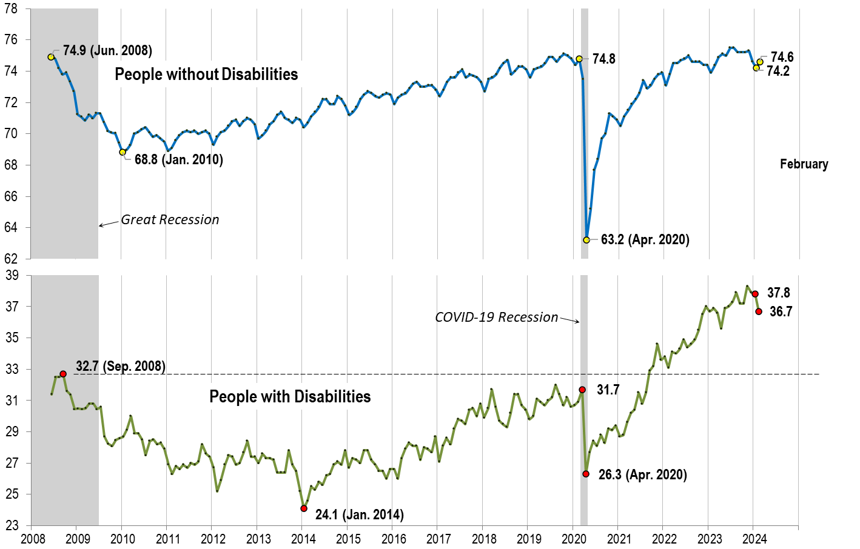
Employment- to-Population
Ratio:
February
Notes:
Chart Details:
Great recession started in mid-2009, Covid-19 Recession started in April, 2020
Visible Data points (highlights pre-Great Recession highs, the lowest point pre-covid, the points right before and after the Covid-19 recession hit, and the current Employment-to-Population Ratio
People without Disabilities:
Jun 2008: 74.9
Jan 2012 (lowest point pre-covid): 68.8
Feb 2020: 74.8
Apr 2020 (Covid-19 Recession hits): 63.2 (lowest point)
Jan 2024: 74.2
Feb 2024: 74.6
People with Disabilities
Sep 2008: 32.7
Jan 2014 (lowest point pre-covid): 24.1
Mar 2020: 31.7
Apr 2020 (Covid-19 Recession hits): 26.3 (lowest point)
Jan 2024: 37.8
Feb 2024: 36.7

Slide 10

Employment- to-Population
Ratio:
March

Slide 11
nTIDE Mid-Month Deeper Dive
Investigate Trends for Demographic Subpopulations
Sex, Age, Education, Race, Ethnicity, Metro, Veteran, Disability Type
**Use 12-Month Average of the Monthly E-P Ratio**

Slide 12
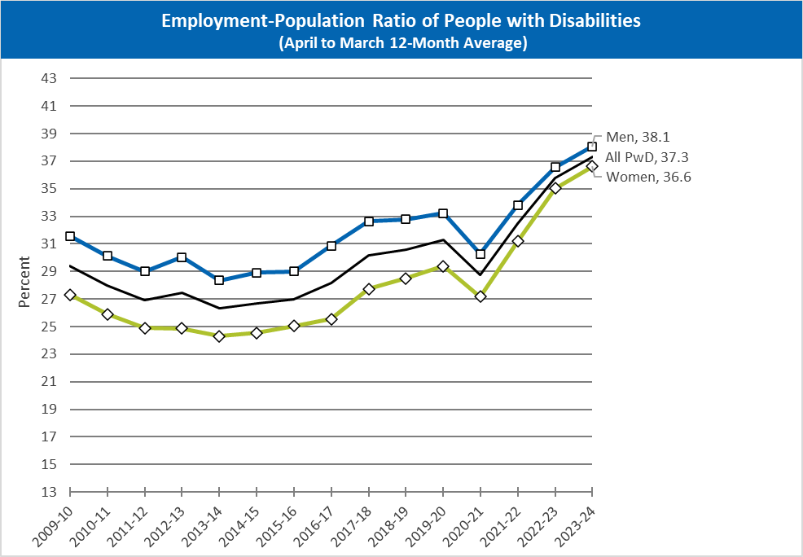
Employment-Population Ratio of People with Disabilities: By Gender
Notes:
All three lines show a gradual dip from 2009 to 2014, and then a gradual rise until 2020. In 2020 there is a significant dip and then in 2021 a sharp rise starts. The lines rank as following for the entire chart, Men highest, then All PwD, then women, the only data points visible are fore 2023-2024: 38.1 for Men, 37.3 for All PwD, and 36.6 for Women.

Slide 13
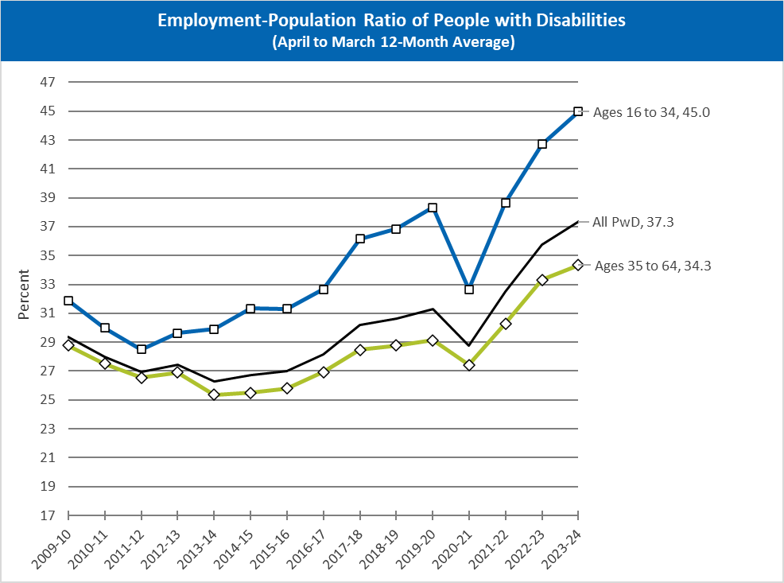
Employment-Population Ratio of People with Disabilities: By Age
Notes:
Age groups are 16 to 34 (the highest), All People with Disabilities (PwD) (the mid range) and Ages 35 to 64 (the lowest). the only data points visible are for 2023-2024: 45.0 for ages 16 to 34, 37.3 for All PwD, and 34.3 for ages 35 to 64.
All three lines show a gradual dip from 2009 to 2012, with Ages 16 to 34 changing to a gradual rise until a significant dip in 2020. For All PwD and ages 35 to 64, the EPR continues to drop until 2014 when there is a ver slight gradual rise until 2020. For all three groups there is a significant dip from 2020 to 2021 and then a rather sharp rise starting in 2021 that continues on til the present.

Slide 14
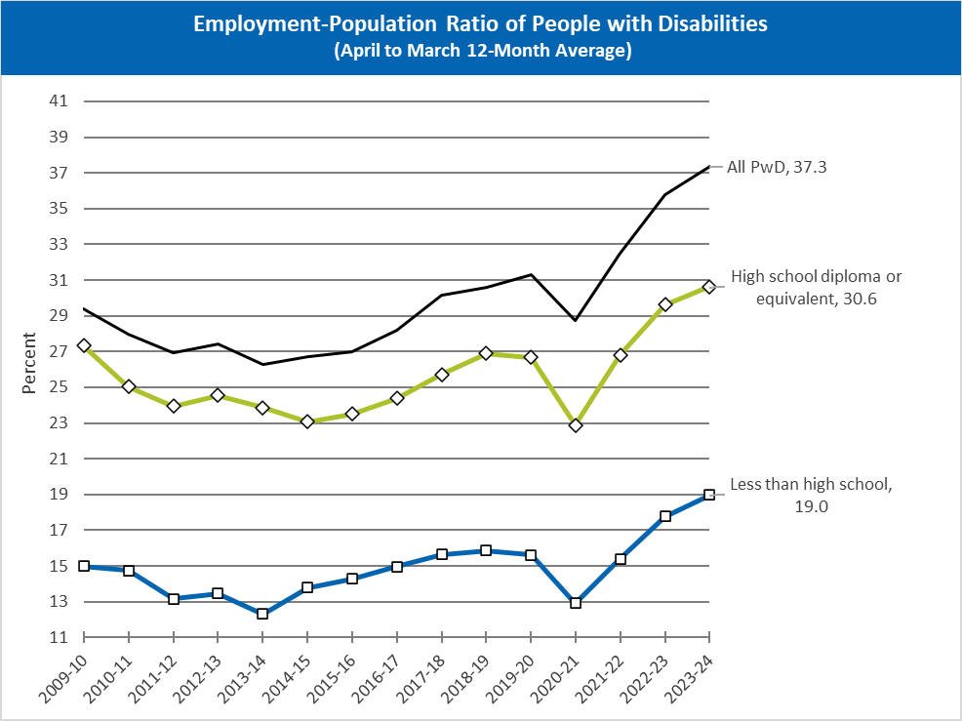
Employment-Population Ratio of People with Disabilities: By High School Education
Notes:
the only data points visible are for 2023-2024: All People with Disabilities (PwD) 37.3, high school diploma or equivalent 30.6 and less than high school 19.0.
Less than high school is consistently the lowest segment starting around 15 in 2009 to 2010 with a slow drop below 13 until about 2014 then a slow gradual rise to about 16 in 2018 to 2019 with a small drop into 2020 that then is a steep drop to around 13 when COVID hits until 2021. After 2021 there is a sharp rise to ending at 19.0 in 2023 to 2024.
High school diploma or equivalent is the second highest starting with what looks to be a 12 point gap above the less than high school segment but following a very similar trend over the years including the steep drop at COVID and then the high rise.
All people with disabilities is the highest of the segments starting a little over 29% and following the same general trajectory as the other two segments with the steep drop and COVID and then a sharp rise ending at 37.3 in 2023 to 2024.

Slide 15
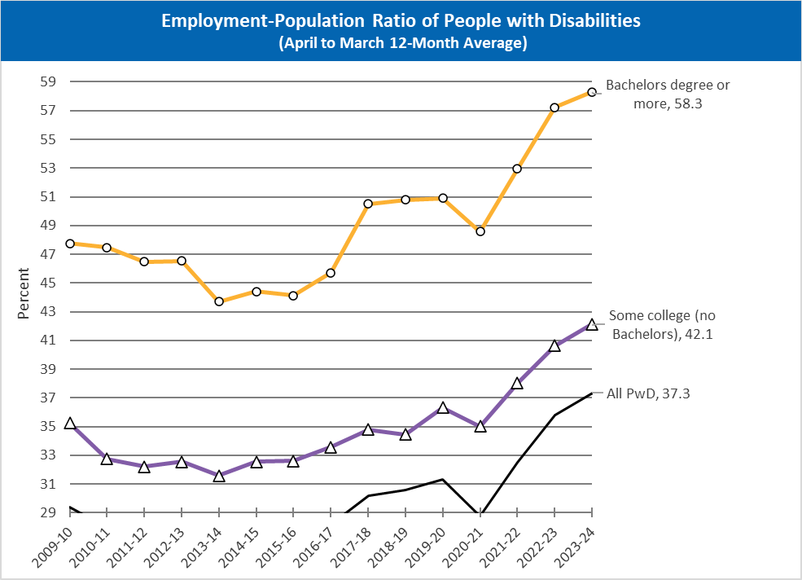
Employment-Population Ratio of People with Disabilities: By College Education
Notes:
The only data points visible for the three segments are the final ones for 2023 to 2024: all people with disabilities 37.3%; some college (no bachelors) 42.1%; and bachelor's degree or more 58.3%.. All people with disabilities is the lowest segment sometimes going off the chart. It starts a little over 29 percent in 2009 to 2010 can't see the trend since it goes off the chart until 2017 to 2018 when there's a slight rise until 2020 when there is a sharp drop to just below the chart line it looks so a little below 29 and then a sharp rise that ends at 37.3 in 2023 to 2024.
Some college (no bachelors) is the mid range starting around 35 and slowly dipping to around 32 in 2013 to 2014 with a gradual rise until 2019 to 2020 to around 36 percent after which there's a slight dip down to around 35% with a sharp rise to 42.1% in 2023 to 2024.
Bachelors degree or more is the highest starting about 13 percentage points higher than the some college segment at a little under 48 percent, with a gradual drop to a little above 46 in 2012 to 2013 followed by a slightly steeper drop to about 44 in 20/13/2014 with the gradual rise to a little under 46% in 2016 to 2017 followed by a sharp rise to a little over 50 in 2017 to 2018 staying kind of stagnant until a slightly steep drop of a couple percentage points in 2020 when COVID hits. Followed by the sharp rise ending at 58.3 in 2023 to 2024

Slide 16
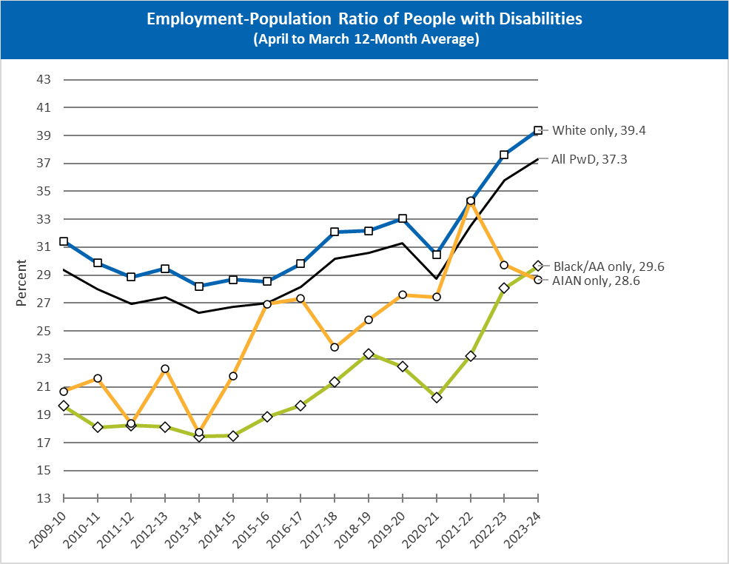
Employment-Population Ratio of People with Disabilities: By Race
Notes:
The only stated data points are for 2023 to 2024: White only 39.4% (overall rise of around 8 percentage points from 2009 to 2010); All people with disabilities 37.3% (overall rise of around 8 percentage points from 2009 to 2010); Black/African American only 29.6% (overall rise of around 7 percentage points from 2009 to 2010 ); American Indian/Alaska Native (AIAN) 28.6% (overall rise of around 10 percentage points from 2009 to 2010).
The Black/African American only, all people with disabilities and white only segments follow a similar trend of a gradual decline from 2009 to 2010 2000 14 followed by a gradual rise. The Black/African American only segment trends about 10 percentage points below the All People with Disabilities segment, and starts to drop a year before the other segments in 2018 to 2019, followed by a steeper drop that starts in 2020, followed by a sharp rise to the present day.
The American Indian/Alaska Native only segment has more of a sawtooth trend line from 2009 to 2014 when there is a sharp rise for the next two years of almost nine percentage points that starts to plateau where the steep drop of three percentage points in 2017 to 2018 than a gradual rise back up to 2016/2017 levels in 2020 that doesn't really have a steep drop at all from COVID outbreak, and then a sharp rise from 2021 to 2022 to the highest point in this 15 year range of about 34% followed by a steep drop over the next two years to 28.6 percentage points.

Slide 17
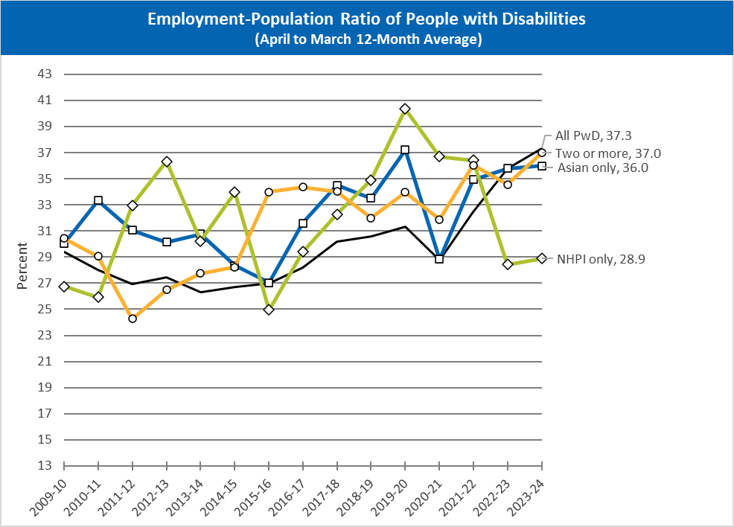
Employment-Population Ratio of People with Disabilities: By Asian and NHPI Identity
Notes:
The only stated data points are for the 2023 to 2024 year: all people with disabilities 37.3% For an overall rise of about eight percentage points from 2009; the two or more segment ended at 37.0 for an overall rise of a little over 7 percentage points from 2009; the Asian only segment ended at 36.0% for an overall rise of about 6 percentage points from 2009; and the NHPI only segment ended at 28.9% with an overall rise of around 2 percentage points.
All of the segments seem to have more of a sawtooth trend Though they all seem to have a significant drop from from 2020 to 2021 with the Asian only segment being the steepest with an 8 percentage point drop.

Slide 18
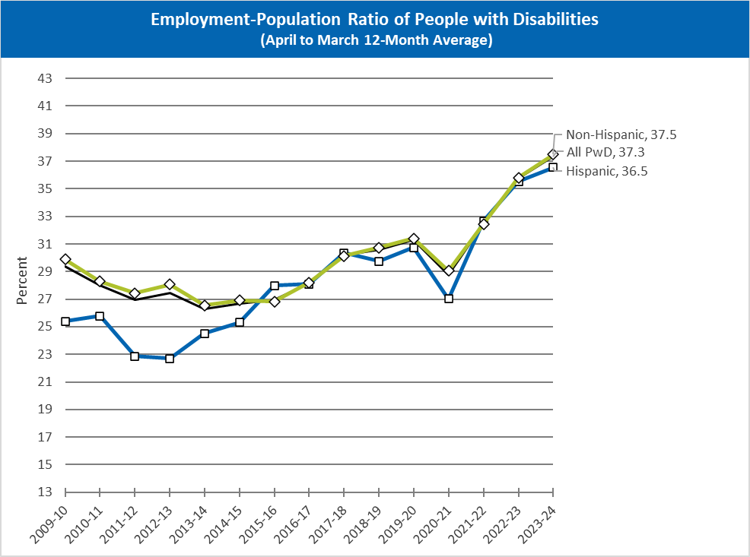
Employment-Population Ratio of People with Disabilities: By Hispanic Identity
Notes:
The only visible data points are for the 2023 to 2024 year: The non Hispanic segment ended at 37.5 percent for an overall rise of about 7.5% from 2009; all people with disabilities ended at 37.3% for an overall rise of about 7 percentage points; and the Hispanic segment ended at 36.5% for an overall rise of about 10.5 percentage points from 2009. The non Hispanic and all people with disabilities segment follow each other very closely seeming to overlap at times and following a general trend of decline from 2009 to 2014 with a gradual rise until 2020 when COVID hits followed by a one year drop and then a sharp rise until 2024. The Hispanic segment has a slight rise from 2009 to 2000 10 or 11 followed by a drop until 2013 when it starts to gradually rise until 2020 with a drop from COVID and then a sharp rise.

Slide 19
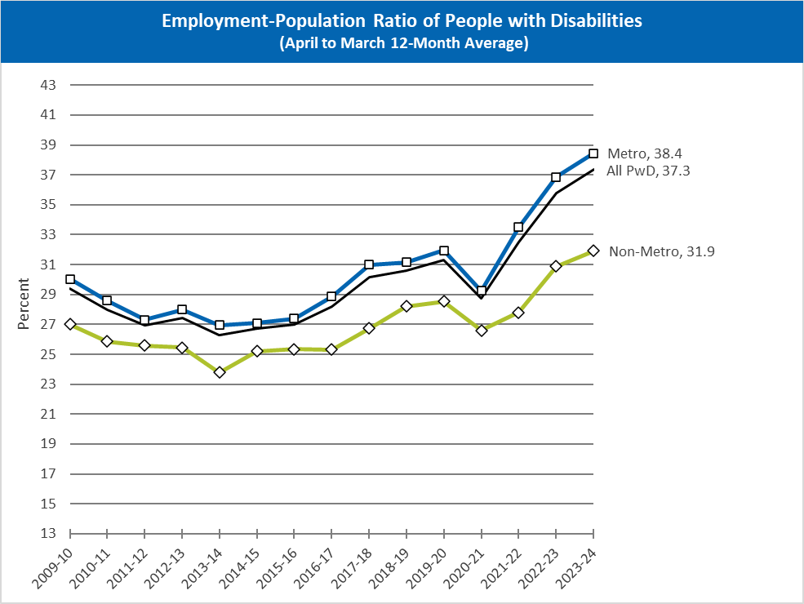
Employment-Population Ratio of People with Disabilities: By Metro
Notes:
Only visible data points are for the 2023 to 2024 year: the metro segment ends at 38.4% up about 8.5 percentage points from 2009; the all people with disabilities segment ends at 37.3 up about Eight percentage points from 2009; and the non metro segment ends at 31.9 up about five percentage points from 2009. All three segments follow a similar trend of a slow decline and until 2014 when a gradual rise starts and lasts until 2020 when there's a one year drop of about two to three percentage points followed by a sharp rise until 2024.

Slide 20
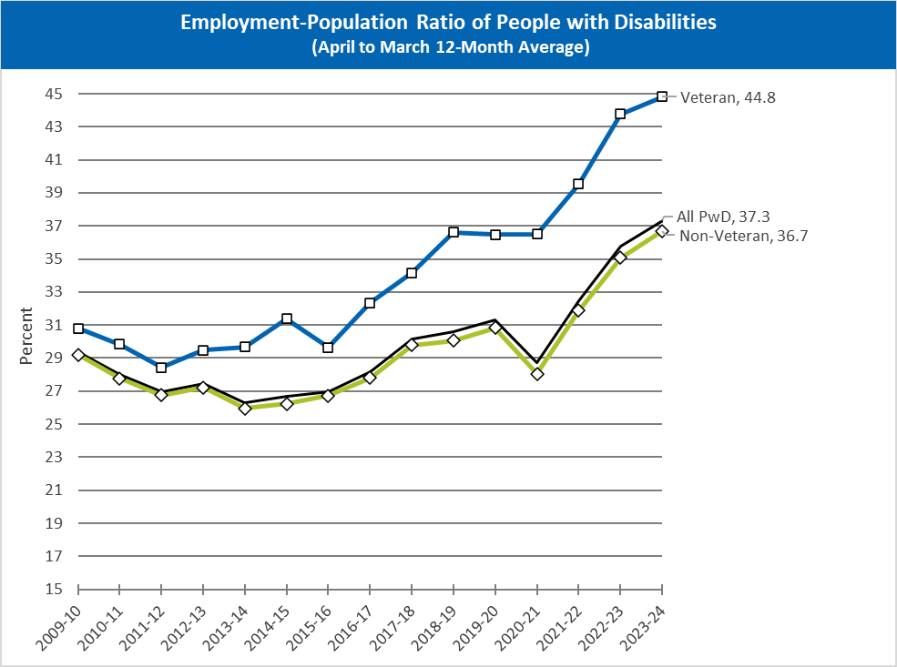
Employment-Population Ratio of People with Disabilities: By Veteran Status
Notes:
Only visible data points are for the 2023 to 2024 year: the veteran segment ends at 44.8 up about 14 percentage points from 2009; the all people with disability segment ends at 37.3 up about 8 percentage points from 2009; And the non veteran segment ends at 36.7 up about 7 percentage points from 2009. The veteran segment seems to trend a couple points higher than the other two until about 2018 when the difference starts to become larger. There doesn't seem to be a drop from COVID-19 in 2020, just a plateau followed by a steep rise. The all people with disabilities and non veteran segments follow each other very closely seeming to overlap at times with the slow decline to 2014 followed by a general rise until COVID-19 hits in 2020 with a one year drop of about three percentage points followed by a steep rise until 2024.

Slide 21
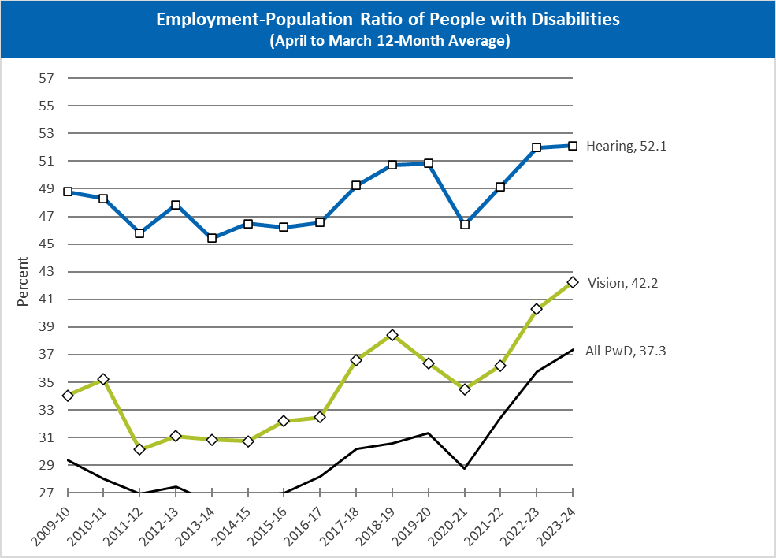
Employment-Population Ratio of People with Disabilities: By Vision or Hearing Disability
Notes:
The only visible data points are for the 2023 to 2024 year: hearing segment ends at 52.1% up about 2.5 percentage points from 2009; the vision segment ends at 42.2% up about 8 percentage points from 2009; And the all people with disabilities segment ends at 37.3% up about 8 percentage points from 2009. The trend lines generally follow the same pattern, though there was a steep drop of about 5 percentage points from 2011 to 2012 for the vision segment, which also started to decline the year before COVID hit in 2019 as well.

Slide 22
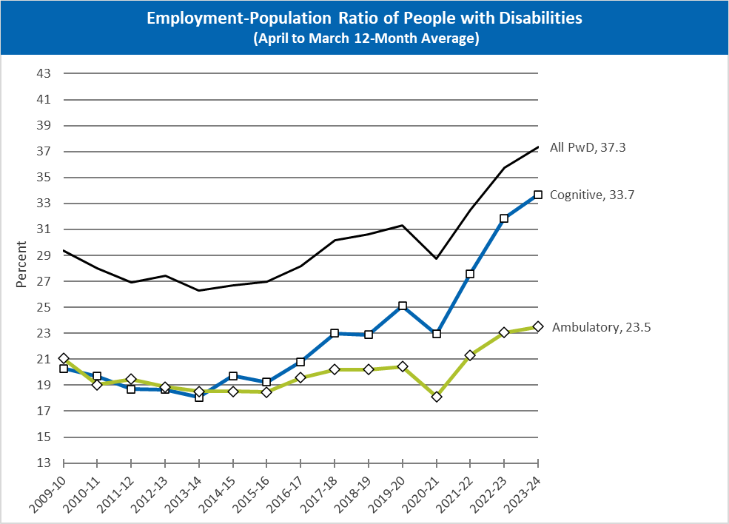
Employment-Population Ratio of People with Disabilities: By Cognitive or Ambulatory Disability
Notes:
The only visible data points are for 2023 to 2024: the all people with disabilities segment ending at 37.3 for an overall rise of around 8 percentage points from 2009; the cognitive segment ended at 33.7 for an overall rise of around 13.4 percentage points from 2009; and the ambulatory segment ended at 23.5 percent for an overall rise of around 2.5 percentage points from 2009.
The ambulatory segment seems to have a much flatter decline from 2009 to about 2016 followed by a very gradual rise of around 2 percentage points until 2020 when COVID heads for one year drop to its lowest 15 year point of around 18% followed by a more gradual rise to 23.5% in 2024.
The cognitive segment has of flat gradual decline of around two points from 2009 to 2014 followed by a gradual rise to around 25% in 2020 followed by a two point drop and then a sharp rise to hit 33.7% in 2024. This trend mirrors the all people with disabilities trend pretty closely.

Slide 23

Guest Speaker
Andrew Houtenville
Institute on Disability/UNH

Slide 24
History of Defining Disability in Surveys
  Support ongoing discussions, regarding the survey questions used in federal surveys,
  Proposed changes to the American Community Survey (ACS) and beyond.
  Provide a conceptual and historical context, regarding the definition of disability, as operationalized in surveys and programs.
  Describe implications for demographic and economic estimates.

Slide 25
Defining Disability in Federal Surveys
  Many Federal surveys use (some required to use) the same six questions to identify the population with disabilities.
Vision
Are you blind or do you have serious difficulty seeing, even when wearing glasses?
Hearing
Are you deaf or do you have serious difficulty hearing?
Mobility
Do you have serious difficulty walking or climbing stairs?
Cognition
Because of a physical, mental, or emotional condition, do you have serious difficulty concentrating, remembering, or making decisions?
Self-care
Do you have difficulty dressing or bathing?
Independent living
Because of a physical, mental, or emotional condition, do you have difficulty doing errands alone such as visiting a doctor’s office or shopping?

Slide 26
Defining Disability in Federal Surveys
  Proposal to change these questions that would …
    Add a communication difficulty … which is great!
    Still ignoring mental health … which is not great!
    Change the response from Yes or No serious difficulty to a “scale” …
      No difficulty,
      Some difficulty,
      A lot of difficulty, or
      Cannot do at all,
      which could help allocate resources to those with the greatest need.
  Use “Cannot do all” and “A lot of difficulty” as primary way to define disability.

Slide 27
HOWEVER … …
  With these changes, the estimated size of the US population of people with disabilities would be … … … …
  … reduced from 14% to …
  Tremendous concern about affecting federal, state, and local funding.
  Questions likely go into most Federal surveys, including CPS source of nTIDE stats.
  Still (like the current questions) are based on “limitation” and would miss people for whom “mitigating measures” remove limitations.
  The decision to start the five-year process for testing these questions was done without a public comment period or engagement of people with disabilities.
  There was very little engagement of people with disabilities, especially in the US, when questions
8%.

Slide 28
Underlying Concepts
Body/Mind
Uses of Body/Mind
Cells/Tissues
Structures/Systems
Functions
Activities
Instrum. Activities
Participation
Diseases,
Disorders, Chronic Cond
Impairments
Hearing, Seeing,
Cognition,
Ambulation
Bathing,
Showering
Dressing
Preparing Meals,
Shopping,
Managing Money
Recreating,
Voting,
Working
Compared to “Normal”
Characterized by “Limitations” or Needs for Support
Mitigating and Aggravating Factors (at Person and/or Environment Levels)
Medications, Functional Restoration Procedures, Assistive Devices, Skill Building,
Environmental Modifications, Workplace Accommodations
Notes:
Two sides:
Body/Mind (compared to “Normal”)
Cells/Tissues: diseases, disorders, chronic conditions
Structures/Systems: impairments
Uses of Body/Mind (Characterized by “Limitations” or Needs for Support
Functions: Hearing, Seeing, Cognition, Ambulation
Activities: Bathing, Showering, Dressing
Instrumental Activities: Preparing Meals, Shopping, Managing Money
Participation: Recreating, Voting, Working
Underlying these is the idea that mitigating and aggravating factors at the personal and/or environmental levels will influence movement along a spectrum in both directions between these two sides.
Some of these factors include Medications, Functional Restoration Procedures, Assistive Devices, Skill Building, Environmental Modifications, and Workplace Accommodations

Slide 29
What is “Disability” … Conceptually? Medical Model
Medical Model
Nagi Model
ICF[DH] Framework
Body/Mind
Uses of Body/Mind
Cells/Tissues
Structures/Systems
Functions
Basic Activ.
Instrum. Activities
Participation
Diseases,
Disorders, Chronic Cond
Impairments
Hearing, Seeing,
Cognition,
Ambulation
Bathing,
Showering
Dressing
Preparing Meals,
Shopping,
Managing Money
Recreating,
Voting,
Working
Compared to “Normal”
Characterized by “Limitations” or Needs for Support
Mitigating and Aggravating Factors (at Person and/or Environment Levels)
Medications, Functional Restoration Procedures, Assistive Devices, Skill Building,
Environmental Modifications, Workplace Accommodations

Slide 30
What is “Disability” … Conceptually?
Nagi Model
Medical Model
Nagi Model
ICF[DH] Framework
Body/Mind
Uses of Body/Mind
Cells/Tissues
Structures/Systems
Functions
Basic Activ.
Instrum. Activities
Participation
Diseases,
Disorders, Chronic Cond
Impairments
Hearing, Seeing,
Cognition,
Ambulation
Bathing,
Showering
Dressing
Preparing Meals,
Shopping,
Managing Money
Recreating,
Voting,
Working
Compared to “Normal”
Characterized by “Limitations” or Needs for Support
Mitigating and Aggravating Factors (at Person and/or Environment Levels)
Medications, Functional Restoration Procedures, Assistive Devices, Skill Building,
Environmental Modifications, Workplace Accommodations

Slide 31
What is “Disability” … Conceptually?
ICF[DH] Framework
Medical Model
Nagi Model
ICF[DH] Framework
Body/Mind
Uses of Body/Mind
Cells/Tissues
Structures/Systems
Functions
Basic Activ.
Instrum. Activities
Participation
Diseases,
Disorders, Chronic Cond
Impairments
Hearing, Seeing,
Cognition,
Ambulation
Bathing,
Showering
Dressing
Preparing Meals,
Shopping,
Managing Money
Recreating,
Voting,
Working
Compared to “Normal”
Characterized by “Limitations” or Needs for Support
Mitigating and Aggravating Factors (at Person and/or Environment Levels)
Medications, Functional Restoration Procedures, Assistive Devices, Skill Building,
Environmental Modifications, Workplace Accommodations

Slide 32
What is “Disability” … in Legislation?
SSA Disability Programs
SSA Dis. Programs
ADA (Rights)
ADAA (Rights)
Body/Mind
Uses of Body/Mind
Cells/Tissues
Structures/Systems
Functions
Basic Activ.
Instrum. Activities
Participation
Diseases,
Disorders, Chronic Cond
Impairments
Hearing, Seeing,
Cognition,
Ambulation
Bathing,
Showering
Dressing
Preparing Meals,
Shopping,
Managing Money
Recreating,
Voting,
Working
Compared to “Normal”
Characterized by “Limitations” or Needs for Support
Mitigating and Aggravating Factors (at Person and/or Environment Levels)
Medications, Functional Restoration Procedures, Assistive Devices, Skill Building,
Environmental Modifications, Workplace Accommodations

Slide 33
What is “Disability” … in Legislation?
ADA (Rights)
SSA Dis. Programs
ADA (Rights)
ADAA (Rights)
Body/Mind
Uses of Body/Mind
Cells/Tissues
Structures/Systems
Functions
Basic Activ.
Instrum. Activities
Participation
Diseases,
Disorders,
Chronic Cond
Impairments
Hearing, Seeing,
Cognition,
Ambulation
Bathing,
Showering
Dressing
Preparing Meals,
Shopping,
Managing Money
Recreating,
Voting,
Working
Compared to “Normal”
Characterized by “Limitations” or Needs for Support
Mitigating and Aggravating Factors (at Person and/or Environment Levels)
Medications, Functional Restoration Procedures, Assistive Devices, Skill Building,
Environmental Modifications, Workplace Accommodations

Slide 34
What is “Disability” … in Legislation?
ADAA (Rights)
SSA Dis. Programs
ADA (Rights)
ADAA (Rights)
Body/Mind
Uses of Body/Mind
Cells/Tissues
Structures/Systems
Functions
Basic Activ.
Instrum. Activities
Participation
Diseases,
Disorders,
Chronic Cond
Impairments
Hearing, Seeing,
Cognition,
Ambulation
Bathing,
Showering
Dressing
Preparing Meals,
Shopping,
Managing Money
Recreating,
Voting,
Working
Compared to “Normal”
Characterized by “Limitations” or Needs for Support
Mitigating and Aggravating Factors (at Person and/or Environment Levels)
Medications, Functional Restoration Procedures, Assistive Devices, Skill Building,
Environmental Modifications, Workplace Accommodations

Slide 35
What is “Disability” … in Surveys?
Early Census
1970 Long Form
1990 Long Form
2000 LF &
Early ACS
2008+
ACS
1983-96
NHIS ✓
Body/Mind
Uses of Body/Mind
Cells/Tissues
Structures/Systems
Functions
Basic Activ.
Instrum. Activities
Participation
Diseases,
Disorders,
Chronic Cond
Impairments
Hearing, Seeing,
Cognition,
Ambulation
Bathing,
Showering
Dressing
Preparing Meals,
Shopping,
Managing Money
Recreating,
Voting,
Working
Compared to “Normal”
Characterized by “Limitations” or Needs for Support
Mitigating and Aggravating Factors (at Person and/or Environment Levels)
Medications, Functional Restoration Procedures, Assistive Devices, Skill Building,
Environmental Modifications, Workplace Accommodations

Slide 36
What is “Disability” … in Surveys?
1830 - 1870
1830 Decennial Census Enumeration Form
Blind
Deaf
Deaf and Dumb
1840 Decennial Census Enumeration Form
Deaf and Dumb
Blind
Insane and idiots at public charge
Insane and idiots at private charge
1850, 1860, and 1870 Decennial Census Enumeration Forms
Whether deaf and dumb, blind, insane, idiotic, pauper, or convict [all in one category]
Notes:
1840 Decennial Census Enumeration Form, Six categories:
Deaf and Dumb
Under 14
14 & under 25
25 & upwards
Blind and Insane
Blind.
Insane and idiotic at public charge.
Insane and idiotic at private charge

Slide 37
What is “Disability” … in Surveys?
1880 - 1890
1880 Decennial Census Enumeration Form
Blind
Deaf and dumb
Idiotic
Insane
Maimed, crippled, bedridden, or otherwise disabled
1890 Decennial Census Enumeration Form
Whether suffering from acute or chronic disease, with name of disease and length of time afflicted.
Whether defective in mind, sight, or speech, or whether crippled, maimed, or deformed, with name of the defect.
1910 Decennial Census Enumeration Form
Whether blind (both eyes)
Whether deaf and dumb

Slide 38
What is “Disability” … in Surveys?
Early Census
Early Census
1970 Long Form
1990 Long Form
2000 LF &
Early ACS
2008+
ACS
1983-96
NHIS ✓
Body/Mind
Uses of Body/Mind
Cells/Tissues
Structures/Systems
Functions
Basic Activ.
Instrum. Activities
Participation
Diseases,
Disorders,
Chronic Cond
Impairments
Hearing, Seeing,
Cognition,
Ambulation
Bathing,
Showering
Dressing
Preparing Meals,
Shopping,
Managing Money
Recreating,
Voting,
Working
Compared to “Normal”
Characterized by “Limitations” or Needs for Support
Mitigating and Aggravating Factors (at Person and/or Environment Levels)
Medications, Functional Restoration Procedures, Assistive Devices, Skill Building,
Environmental Modifications, Workplace Accommodations

Slide 39
What is “Disability” … in Surveys?
1970
1970 Decennial Census Long Form
Does this person have a health or physical condition which limits the kind or amount of work he can do at a job? Yes or No.
Does his health or physical condition keep him from holding any job at all?
If “Yes: in a or be— How long has he been limited in his ability to work? Less than 6 months, 6 to 11 months, 1 to 2 years, 3 to 4 years, 5 to 9 years, or 10 years or more

Slide 40
What is “Disability” … in Surveys?
1970 Long Form
Early Census
1970 Long Form
1990 Long Form
2000 LF &
Early ACS
2008+
ACS
1983-96
NHIS ✓
Body/Mind
Uses of Body/Mind
Cells/Tissues
Structures/Systems
Functions
Basic Activ.
Instrum. Activities
Participation
Diseases,
Disorders,
Chronic Cond
Impairments
Hearing, Seeing,
Cognition,
Ambulation
Bathing,
Showering
Dressing
Preparing Meals,
Shopping,
Managing Money
Recreating,
Voting,
Working
Compared to “Normal”
Characterized by “Limitations” or Needs for Support
Mitigating and Aggravating Factors (at Person and/or Environment Levels)
Medications, Functional Restoration Procedures, Assistive Devices, Skill Building,
Environmental Modifications, Workplace Accommodations

Slide 41
What is “Disability” … in Surveys?
1990
1990 Decennial Census Long Form
Does this person have a physical, mental, or other health condition that has lasted for 6 or more months and which –
  Limits the kind or amount of work this person can do at a job? [Yes or No]
  Prevents this person from working at a job? [Yes or No]
Because of a health condition that has lasted for 6 or more months, does this person have any difficulty –
  Going outside alone, for example, to shop or visit a doctor’s office? [Yes or No]
  Taking care of his or her own personal needs, such as bathing, dressing, or getting around inside the home? [Yes or No]

Slide 42
What is “Disability” … in Surveys?
1990 Long Form
Early Census
1970 Long Form
1990 Long Form
2000 LF &
Early ACS
2008+
ACS
1983-96
NHIS ✓
Body/Mind
Uses of Body/Mind
Cells/Tissues
Structures/Systems
Functions
Basic Activ.
Instrum. Activities
Participation
Diseases,
Disorders,
Chronic Cond
Impairments
Hearing, Seeing,
Cognition,
Ambulation
Bathing,
Showering
Dressing
Preparing Meals,
Shopping,
Managing Money
Recreating,
Voting,
Working
Compared to “Normal”
Characterized by “Limitations” or Needs for Support
Mitigating and Aggravating Factors (at Person and/or Environment Levels)
Medications, Functional Restoration Procedures, Assistive Devices, Skill Building,
Environmental Modifications, Workplace Accommodations

Slide 43
What is “Disability” … in Surveys?
1996 - 1998
1996-1998 ACS Questionnaire
If this person has difficulty seeing, hearing, or walking mark X the appropriate boxes. If this person has no difficulty with these activities, mark “None of the above.”
Difficulty seeing (even with glasses)
Difficulty hearing (even with hearing aids)
Difficulty walking, or
None of the above
Does this person have a long-lasting physical or mental condition that –
  Make it difficult to go outside the home alone, for example, to shop or visit a doctor’s office? [Yes or No]
  Prevents this person from working at a job or business? [Yes or No]

Slide 44
What is “Disability” … in Surveys?
1999 - 2003
1999-2003 ACS Questionnaire and 2000 Decennial Census Long Form Questionnaire
Does this person have any of the following long-lasting conditions:
Blindness, deafness, or a severe vision or hearing impairment? [Yes or No]
A condition that substantially limits one or more basic physical activities such as walking, climbing stairs, reaching, lifting, or carrying? [Yes or No]
Because of a physical, mental, or emotional condition lasting 6 months or more, does this person have any difficulty in doing any of the following activities:
  Learning, remembering, or concentrating? [Yes or No]
  Dressing, bathing, or getting around inside the home? [Yes or No]
  Going outside the home alone to ship or visit a doctor’s office ? [Yes or No]
  Work at a job or business ? [Yes or No]

Slide 45
What is “Disability” … in Surveys?
2004 - 2007
2004-2007 ACS Questionnaire
[Not too much different]
Does this person have any of the following long-lasting conditions:
Blindness, deafness, or a severe vision or hearing impairment? [Yes or No]
A condition that substantially limits one or more basic physical activities such as walking, climbing stairs, reaching, lifting, or carrying? [Yes or No]
Because of a physical, mental, or emotional condition lasting 6 months or more, does this person have any difficulty in doing any of the following activities:
  Learning, remembering, or concentrating? [Yes or No]
  Dressing, bathing, or getting around inside the home? [Yes or No]
Because of a physical, mental, or emotional condition lasting 6 months or more, does this person have any difficulty in doing any of the following activities:
  Going outside the home alone to ship or visit a doctor’s office ? [Yes or No]
  Work at a job or business ? [Yes or No]

Slide 46
What is “Disability” … in Surveys?
2000 Long Form & ACS
Early Census
1970 Long Form
1990 Long Form
2000 LF &
Early ACS
2008+
ACS
1983-96
NHIS ✓
Body/Mind
Uses of Body/Mind
Cells/Tissues
Structures/Systems
Functions
Basic Activ.
Instrum. Activities
Participation
Diseases,
Disorders,
Chronic Cond
Impairments
Hearing, Seeing,
Cognition,
Ambulation
Bathing,
Showering
Dressing
Preparing Meals,
Shopping,
Managing Money
Recreating,
Voting,
Working
Compared to “Normal”
Characterized by “Limitations” or Needs for Support
Mitigating and Aggravating Factors (at Person and/or Environment Levels)
Medications, Functional Restoration Procedures, Assistive Devices, Skill Building,
Environmental Modifications, Workplace Accommodations

Slide 47
What is “Disability” … in Surveys?
2008
2008 – Current ACS Questionnaire
Is this person deaf or does he/she have serious difficulty hearing? [Yes or No]
Is this person blind or does he/she have serious difficulty seeing even when wearing glasses? [Yes or No]
Because of a physical, mental, or emotional condition lasting 6 months or more, does this person have any difficulty concentrating, remembering, or making decisions? [Yes or No]
Does this person have serious difficulty walking or climbing stairs? [Yes or No]
Does this person have difficulty dressing or bathing? [Yes or No]
Because of a physical, mental, or emotional condition lasting 6 months or more, does this person have any difficulty doing errands alone such as visiting a doctor’s office or shopping? [Yes or No]
[No reference to work limitation]

Slide 48
What is “Disability” … in Surveys?
Proposed ACS Questionnaire
Proposed ACS Questionnaire
Response Options = No difficulty, Some difficulty, A lot of difficulty, or Cannot do at all
Does this person have difficulty hearing, even if using a hearing aid?
Does this person have difficulty seeing, even when wearing glasses?
Does this person have difficulty remembering or concentrating?
Does this person have difficulty walking or climbing steps?
Does this person have difficulty with self-care, such as washing all over or dressing?
Using his or her usual language, does this person have difficulty communicating with others, for example understanding or being understood?
Because of a physical, mental, or emotional condition, does this person have difficulty doing errands alone such as visiting a doctor’s office or shopping?

Slide 49
What is “Disability” … in Surveys?
2008+ ACS
Early Census
1970 Long Form
1990 Long Form
2000 LF &
Early ACS
2008+
ACS
1983-96
NHIS ✓
Body/Mind
Uses of Body/Mind
Cells/Tissues
Structures/Systems
Functions
Basic Activ.
Instrum. Activities
Participation
Diseases,
Disorders,
Chronic Cond
Impairments
Hearing, Seeing,
Cognition,
Ambulation
Bathing,
Showering
Dressing
Preparing Meals,
Shopping,
Managing Money
Recreating,
Voting,
Working
Compared to “Normal”
Characterized by “Limitations” or Needs for Support
Mitigating and Aggravating Factors (at Person and/or Environment Levels)
Medications, Functional Restoration Procedures, Assistive Devices, Skill Building,
Environmental Modifications, Workplace Accommodations

Slide 50
What is “Disability” … in Surveys?
1983 - 1996
1983-1996 National Health Interview Impairment Checklist
Blind - Both eyes
Other Visual Impairment
Deaf - Both ears
Other Hearing Impairments
Stammering and Stuttering
Other Speech Impairments
Impairment of Sensation
Mental Retardation
Absence Upper Extremities
  Both Arms/Hands
  One Hand/Arm
  Fingers - One/Both Hands
Absence Lower Extremities
  One/Both Legs
  Feet/Toes - One/Both Limbs
Absence of
  Lung
  Kidney
  Breast
Absence of
  Bone, Joint,
  Muscle of extremity
  Tips of Fingers, Toes
Paralysis of Extremities - Complete
  Entire Body
  One Side of Body - Hemiplegia
  Both Legs - Paraplegia
  Other paralysis
Paralysis of Extremities - Partial
  Cerebral Palsy
  One Side of Body Only - Hemiparesis
  Legs - Both/Paraparesis
  Other paralysis
Paralysis - Complete/Partial - Other site
  Deformity/Orthopedic Impairment
  Back
    Curvature/other deformity of back/spine
    Orthopedic Impairment
    Spina Bifida
  Other Upper Extremities
    Hands, Fingers only
    Shoulder(s)
    Other
  Lower Extremities
    Flatfeet
    Clubfoot
    Other
  Other
Cleft Palate
Color Blindness
Tinnitus
Cataracts
Glaucoma
Diseases of Retina

Slide 51
What is “Disability” … in Surveys?
1983 – 1996 NHIS
Early Census
1970 Long Form
1990 Long Form
2000 LF &
Early ACS
2008+
ACS
1983-96
NHIS ✓
Body/Mind
Uses of Body/Mind
Cells/Tissues
Structures/Systems
Functions
Basic Activ.
Instrum. Activities
Participation
Diseases,
Disorders, Chronic Cond
Impairments
Hearing, Seeing,
Cognition,
Ambulation
Bathing,
Showering
Dressing
Preparing Meals,
Shopping,
Managing Money
Recreating,
Voting,
Working
Compared to “Normal”
Characterized by “Limitations” or Needs for Support
Mitigating and Aggravating Factors (at Person and/or Environment Levels)
Medications, Functional Restoration Procedures, Assistive Devices, Skill Building,
Environmental Modifications, Workplace Accommodations

Slide 52
Survey Design … Impacts Estimates!!!
Estimates using 1983-1996 NHIS Core and Impairment Check List
20% were employed
69% reported a work limitation
0.15% reported being blind in both eyes
81% were employed
31% reported no work limitation
39% were employed
Source: Burkhauser, R., Daly, M., Houtenville, A. & Nigras, N. (2002). The employment of people with disabilities: What can the data tell us. Demography 39(3), 541-555.

Slide 53
Future of Survey Design
  Need to reconcile expectations with regard to how survey questions support …
  Identity and sources of discrimination (chronic health condition and impairment) and
  Programmatic needs for data to more effectively direct resources (function, activities, participation)

Slide 54

Q & A
Use “Q&A” button on Zoom to ask a questions
Slides will be archived at
 https://www.researchondisability.org/ntide-episodes-list
Take our feedback survey at
 https://www.researchondisability.org/ntide-episodes-list

Slide 55

Thank You!
Thanks to our partners:
- UNH/Institute on Disability (www.ResearchOnDisability.org)
- Kessler Foundation (www.KesslerFoundation.org)
- AUCD (www.AUCD.org)
Contact us:
- Email: Disability.Statistics@unh.edu
- Call: 866-538-9521 (toll free)
Twitter at #nTIDELearn

Slide 56
Thank You! audio
Thanks to our partners:
- UNH/Institute on Disability (www.ResearchOnDisability.org)
- Kessler Foundation (www.KesslerFoundation.org)
- AUCD (www.AUCD.org)
Contact us:
- Email: Disability.Statistics@unh.edu
- Call: 866-538-9521 (toll free)
Twitter at #nTIDELearn

