Slide 1
State-Specific Reports
Sarah Boege, MPP
February 13th, 2019

Slide 2
Introduction
Goal: To advance the use and usefulness of disability data and statistics to inform disability policy and services.
Compendium & Supplement
National- and state-level statistics
Annual Report
National-level statistics & trends over time
State-Specific Reports
State- and county-level statistics
Local policy & service providers

Slide 3
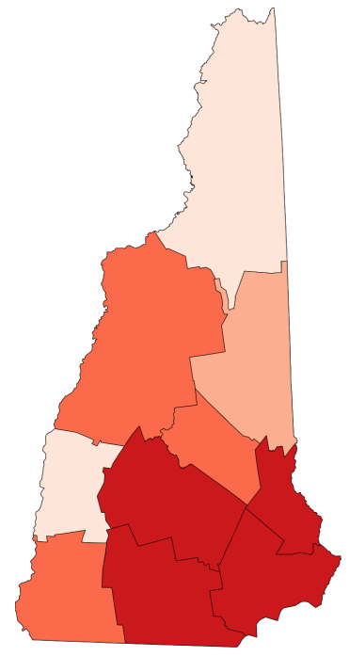
State Reports
State- and county- level statistics
American Community Survey (ACS) 5-year data
Individualized reports for all 50 states on each topic (disability prevalence & employment)
Tables
Interpretive text, discussion
County-level heat maps
HTML and PDF versions
Heat map of the number of people with disabilities in the state of New Hampshire’s 10 counties.

Slide 4
New Additions
Expanding topics
Currently only cover the topics of disability prevalence and employment
Add one or two new topics each year
This summer adding poverty and earnings
Other future topics similar to Compendium
Health insurance coverage, veterans, education, and more

Slide 5
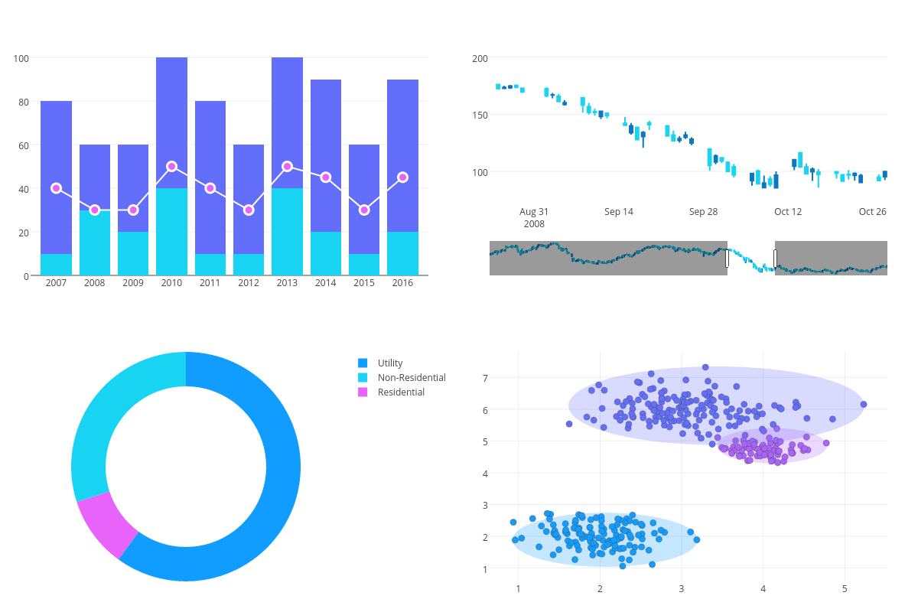
New Additions
Data visualization technology
Using open-source software (plotly) to create highly customized graphics
Expand the variety of ways that people can engage with disability statistics
We always welcome feedback and ideas!
Graphic examples: combo bar and line graph, candlestick chart, donut chart, scatter chart

Slide 6
Infographics
Complement State-Specific Reports
Featuring same updated graphics
Different way to present disability statistics
Annual Series of Intersectionality Infographics
Highlight the intersection of disability with other key demographics in all 50 states
Produced in collaboration with the Association of University Centers on Disability (AUCD) and advocacy organizations

Slide 7
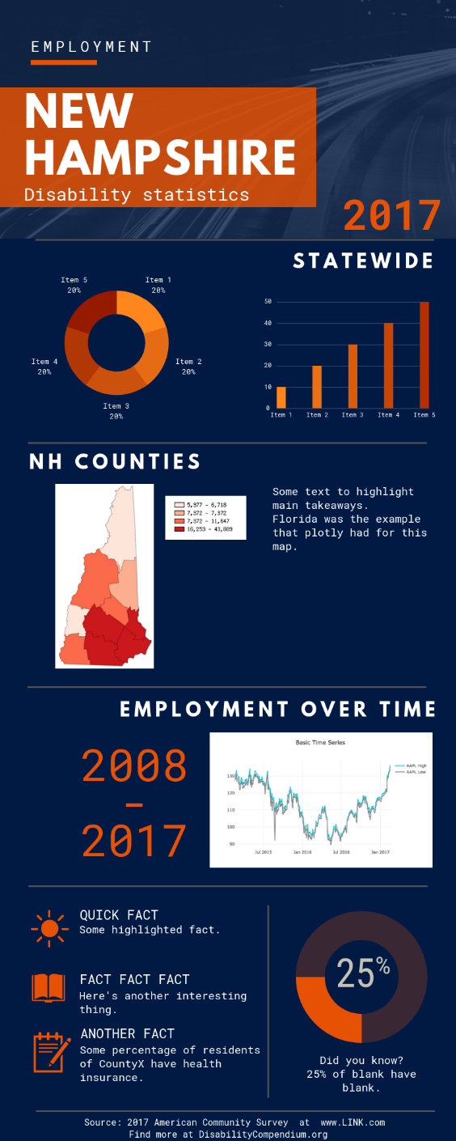
Infographic Example
Example infographic with pie charts, a bar chart, a heat map of NH counties, a line graph, and some text with quick facts.

Slide 8
Takeaway
Goal: To advance the use and usefulness of disability data and statistics to inform disability policy and services.
State-Specific Reports present more localized disability statistics that users can engage with in a variety of ways depending on their topic interests and their preferences in display format.

Slide 9
Thank you!
Contact Information:
Institute on Disability
University of New Hampshire
10 West Edge Drive, Suite 101
Durham, NH 03824
Sarah Boege
(603) 862-0165
Sarah.Boege@unh.edu

