Slide 1
State-Level Reports
Annual Disability Statistics Compendium
February 11, 2020
Megan Henly

Slide 2
Overview
State Reports with County-Level Data
What’s new this year
Annual Series of Intersectionality Infographics
New Rural Disability Statistics Infographic

Slide 3
Why State-Level Reports?
Goal: To advance the use and usefulness of disability data and statistics to inform disability policy and services.
Compendium & Supplement
National- and state-level statistics
Annual Report
National-level statistics & trends over time
State-Specific Reports
State- and county-level statistics
Local policy & service providers

Slide 4
State Reports
State- and county- level statistics
American Community Survey (ACS) 5-year data
Individualized reports for all 50 states on each topic
Disability prevalence
Employment
Poverty (new this year)
2018 State Reports now available
Based on 2014-2018 ACS 5-year data

Slide 5
What you can expect to find
Tables
Interpretive text
Discussion
County-level heat maps
Count (number of people)
Percentages
HTML and PDF versions
Image description: Heat map of the percentage of people with disabilities in the state of Maine’s 16 counties.

Slide 6
New for this year
Updated heat maps
Improved legend, size, updated colors (now blue)
Expanding topics
Currently cover the topics of disability prevalence, employment, and poverty
Add one or two new topics each year
Last summer added poverty, this summer adding earnings
Other future topics in line with Compendium content
Health insurance coverage, veterans, education, and more

Slide 7
Infographics
Annual Series of Intersectionality Infographics
Highlight the intersection of disability with other key demographics in all 50 states
Produced in collaboration with the Association of University Centers on Disability (AUCD) and advocacy organizations and research centers

Slide 8
Rural Infographic
Collaboration with the Research and Training Center on Disability in Rural Communities (RTC:Rural) at the Rural Institute for Inclusive Communities at the University of Montana
Infographic to complement the new RTC:Rural sponsored Compendium section this year
Infographic as a national introduction to this intersection
Overview of trends (as places get more rural, disparities between those with and without disabilities widen)
Includes topics of disability prevalence, poverty, employment, and health insurance coverage

Slide 9
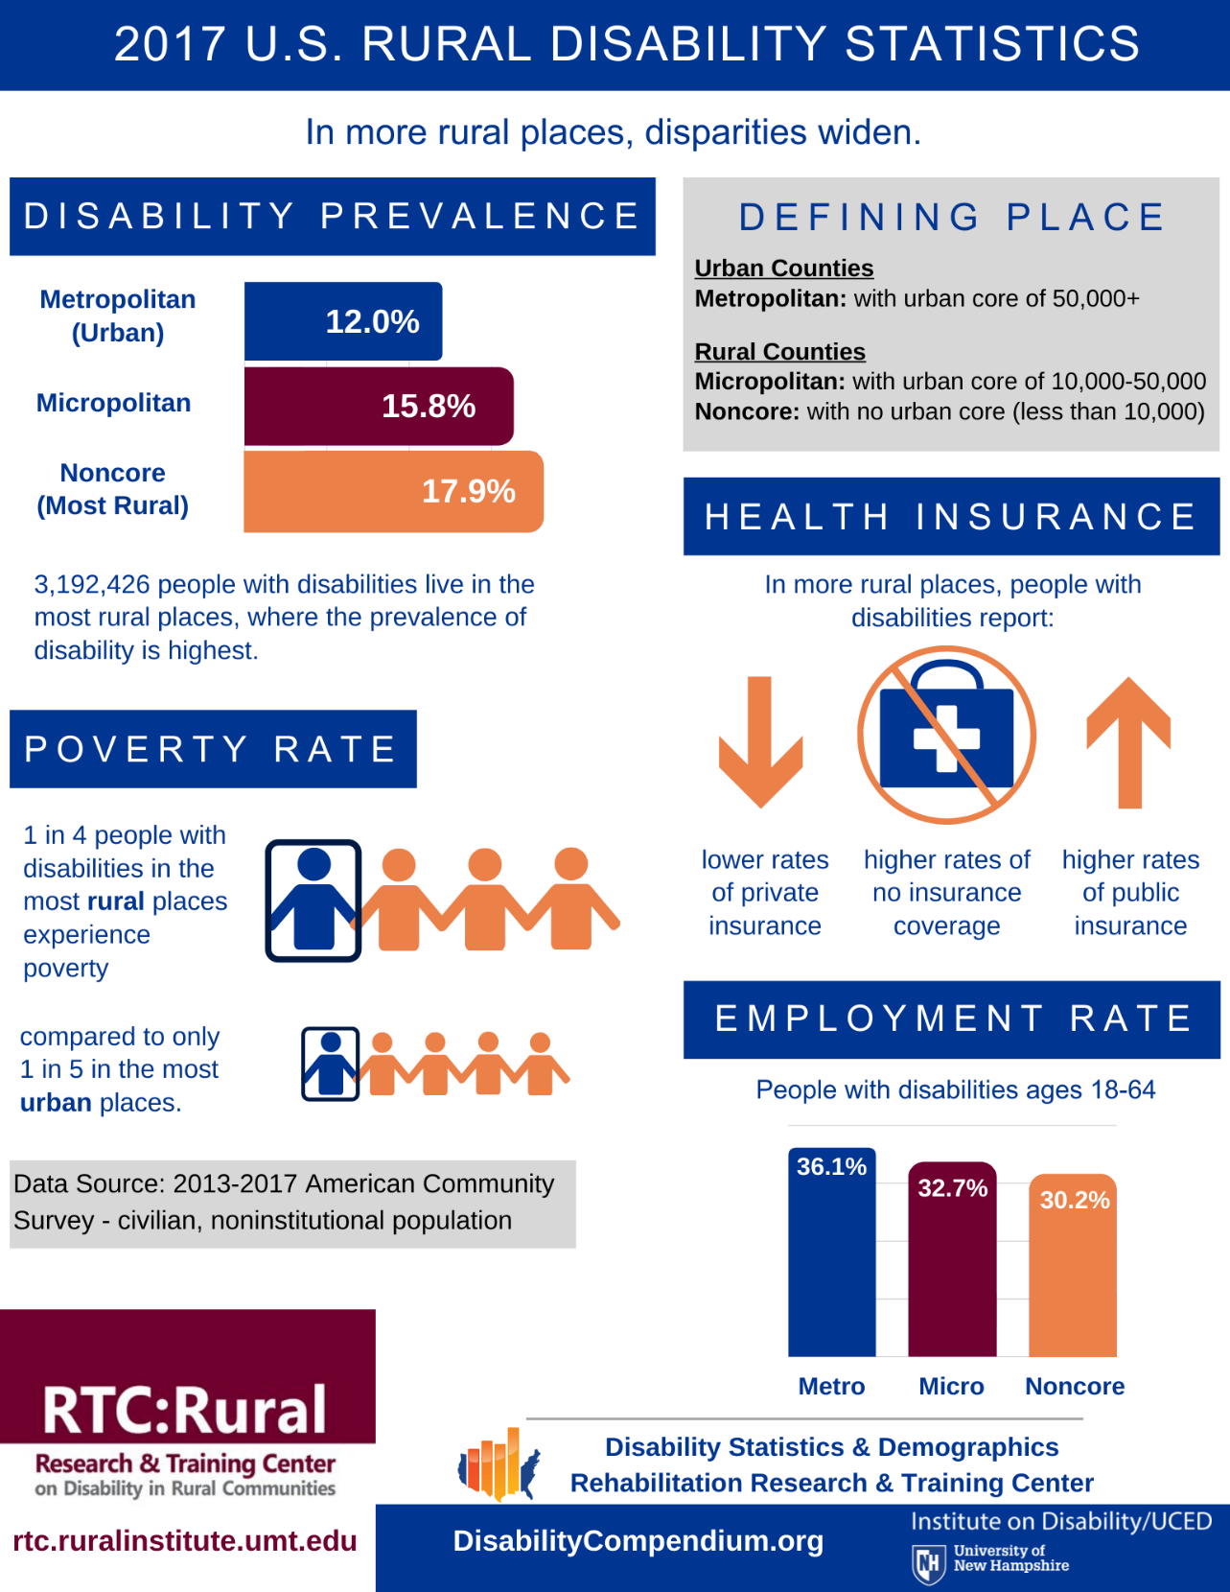

Slide 10
Infographic text description
An infographic showing 2017 Rural Disability Statistics. In more rural places, disparities widen.
The most rural places have the highest disability prevalence (at 17.9% compared to 12.0% in urban places).
People with disabilities in rural places are more likely to experience poverty than their counterparts in urban places.
The employment rate for people with disabilities ages 18-64 goes down as places become more rural (it's 36.1% in urban places while only 30.2% in the most rural places).
In more rural places, people with disabilities report lower rates of private insurance, higher rates of no insurance coverage, and higher rates of public insurance coverage.
The source of these data is the 2013-2017 American Community Survey and represents the civilian, noninstitutional population.

Slide 11
Thank you!
Contact Information:
Institute on Disability
University of New Hampshire
10 West Edge Drive, Suite 101
Durham, NH 03824
Megan Henly, Ph.D.
(603) 862-1488
Megan.Henly@unh.edu

