Slide 1
nTIDE Lunch & Learn Webinar Series
Kessler Foundation, AUCD, University of New Hampshire Institute on Disability Season 10, Episode 1 Date: January 10, 2025

Slide 2
nTIDE Lunch & Learn Webinar Series
Kessler Foundation, AUCD, University of New Hampshire Institute on Disability Season 10, Episode 1 Date: January 10, 2025

Slide 3
Up Front Matters
This webinar is being recorded. We will post an archive of along side the Monthly nTIDE broadcast on our webinar, each month, on our website at www.researchondisability.org/nTIDE. This site will also provide copies of the presentations, the speakers’ bios, full transcripts, and other valuable resources.
As an attendee of this webinar, you are a viewer. To ask questions of the speakers, click on the Q & A box on your webinar screen and type your questions into the box. Speakers will review these questions and provide answers during the last section of the webinar. Some questions may be answered directly in the Q & A box.

Slide 4
Up Front Matters – Contact Info
If you have any questions following this recording, please contact us at disability.statistics@unh.edu, or toll free at 866-538-9521 for more information. Thanks for joining us. Enjoy today's webinar!

Slide 5
ASL & Captioning
To see the ASL interpreter and the gallery of speakers at the same time, we recommend using a computer or laptop, rather than a phone or tablet.
For closed captioning, click on the Closed Caption button and select Show Subtitle or View Full Transcript.

Slide 6
About nTIDE Lunch & Learn
Occurs at noon Eastern-time on the first Friday day of each month, with the release of the nTIDE Report.
A joint effort of the University of New Hampshire, Kessler Foundation, and the Association of University Centers on Disabilities (AUCD).

Slide 7
Today’s Program
Part 1: nTIDE Report … “The Numbers”
John O’Neill, Kessler Foundation
Hyun Ju Kim, University of New Hampshire
Part 2: nTIDE News
Denise Rozell, Association of University Centers on Disabilities (AUCD)
Part 3: Guest Speaker
Bill Field, AgrAbility/Purdue University
Part 4: Q&A

Slide 8
Part 1: The nTIDE Report
John O’Neill
Kessler Foundation

Slide 9
The Monthly nTIDE Report
The monthly nTIDE Report is a press release and infographic, looking at the latest employment statistics.
Uses data from the “jobs report” released by the U.S. Bureau of Labor Statistics, on the 1st Friday of each month.

Slide 10
Source of the Data
U.S. BLS, Current Population Survey (CPS).
Source of the “official” unemployment rate.
Civilians, ages 16-64, not living in institutions.
Available September 2008 onward.
Not yet seasonally adjusted.
which is why we compare to the same month last year.

Slide 11
The Numbers
Hyun Ju Kim University of New Hampshire

Slide 12
Employment- to-Population Ratio:

Slide 13
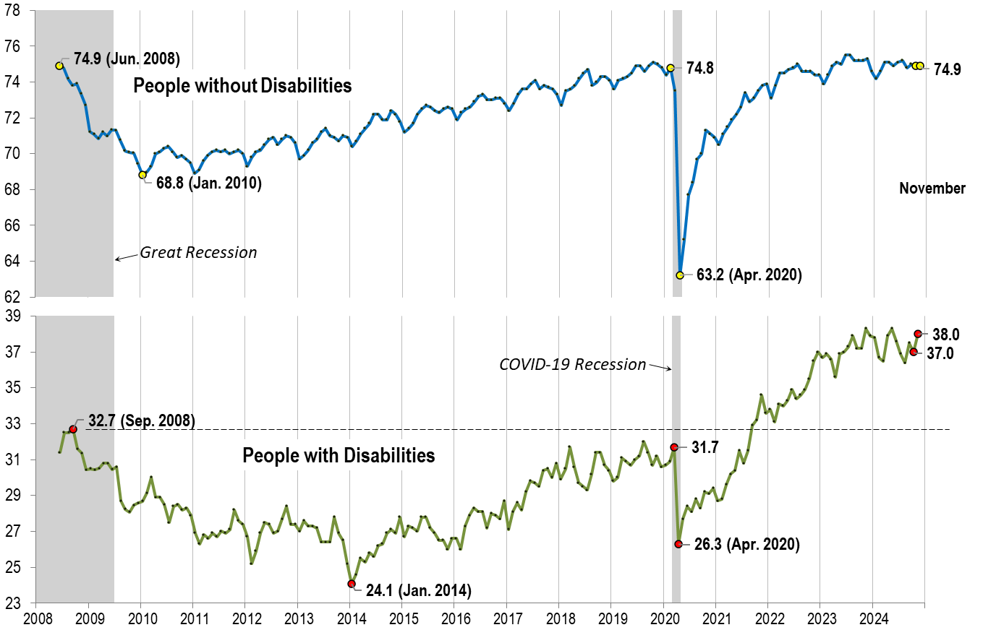
Employment- to-Population Ratio: November
Notes:
Chart Details:
The data series starts in June 2008 during the Great Recession which lasted until Mid-2009. The COVID-19 Recession started in April 2020 and last for two months
Visible Data points (highlights start of the series, the lowest point pre-covid, the points right before and after the Covid-19 recession hit, and the current Employment-to-Population Ratio
People without Disabilities:
June 2008 74.9
January 2010 (lowest point pre-covid) 68.8
February 2020 74.8
April 2020 (Covid-19 Recession hits) 63.2 (lowest point)
August 2024 74.8
September 2024 75.0
People with Disabilities:
September 2008 32.7
January 2014 (lowest point pre-covid) 24.1 (lowest point)
March 2020 31.7
April 2020 (Covid-19 Recession hits) 26.3
August 2024 38.4
September 2024 37.5

Slide 14
Employment- to-Population Ratio: December
Notes:
Chart Details:
This chart adds another month to the previous chart.
The data series starts in June 2008 during the Great Recession which lasted until Mid-2009. The COVID-19 Recession started in April 2020 and last for two months
Visible Data points (highlights start of the series, the lowest point pre-covid, the points right before and after the Covid-19 recession hit, and the current Employment-to-Population Ratio
People without Disabilities:
June 2008 74.9
January 2010 (lowest point pre-covid): 68.8
February 2020 74.8
April 2020 (Covid-19 Recession hits): 63.2 (lowest point)
September 2024 75.0
October 2024 74.9
People with Disabilities:
September 2008 32.7
January 2014 (lowest point pre-covid) 24.1 (lowest point)
March 2020 31.7
April 2020 (Covid-19 Recession hits) 26.3
September 2024 37.5
October 2024 37

Slide 15
Labor Force Participation Rate:

Slide 16
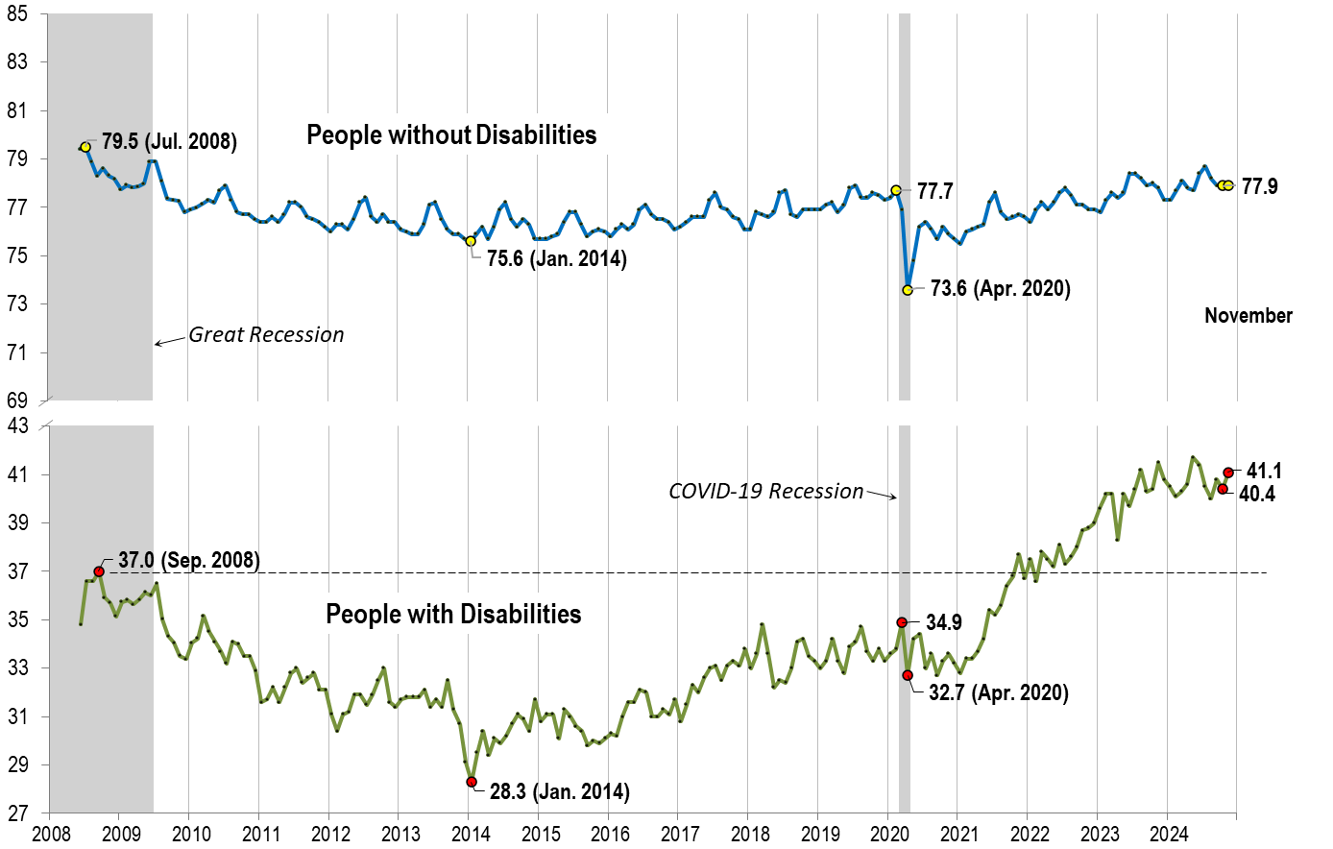
Labor Force Participation Rate: November
Notes:
Chart Details:
The data series starts in June 2008 during the Great Recession which lasted until Mid-2009. The COVID-19 Recession started in April 2020 and last for two months
Visible Data points (highlights start of the series, the lowest point pre-covid, the points right before and after the COVID-19 recession hit, and the current labor force participation rate.
People without Disabilities:
July 2008 79.5
January 2014 (lowest point pre-covid) 75.6
February 2020 77.7
April 2020 (Covid-19 Recession hits) 73.6 (lowest point)
September 2024 77.9
People with Disabilities:
September 2008 37.0
January 2014 28.3 (lowest point)
March 2020 34.9
April 2020 (Covid-19 Recession hits) 32.7
September 2024 40.8

Slide 17
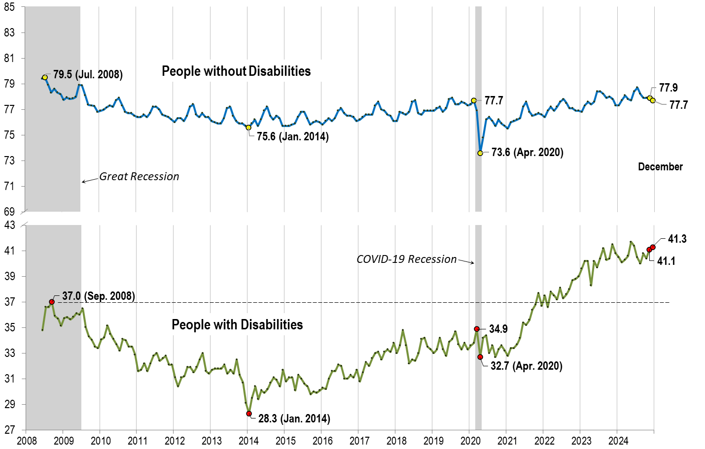
Labor Force Participation Rate: December
Notes:
Chart Details:
This chart adds another month to the previous chart.
The data series starts in June 2008 during the Great Recession which lasted until Mid-2009. The COVID-19 Recession started in April 2020 and last for two months
Visible Data points (highlights start of the series, the lowest point pre-covid, the points right before and after the COVID-19 recession hit, and the current labor force participation rate.
People without Disabilities:
July 2008 79.5
January 2014 (lowest point pre-covid) 75.6
February 2020 77.7
April 2020 (Covid-19 Recession hits) 73.6 (lowest point)
September 2024 77.9
October 2024 77.9
People with Disabilities:
September 2008 37.0
January 2014 28.3 (lowest point)
March 2020 34.9
April 2020 (Covid-19 Recession hits) 32.7
September 2024 40.8
October 2024 40.4

Slide 18
Part 2 nTIDE News
Denise Rozell
Association of University Centers on Disabilities (AUCD)

Slide 19
Federal Policy Update
Welcome to the 119th Session of Congress!
The end of the 118th??
No WIOA reauthorization
No TCIEA
Final rule on airline protections for people with disabilities – effective January 16
Appropriations: FY 2025 -- Continuing Resolution (CR) through March 14, 2025
Appropriations FY 2026? Coming up soon!
Reconciliation – what will be in it??

Slide 20
Department of Labor Rule on subminimum wage - out for comment
Federal Register December 4, 2024; comments due January 17, 2025
What does it say?
No more Section 14c certificates issued by Department of Labor
Current certificates phased out over a three year period
Questions to the field:
Is 3 years too long or too short?
Should there be exceptions for cause? What would be cause?
What happens after the Inauguration??

Slide 21
Free Digital Skills Training – AT&T/The Arc
AT&T, The Arc, and The Arc San Francisco have created free, safe, accessible digital skills training specifically for people with ID/DD. Workshops are available in-person in 26 regions and online nationwide.
Training modules include:
Getting started with computers, mobile devices, and video conferencing;
Introduction to email;
Navigating websites and search engines;
Online safety, passwords, fraud, and scams.
Modules list times, provide activities, additional resources and text printouts in addition to video lessons. Available in English and Spanish.

Slide 22
Disability Employment Resource Map by State
ODEP-funded National Center on Leadership for the Employment and Economic Advancement of People with Disabilities (LEAD Center).
State-by-State policy and data resource map includes links to:
State departments of labor and health, vocational rehabilitation agencies and other organizations;
Recently passed executive orders and legislation;. Get started by selecting your state on the map now;
HCBS rates;
Medicaid waivers;
Policies, programs and initiatives like housing, mentorship, mental health, entrepreneurship, Employment First, long term care manuals, work based learning guidelines… and MORE!!!

Slide 23
Repeal of Subminimum Wages and Social Determinants of Health
Kakara M, Bair EF, Venkataramani AS. Repeal of Subminimum Wages and Social Determinants of Health Among People With Disabilities. JAMA Health Forum. 2024;5(11):e244034. doi:10.1001/jamahealthforum.2024.4034
“Findings: In this difference-in-differences study including 450 838 individuals from 2 states (New Hampshire and Maryland) that repealed Section 14(c), repeal was associated with a statistically significant increase in employment-related outcomes for people with cognitive disabilities in New Hampshire but not Maryland.” note: while Maryland’s was not statistically significant in an increase in employment, it seemed to rule out any large negative effects of Section 14(c) repeal
“Conclusions and Relevance In this study, repeal of Section 14(c), a policy allowing subminimum wages for people with disabilities, led to increases in labor force participation, though with heterogeneity at the state level. These findings suggest the importance of state-level factors in shaping program effects, especially as national-level Section 14(c) repeal is being debated.”

Slide 24
Employment/Social Determinants of Health
Mascayano F, Drake RE. Supported employment as a global mental health intervention. Cambridge Prisms: Global Mental Health. 2024;11:e102. doi:10.1017/gmh.2024.112
Authors argue for the preeminence of employment among social determinants of mental health
People with mental health disabilities want to work and a well-validated model of supported employment that is effective and cost-effective exists;
Employment leads to improvements in income, daily structure, self-esteem, social support, community integration and illness management;
People who are employed experience fewer emergencies and hospitalizations;
Employment is empowering - people can use added income to activate their own choices regarding other social determinants;
Supported employment actualizes the recovery paradigm: - meaningful functional life, increased self-esteem and new social supports;
Examples of supported employment developments in diverse settings; implications of scaling up these services worldwide.

Slide 25
Supported Employment in the Medicaid and CHIP Working-Age Population
Use of Supported Employment in the Medicaid and CHIP Working-Age Population (2019) Issue Brief; Dey, Rooney, Irvin, Self, and Nolan; November 27, 2024; ASPE (Assistant Secretary for Planning and Evaluation, U.S. Department of HHS)
State Medicaid programs have the option to cover supported employment (SE) services (payer of last resort often via waiver or HCBS);
Of 52 million Medicaid and CHIP beneficiaries ages 14-65 in the 47 states we analyzed, fewer than 1.0% had a SE claim in 2019;
Beneficiaries receiving SE are disproportionately older, male, and White compared with the general working-age population in Medicaid;
Of the beneficiaries who used SE and had a chronic condition, 61.2% had ID/DD, and 50.8% had a behavioral health condition;
Study shows state-by-state data.

Slide 26
AAPD’s 2025 Fall Internship Program: Apply Now – Deadline February 6, 2025
AAPD’s Internship Program places students and recent graduates with disabilities in paid internships. Interns build leadership skills, explore career opportunities, and connect with the disability community.
14 weeks from Sept. 2 to Dec. 5, 2025 – fully virtual and part time; work 15 hours per week;
Disability advocacy class every 2 weeks;
Kickoff call on April 4, 2025; optional in-person in Washington D.C. week of July 21; virtual orientation on Aug. 24 from 12-4pm ET;
Virtual mentor and virtual community events throughout the fall.
Join AAPD for a virtual information session on Tuesday, Jan. 14, 4-5 PM EST; CART and ASL provided. The session will be recorded and available on the AAPD website.
https://www.aapd.com/fall-internship-program/

Slide 27
Webinar: Perspectives on Advancing CIE Through Employer Engagement
Tuesday, January 14, 2025; 3:00-4:30 p.m. ET Sponsored by Disability Employment Technical Assistance Center (DETAC)
Strategies for partnering with businesses to create meaningful, sustainable job opportunities:
Strategies include raising awareness, providing support, and leveraging technology.
Success stories from a state VR agency and advocates on engaging with employers;
The importance of building relationships with employers to advance CIE;
The business advantages of hiring people with disabilities;
Innovative strategies for building a community of employer champions.
Live captioned (with Spanish machine translations) ASL interpretation
Webinars are recorded and posted with supporting materials on the DETAC website

Slide 28
Webinar: Advancing Equity: Building a Strong Workforce by Including Workers with Disabilities
On January 14, 2025, at 3 p.m. ET
ODEP and the Office of Federal Contract Compliance Programs (OFCCP) will cover
The legal framework to protect and empower disabled employees;
OFCCP: the Mega Construction Project Program and importance of an inclusive and equitable workforce for the construction trades industry;
ODEP: inclusive recruiting practices, affirmative outreach, considerations when using AI, onboarding and training using inclusive design, cultural competency workgroups, and the importance of being flexible and offering wrap-around services
Showcase their “Helping Workers with Disabilities Get Ahead Through Good Jobs: A Toolkit of Practical Strategies”.

Slide 29
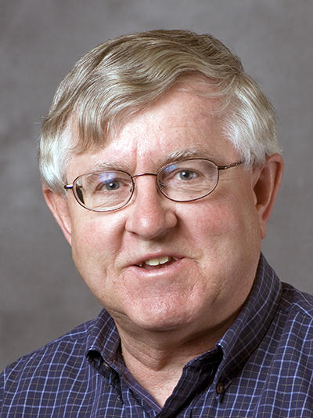
Part 3: Guest Speaker
Bill Field
AgrAbility/Purdue University

Slide 30
nTIDE Lunch & Learn Series January 10, 2025
Dr. Bill Field
National AgrAbility Project
Purdue University

Slide 31
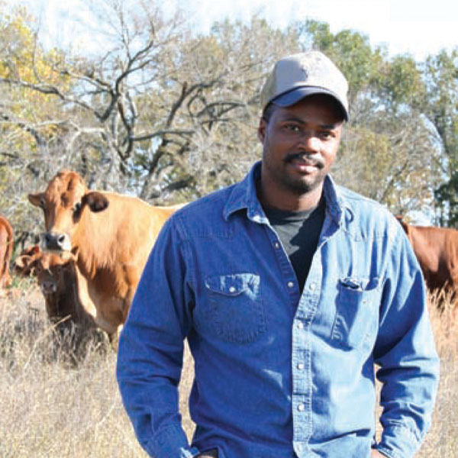
Session Overview
Overview of AgrAbility with emphasis on National AgrAbility Project (NAP)
History
Goals
Structure
Services
Personnel
Resources

Slide 32
AgrAbility History
Several similar programs prior to establishment of AgrAbility at federal level
AgrAbility began through the 1990 Farm Bill with funding starting in 1991
In 1991, there were 8 funded state and regional AgrAbility projects (SRAPs); as of 2024, there are 21 SRAPs and several previously-funded affiliate projects
One National AgrAbility Project (NAP) supports the SRAPs and provides limited services to those in non-SRAP states
Early tractor lift prototype
Notes:
Included in 1990 Farm Bill; funded in 1991. Other pre-AgrAbility models existed in Vermont and Iowa. Maximum number of funded AgrAbility projects was 23 covering 25 states – reduced since 2013.

Slide 33
What Disability Types (Functional Limitations) does AgrAbility Address?
AgrAbility addresses a wide variety of disabling conditions in agriculture, including, but not limited to:
Amputation
Arthritis
Back impairment
Deafness/hearing impairment
Developmental disabilities, such as cerebral palsy or autism
Disabling diseases, such as cancer or heart disease
Mental/behavioral health problems
Respiratory diseases
Spinal cord injuries
Stroke
Traumatic brain injury
Visual impairments
Importance of staying with your realm of expertise!

Slide 34
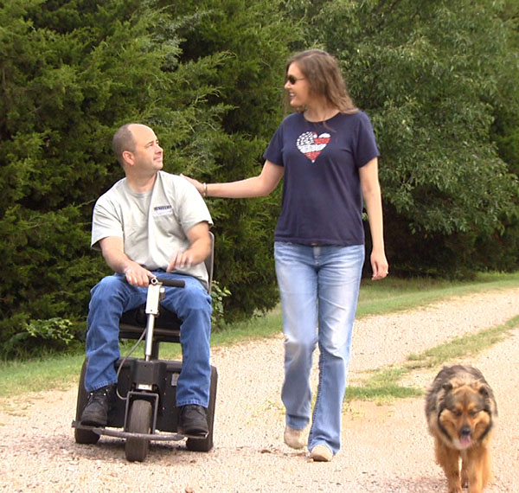
Disability within the Agricultural Community
Causes of disability
Traumatic injury (agriculture is one of the most hazardous occupations)
Many injuries also come from off-farm incidents
Exposure to chemicals, dust, gases
Diseases and chronic health conditions
Arthritis, back problems
Ergonomics and repetitive tasks
Aging (Average age of U.S. farmers is 57+)
Notes:
Deboy, G.R., P.J. Jones, W.E. Field, J. Metcalf, and R.L. Tormoehlen. Estimating the Prevalence of Disability within the U.S. Farm and Ranch Population. Journal of Agromedicine, 13(3).

Slide 35
Prevalence of Disability within the Agricultural Community
2008
Approximately 15-20% of farm population impacted by disability
1.04 – 2.23 million of the U.S. farm, ranch, and agricultural community impacted by disability
Deboy, G.R., P.J. Jones, W.E. Field, J. Metcalf, and R.L. Tormoehlen. Estimating the Prevalence of Disability within the U.S. Farm and Ranch Population. Journal of Agromedicine, 13(3).
2018
At least 12.9% of farm population impacted by disability
At least 634,000 of the U.S. farm, ranch, and agricultural community impacted by disability
Miller, C.D. and A.R. Aherin. Journal of Agricultural Safety and Health, 24(4): 243-260.
Notes:
Deboy, G.R., P.J. Jones, W.E. Field, J. Metcalf, and R.L. Tormoehlen. Estimating the Prevalence of Disability within the U.S. Farm and Ranch Population. Journal of Agromedicine, 13(3).

Slide 36
What Agricultural Operations does AgrAbility Serve?
Just as disability is a wide continuum, agriculture is also:
Row crops: corn, soy, wheat, cotton, etc.
Ranching
Sheep and goats
Dairy
Produce, including organic
Orchards
Agritourism
Niche markets, like llamas, herbs, etc.
Floriculture
Aquaculture
Hydroponics
Aquaponics
Urban agriculture

Slide 37
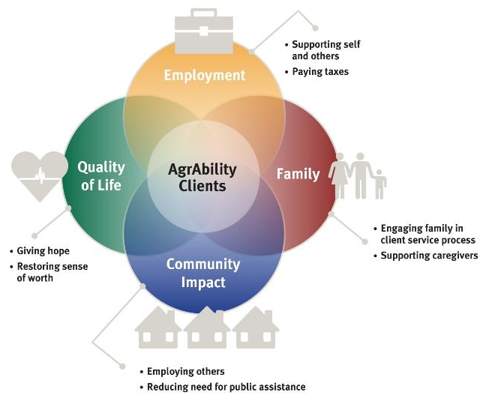
Multifaceted Impact

Slide 38
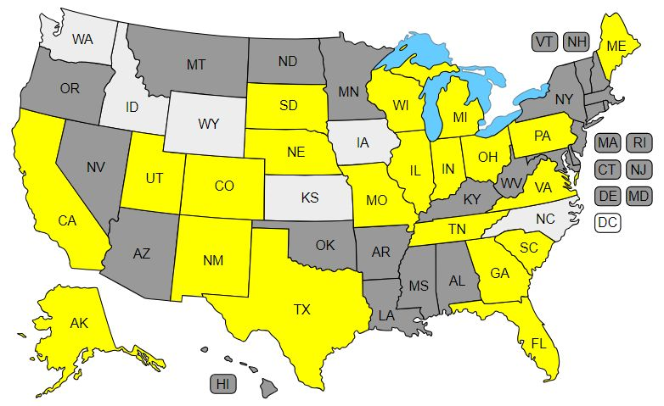
AgrAbility Projects 2025
Notes:
As of October 2014

Slide 39
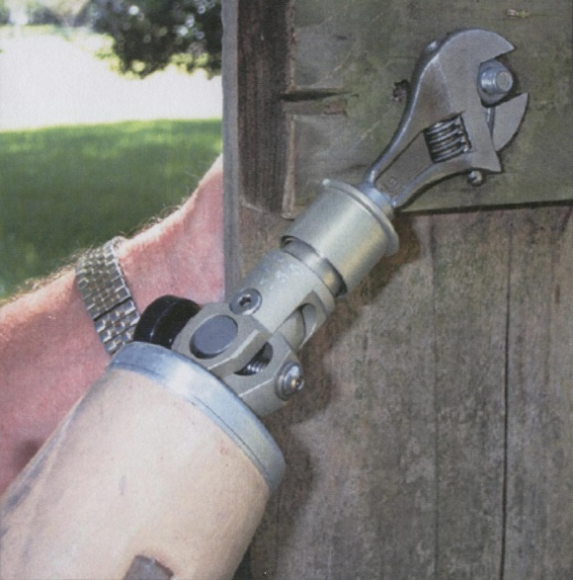
AgrAbility Partnerships
All AgrAbility projects – state projects and the national project – are partnerships between a land-grant university and at least one disability-services program.
1862 and 1890 land-grant institutions are eligible to apply for AgrAbility grants.
Notes:
Many projects have more than one partner. Land-grant university Extension service must hold the grant. 1862 and 1890 land-grants are eligible to apply. 1994 are currently not eligible.

Slide 40
Current NAP Partners
Breaking New Ground Resource Center, Purdue University (lead organization)
Goodwill of the Finger Lakes (NY)
Osteoarthritis Action Alliance
AgriSafe Network
Colorado State University (evaluation specialists)
Washington State University (evaluation specialists)
Consultants
Many non-funded partners: FVC, RESNA,VA, FFA, etc.

Slide 41
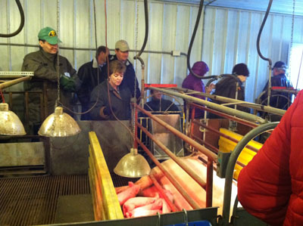
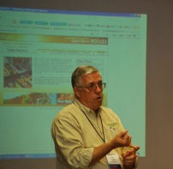
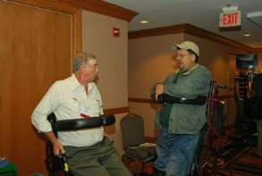
AgrAbility Services/Priorities
Education
Workshops; resource development; online education
Networking
Leveraging efforts with other groups; peer support
Direct Assistance
Site visits; consultations; business planning
Marketing
Public awareness activities and materials
Notes:
These are the priority areas listed in the RFAs. Not exhaustive lists

Slide 42
Special Responsibilities of the NAP
Provide support to the state and regional AgrAbility Projects
Training
In-person
Virtual
Resources
Consultations with NAP specialists
Provide limited direct services to customers in states without AgrAbility projects
Notes:
SRAPs complete annual assessment of NAP and also suggestions for future work. Services in non-AgrAbility states generally consist of email or phone contact.

Slide 43
What Does AgrAbility Not Provide?
Funding to clients
Equipment for clients
Most funding for assistive technology comes through state vocational rehabilitation systems
Other sources of grants and loans are available (www.agrability.org/funding-assistance/)
Some state Assistive Technology Act projects can provide free or low-cost AT + loan programs
SRAPs can raise funds independent of USDA
Notes:
Some states partner with AT Act Projects, which usually have a lending “library” of AT or an AT re-use program.

Slide 44
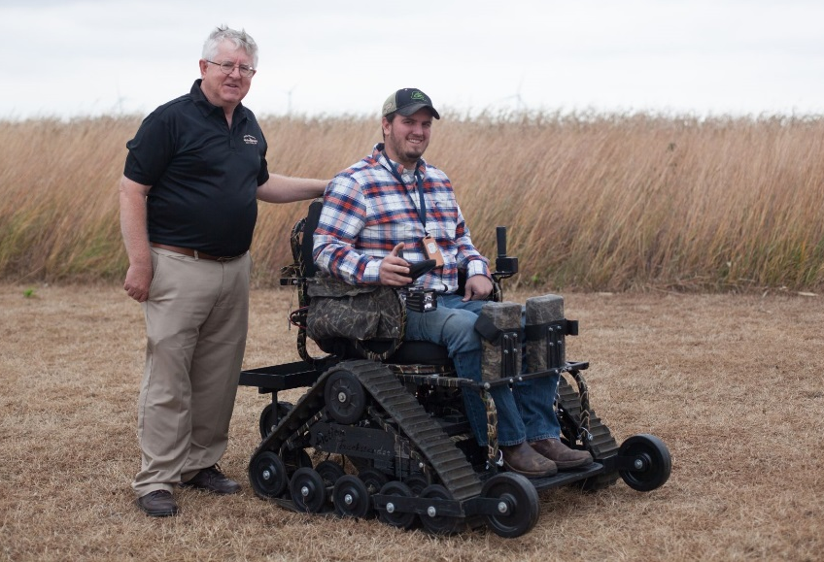
What if Your State Doesn’t Have an AgrAbility Project
Can still get technical support from the National AgrAbility Project
Pilot project to hire limited number of consultants
Expanded web “Services in Your State”
Resources available at www.agrability.org
Encourage your state’s land-grant university(s) to apply for an AgrAbility grant

Slide 45
Resources for Farmer/Ranchers with Disabilities in All States
State Vocational Rehabilitation (VR) Agencies
U.S. Department of Veterans Affairs
Centers for Independent Living
State Assistive Technology Act Projects
Cooperative Extension
USDA
FSA
NRCS

Slide 46
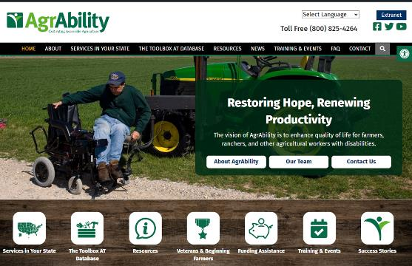
Educational Resources: www.agrability.org
Project information and contacts
Downloadable resources
Online training
Mobile friendly
Notes:
Discuss importance of site and give tour if feasible.

Slide 47
The Toolbox Assistive Technology Database
Print, CD, and web versions www.agrability.org/Toolbox
More than 1925 products to help agricultural workers with disabilities

Slide 48
WWW.AGRABILITY.ORG WEBSITE
Estimated Statistics 8/1/23 – 7/31/24
Hits
Total visitor hits 9,219,593
Page views
Total page views 2,868,954
Visitors
Total visitors (not unique) 803,875
Change from
previous year
+ 18%
+ 19%
+ 38%

Slide 49
International Traffic to www.agrability.org
 | Country
1 | United States
2 | China
3 | Unknown
4 | Russian Federation
5 | United Kingdom
6 | Germany
7 | Canada
8 | France
9 | India
10 | Ukraine

Slide 50
Most Viewed Topics on AgrAbility YouTube Channel
Most viewed videos – channel lifetime
An Overview of Vocational Rehabilitation
Farm Service Agency (FSA) Farm Loan Programs
Caring for a Residual Limb
Using the VA Accelerator Program to Help Farmers Veterans with Disabilities
AgrAbility: It’s About Hope (long version)
Garden Seats
An Introduction to Vocational Rehabilitation Services
Mental Health First Aid
Then Next Mission: Breaking Down Barriers for Veterans in Agriculture
AgrAbility: It’s About Hope (short version)

Slide 51
Recent Publications

Slide 52
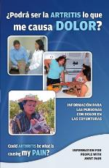
Arthritis Resources
Arthritis and Gardening
Arthritis and Agriculture
Plain Facts about Arthritis
¿Podrá ser la Artritis lo que me causa Dolor? (Could Arthritis be the cause of my Pain?)
Gaining Ground on Arthritis DVD
Notes:
Arthritis and Agriculture is AgrAbility’s most popular print resource with 70,000 copies in print. Plain Fact is for Old Order/Amish Communities. ¿Podrá ser la Artritis lo que me causa Dolor? is a fotonovla (comic book) in Spanish for migrant/seasonal workers.

Slide 53
BACK on the Farm, BACK in the Saddle
Back problems = one of the most common disabling conditions reported by AgrAbility clients.
21-page booklet discusses many aspects of back problems in ag settings
www.agrability.org/ resources/back
Notes:
Newest print resource. 30,000 copies in print.

Slide 54
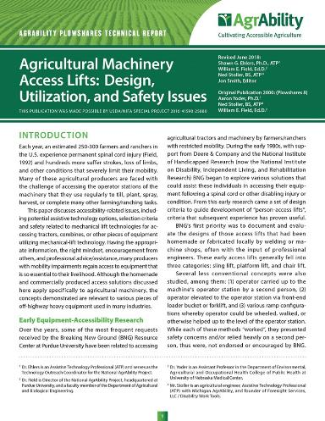
Plowshares
30+ technical reports on specific topics, such as farming with a spinal cord injury
Several new topics and updates underway
Notes:
Hand Controls for Agricultural Equipment ( Issue 2) [PDF]
Prosthetic and Worksite Modifications for Farmers with Upper Extremity Amputations (Issue 3) [PDF]
Selection and Operation of All-Terrain Vehicles by Physically Impaired Farmers (Issue 5) [PDF]
Farming Following a Spinal Cord Injury (Issue 6) [PDF]
New Concepts in Manlift Attachments for Tractors and Combines (Issue 8) [PDF]
Improving Worksite Mobility for Farmers with Physical Disabilities (Issue 9) [PDF]
Farming with a Visual Impairment (Issue 13) [PDF]
Assistive Communication Devices for Farmers/Ranchers with Physical Disabilities (Issue 16) [PDF]
Farming/Ranching with Cerebral Palsy (Issue 17) [PDF]
Making Your Farmhouse Accessible (Issue 19) [PDF]
Farming with a Respiratory Impairment (Issue 20) [PDF]
Farming with a Hearing Impairment (Issue 23) [PDF]
Farming with a Lower Extremity Amputation (Issue 24) [PDF]
Accessing Horses and Horse-Drawn Vehicles (Issue 25) [PDF]
Farming With a Back Impairment (Issue 26) [PDF]
Potential Health and Safety Risks of Farming/Ranching with a Disability (Issue 27) [PDF]
Accessible Recreation (Issue 28) [PDF]
Rural Church Accessibility (Issue 30) [PDF]

Slide 55
Conducting Agricultural Worksite Assessments
Step-by-step guide for evaluating farms and ranches
Reproducible assessment form

Slide 56
AT Secondary Injury Evaluation
Step-by-step guide for evaluating AT for secondary injury hazards
Reproducible assessment forms

Slide 57
What is AgrAbility’s Impact?
AgrAbility recently conducted a multi-year study to compare the program’s impact with a no-treatment comparison group. Using the McGill Quality of Life (QOL) survey and a newly-developed Independent Living and Working (ILW) instrument, AgrAbility gathered data both on AgrAbility clients and on farmers/ranchers with disabilities who had not received services.
Fetsch, R. J., Jackman, D. M., & Collins, C. L. (2018). Assessing changes in quality of life and independent living and working levels among AgrAbility farmers and ranchers with disabilities. Disability and Health Journal, 11(2), 230-236. doi: https://doi.org/10.1016/j.dhjo.2017.08.001

Slide 58
Impact: Quality of Life (QOL)
The 199 AgrAbility client group participants showed increased QOL levels of 28%, while the 97 no-treatment comparison group’s QOL level fell by 4%.

Slide 59
Impact: Independent Living and Working (ILW)
The AgrAbility client group participants showed increased ILW levels of 30%, while the no-treatment control group increased only 8%.

Slide 60
Questions?

Slide 61
Thank You!
Information about the nTIDE partners may be found at
Kessler Foundation (www.kesslerfoundation.org)
UNH/Institute on Disability (www.ResearchOnDisability.org)
AUCD (www.AUCD.org)
Contact us at
Email: Disability.Statistics@unh.edu
Call: 866-538-9521 (toll free)
Twitter at #nTIDELearn

Slide 62
Bye!

