Slide 1
nTIDE Lunch & Learn Webinar Series
Kessler Foundation, AUCD, University of New Hampshire Institute on Disability Season 10, Episode 2 Date: February 7, 2025

Slide 2
nTIDE Lunch & Learn Webinar Series
Kessler Foundation, AUCD, University of New Hampshire Institute on Disability Season 10, Episode 2 Date: February 7, 2025

Slide 3
Up Front Matters
This webinar is being recorded. We will post an archive of along side the Monthly nTIDE broadcast on our webinar, each month, on our website at www.researchondisability.org/nTIDE. This site will also provide copies of the presentations, the speakers’ bios, full transcripts, and other valuable resources.
As an attendee of this webinar, you are a viewer. To ask questions of the speakers, click on the Q & A box on your webinar screen and type your questions into the box. Speakers will review these questions and provide answers during the last section of the webinar. Some questions may be answered directly in the Q & A box.

Slide 4
ASL & Captioning
To see the ASL interpreter and the gallery of speakers at the same time, we recommend using a computer or laptop, rather than a phone or tablet.
For closed captioning, click on the Closed Caption button and select Show Subtitle or View Full Transcript.

Slide 5
About nTIDE Lunch & Learn
Occurs at noon Eastern-time on the first Friday day of each month, with the release of the nTIDE Report.
A joint effort of the University of New Hampshire, Kessler Foundation, and the Association of University Centers on Disabilities (AUCD).

Slide 6
Today’s Special Session – Year End
Part 1: nTIDE Report … “The Numbers”
Andrew Houtenville, University of New Hampshire
John O’Neill, Kessler Foundation
Part 2: nTIDE News
Denise Rozell, Association of University Centers on Disabilities (AUCD)
Part 3: Guest Speaker
Kelly Nye-Lengerman, Mathematica
Part 4: Q&A

Slide 7
Part 1: The nTIDE Report
John O’Neill
Kessler Foundation

Slide 8
The Monthly nTIDE Report
The monthly nTIDE Report is a press release and infographic, looking at the latest employment statistics.
Uses data from the “jobs report” released by the U.S. Bureau of Labor Statistics, on the 1st Friday of each month.

Slide 9
Source of the Data
U.S. BLS, Current Population Survey (CPS).
Source of the “official” unemployment rate.
Civilians, ages 16-64, not living in institutions.
Available September 2008 onward.
Not yet seasonally adjusted.
which is why we compare to the same month last year.

Slide 10
The Numbers
Andrew Houtenville University of New Hampshire

Slide 11
Employment- to-Population Ratio:
Notes:
Chart Details:
The data series starts in June 2008 during the Great Recession which lasted until Mid-2009. The COVID-19 Recession started in April 2020 and last for two months
Visible Data points (highlights start of the series, the lowest point pre-covid, the points right before and after the Covid-19 recession hit, and the current Employment-to-Population Ratio
People without Disabilities:
June 2008 74.9
January 2010 (lowest point pre-covid) 68.8
February 2020 74.8
April 2020 (Covid-19 Recession hits) 63.2 (lowest point)
August 2024 74.8
September 2024 75.0
People with Disabilities:
September 2008 32.7
January 2014 (lowest point pre-covid) 24.1 (lowest point)
March 2020 31.7
April 2020 (Covid-19 Recession hits) 26.3
August 2024 38.4
September 2024 37.5

Slide 12
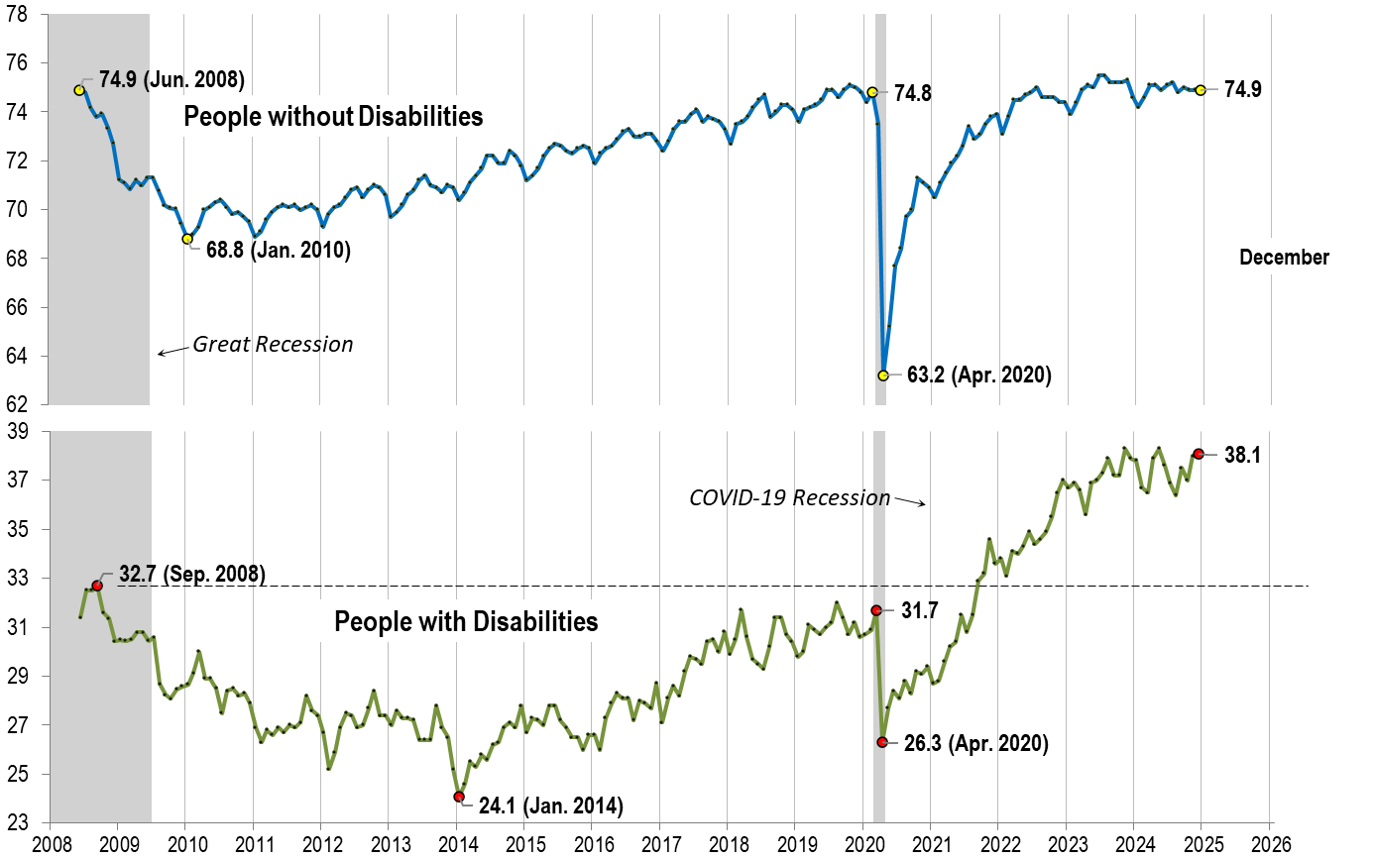
Employment- to-Population Ratio: December
Notes:
Chart Details:
The data series starts in June 2008 during the Great Recession which lasted until Mid-2009. The COVID-19 Recession started in April 2020 and last for two months
Visible Data points (highlights start of the series, the lowest point pre-covid, the points right before and after the Covid-19 recession hit, and the current Employment-to-Population Ratio
People without Disabilities:
June 2008 74.9
January 2010 (lowest point pre-covid) 68.8
February 2020 74.8
April 2020 (Covid-19 Recession hits) 63.2 (lowest point)
December 2024 74.9
People with Disabilities:
September 2008 32.7
January 2014 (lowest point pre-covid) 24.1 (lowest point)
March 2020 31.7
April 2020 (Covid-19 Recession hits) 26.3
December 2024 38.1

Slide 13
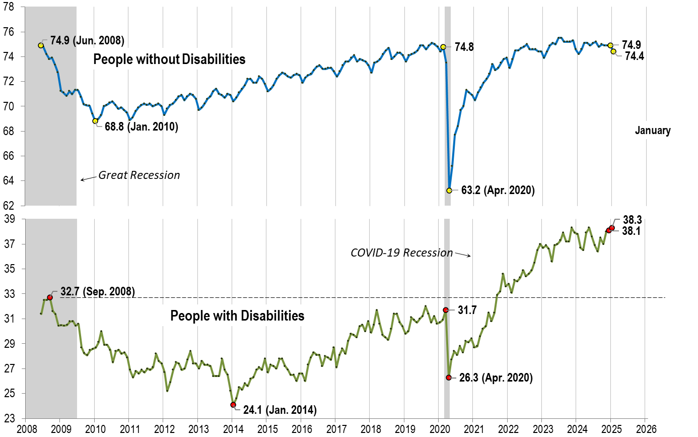
Employment- to-Population Ratio: January
Notes:
Chart Details:
The data series starts in June 2008 during the Great Recession which lasted until Mid-2009. The COVID-19 Recession started in April 2020 and last for two months
Visible Data points (highlights start of the series, the lowest point pre-covid, the points right before and after the Covid-19 recession hit, and the current Employment-to-Population Ratio
People without Disabilities:
June 2008 74.9
January 2010 (lowest point pre-covid) 68.8
February 2020 74.8
April 2020 (Covid-19 Recession hits) 63.2 (lowest point)
December 2024 74.9
January 2025 74.4
People with Disabilities:
September 2008 32.7
January 2014 (lowest point pre-covid) 24.1 (lowest point)
March 2020 31.7
April 2020 (Covid-19 Recession hits) 26.3
December 2024 38.1
January 2025 38.3

Slide 14
Labor Force Participation Rate:

Slide 15
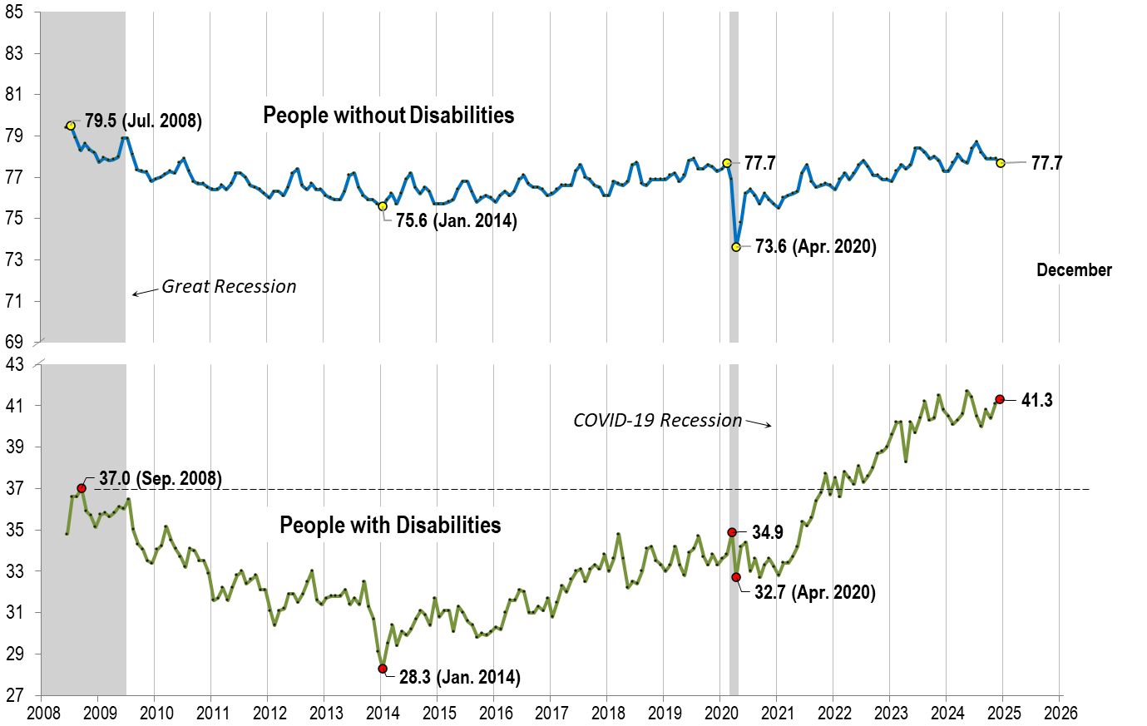
Labor Force Participation Rate: December
Notes:
Chart Details:
The data series starts in June 2008 during the Great Recession which lasted until Mid-2009. The COVID-19 Recession started in April 2020 and last for two months
Visible Data points (highlights start of the series, the lowest point pre-covid, the points right before and after the COVID-19 recession hit, and the current labor force participation rate.
People without Disabilities:
July 2008 79.5
January 2014 (lowest point pre-covid) 75.6
February 2020 77.7
April 2020 (Covid-19 Recession hits) 73.6 (lowest point)
December 2024 77.7
People with Disabilities:
September 2008 37.0
January 2014 28.3 (lowest point)
March 2020 34.9
April 2020 (Covid-19 Recession hits) 32.7
December 2024 41.3

Slide 16
Labor Force Participation Rate: January
Notes:
Chart Details:
This chart adds another month to the previous chart.
The data series starts in June 2008 during the Great Recession which lasted until Mid-2009. The COVID-19 Recession started in April 2020 and last for two months
Visible Data points (highlights start of the series, the lowest point pre-covid, the points right before and after the COVID-19 recession hit, and the current labor force participation rate.
People without Disabilities:
July 2008 79.5
January 2014 (lowest point pre-covid) 75.6
February 2020 77.7
April 2020 (Covid-19 Recession hits) 73.6 (lowest point)
December 2024 77.7
January 2025 77.7
People with Disabilities:
September 2008 37.0
January 2014 28.3 (lowest point)
March 2020 34.9
April 2020 (Covid-19 Recession hits) 32.7
October 2024 40.4
November 2024 41.1
December 2024 41.3
January 2025 42.0

Slide 17
Part 2 nTIDE News
Denise Rozell
Association of University Centers on Disabilities (AUCD)

Slide 18
Federal Policy Update
Welcome to the 119th Session of Congress and the New Administration!
Appropriations: FY 2025 -- Continuing Resolution (CR) through March 14, 2025
Executive Orders
Department of Education
Reconciliation – what will be in it??
Medicaid work requirements
Block grants or caps
Other cuts

Slide 19
The Workplace Accommodation and Accessibility Policy Toolkit
Developed by ODEP: Employer Assistance and Resource Network on Disability Inclusion (EARN) in collaboration with the Job Accommodation Network (JAN)
Step-by-step guide for employers re business’s commitment to disability inclusion; focus on accommodations and accessibility.
Toolkit covers:
Legal basics;
How to coordinate accommodations and accessibility policies and programs;
Policy assessment information, actionable steps, sample policy language;
Addresses direct and indirect benefits of recruiting, hiring, retaining and advancing disabled employees including higher revenue and increased company morale;
Walks employers through the evaluation of their current practices and the creation of disability-inclusive policies.

Slide 20
Advancing Disability Inclusion in Very Small Businesses: Online Dialogue Results Available
2024 national online dialogue “Advancing Disability Inclusion in Very Small Businesses” sponsored by ODEP.
Purpose: to gather insights, experiences and suggestions from the public, including small business experts.
Info to be used for:
Development of policies to support disabled business owners and entrepreneurs;
Help very small businesses (fewer than 50 employees) employ and retain workers with disabilities.
Advancing Disability Inclusion in Very Small Businesses dialogue report and snapshot: results, key themes, takeaways, metrics
Key themes: accessible tech, accommodations, AT, compliance, employed education, entrepreneurship, fed gov’t support, financial support, Vets, VR, Workforce

Slide 21
Deloitte’s first Disability Inclusion @ Work 2024 survey
Deloitte’s first Disability Inclusion @ Work 2024: A Global Outlook. 10,000 people with disabilities, chronic health conditions or who are neurodivergent across workplaces in 20 countries.
Formal disclosure at work is high, although many choose not to share with their team.
Despite high workplace disclosure, requesting workplace accommodations is not yet the norm – still stigmatized
Working from home is more accessible, but many do not have that option.
Work events are not yet fully accessible—and as a result, many are missing out on ”moments that matter.
Non-inclusive behaviors are common to work experience, but many are not reported.
Recommendations.

Slide 22
Instruction in Self-Advocacy
NTACT: The Collaborative – National TA Center on Transition
Instruction in self-advocacy = one of the 5 required PreETS services in WIOA.
Tool kit includes:
What is self-advocacy, peer mentoring, person centered planning;
What skills are needed;
Guiding questions;
Activities;
Progress and outcome indicators for both teachers and students;
MANY other resources!

Slide 23
Disability Employment and Hotels
Bora, Kim, Anyu Liu, Erin Chao Ling, Effects of disability employment on guest perceptions and behavioral intentions in the hotel sector, International Journal of Hospitality Management, Volume 124, 2025,
Employing persons with disabilities (PWD) in hotels – influence on consumer behavior and repurchase intention.
1443 responses
Results:
PWD employment in the hotel industry has a positive impact on word of mouth and repurchase intention - moral decision-making process and perceived corporate social responsibility (CSR).
Effects remain consistent across different hotel star ratings ; chain or independent.

Slide 24
WIOA, SSI, Work Incentives, VR and Employment
Musse, Honeycutt and Hemmeter, The Effects of the Workforce Innovation and Opportunity Act of 2014 on Vocational Rehabilitation Engagement, Employment, and Work Incentive Use Among Supplemental Security Income Recipients Aged 14–24, SS Bulletin Vol. 84, No 4, 2024
Using SSA and RSA data examine how VR engagement, employment, and SSI work incentive use changed for 14-24 year of SSI recipients after WIOA made pre-ETS available.
Findings:
SSI recipients more likely to apply for VR services, sign IPE plans, and have higher annual earnings after WIOA enactment than before;
States that offered greater pre-ETS access, SSI recipients were more likely to sign IPEs, have any earnings, and use an SSI work incentive than in states providing less access;
Access to pre-ETS likely contributed to higher youth engagement with VR and may be associated with better employment outcomes.

Slide 25
Disability Barriers in Academia
Levitt, J. M., Thelwall, M., & Moreira, F. (2023). Identifying disability-related barriers to academic employment. Studies in Higher Education, 49(11), 2104–2115. https://doi.org/10.1080/03075079.2023.2290634
Surveyed over 5,000 authors of scholarly articles with ‘disab’ in the title and with UK or USA academic email addresses.
People with disabilities were asked about barriers they met; people without disabilities were asked about barriers they believed that people with disabilities faced.
Examples of 11 categories of barrier = a wide range of factors.
People with disabilities: attitudinal barriers, inadequate provision of reasonable adjustment, and excessive workload.
Frequencies of categories of barrier vary greatly with impairment.

Slide 26
Kessler Foundation Signature Employment Grants
Open now! Apply by February 21, 2025 at 5:00PM ET.
Kessler Signature Employment Grants:
Innovative solutions with the potential to be replicated by public or private organizations
Looking for groundbreaking employment projects for people with disabiltities from tax-exempt organizations operating in Alabama, Arkansas, Kentucky, Mississippi, and West Virginia, states where targeted interventions can have a transformative impact.
Preference for interventions that address the intersection of race, class, gender, disability, and poverty within the framework of helping individuals with disabilities obtain employment or re-enter the job market following injury.

Slide 27
Two Webinars:
Understanding and Working with Disabilities among Indigenous People: The Sweetgrass Method
Tuesday, February 11, 2025 1:30 PM - 2:30 PM MT by Utah’s Multicultural Disability Network
Introduces ideas for cultural humility, continuous learning, and providing respectful support to individuals with disabilities from diverse backgrounds, specifically American Indian/Alaska Native cultures.
Using Emerging Technologies to Improve Supported Employment Service Delivery to Rural Youth and Adults with IDD
February 20, 2025 1:00-2:00 ET by Tech Center for Quality Employment
How emerging technologies like generative AI, virtual job coaching, and robotics can enhance service delivery and skill-building.
Also innovative tools such as virtual reality and telehealth can support employment success and skill acquisition in rural communities.

Slide 28
Best and Worst States for People Living with Disabilities
Based on: digital accessibility laws, wheelchair friendly trails, median income, employment rate, health insurance coverage, percentage living in poverty, and many more…
How to pick the right state to live in if you have a disability?
Talk to community members;
Test drive public transportation;
Look for accessibility in kids’ areas;
Consider quality of life outside disability.
What do you think? Interesting conversation…

Slide 29
YEAR-IN-REVIEW
Andrew Houtenville University of New Hampshire

Slide 30
Employment- to-Population Ratio:
Notes:
Chart Details:
The data series starts in June 2008 during the Great Recession which lasted until Mid-2009. The COVID-19 Recession started in April 2020 and last for two months
Visible Data points (highlights start of the series, the lowest point pre-covid, the points right before and after the Covid-19 recession hit, and the current Employment-to-Population Ratio
People without Disabilities:
June 2008 74.9
January 2010 (lowest point pre-covid) 68.8
February 2020 74.8
April 2020 (Covid-19 Recession hits) 63.2 (lowest point)
December 2024 74.9
People with Disabilities:
September 2008 32.7
January 2014 (lowest point pre-covid) 24.1 (lowest point)
March 2020 31.7
April 2020 (Covid-19 Recession hits) 26.3
December 2024 38.1

Slide 31
Labor Force Participation Rate:
Notes:
Chart Details:
The data series starts in June 2008 during the Great Recession which lasted until Mid-2009. The COVID-19 Recession started in April 2020 and last for two months
Visible Data points (highlights start of the series, the lowest point pre-covid, the points right before and after the COVID-19 recession hit, and the current labor force participation rate.
People without Disabilities:
July 2008 79.5
January 2014 (lowest point pre-covid) 75.6
February 2020 77.7
April 2020 (Covid-19 Recession hits) 73.6 (lowest point)
December 2024 77.7
People with Disabilities:
September 2008 37.0
January 2014 28.3 (lowest point)
March 2020 34.9
April 2020 (Covid-19 Recession hits) 32.7
December 2024 41.3

Slide 32
Employment-to-Population Ratio 12 Month Average, by Year and 31 groups
Group | Year | PwD | PwoD | Ratio | %Chg | Rank
Total | 2023 | 37.3 | 75.2 | 49.6 | 1.2 | ---
 | 2024 | 37.7 | 75.1 | 50.2
Men | 2023 | 38.4 | 79.9 | 48.1 | 0.4 | 18
 | 2024 | 38.5 | 79.7 | 48.3
Women | 2023 | 36.3 | 70.5 | 51.5 | 1.4 | 11
 | 2024 | 36.8 | 70.5 | 52.2

Slide 33
Employment-to-Population Ratio 12 Month Average, by Year and 31 groups
Group | Year | PwD | PwoD | Ratio | %Chg | Rank
Hispanic | 2023 | 36.3 | 72.3 | 50.2 | 2.6 | 6
 | 2024 | 37.1 | 72.0 | 51.5
Non-Hispanic | 2023 | 37.5 | 75.9 | 49.4 | 0.8 | 17 T
 | 2024 | 37.8 | 75.9 | 49.8

Slide 34
Employment-to-Population Ratio 12 Month Average, by Year and 31 groups
Group | Year | PwD | PwoD | Ratio | %Chg | Rank
White only | 2023 | 39.2 | 76.2 | 51.4 | 1.0 | 13
 | 2024 | 39.5 | 76.1 | 51.9
Black/African American only | 2023 | 30.1 | 72.3 | 41.6 | -0.7 | 24
 | 2024 | 29.7 | 71.9 | 41.3
American Indian/Alaskan Native only | 2023 | 28.9 | 66.7 | 43.3 | 15.2 | 2
 | 2024 | 34.1 | 68.3 | 49.9
Asian only | 2023 | 34.2 | 73.4 | 46.6 | 18.5 | 1
 | 2024 | 40.3 | 73.0 | 55.2
Hawaiian/Pacific Islander only | 2023 | 31.7 | 71.6 | 44.3 | -3.6 | 29
 | 2024 | 30.9 | 72.4 | 42.7
Multiple races | 2023 | 38.1 | 70.6 | 54.0 | -6.1 | 30
 | 2024 | 35.8 | 70.6 | 50.7

Slide 35
Employment-to-Population Ratio 12 Month Average, by Year and 31 groups
Group | Year | PwD | PwoD | Ratio | %Chg | Rank
Less than high school | 2023 | 18.9 | 48.1 | 39.3 | 2.3 | 8
 | 2024 | 18.8 | 46.8 | 40.2
High school diploma or equivalent | 2023 | 30.7 | 73.2 | 41.9 | -1.2 | 26
 | 2024 | 30.3 | 73.2 | 41.4
Some college (no Bachelors) | 2023 | 42.5 | 75.5 | 56.3 | -0.2 | 20
 | 2024 | 42.6 | 75.8 | 56.2
Bachelors degree or more | 2023 | 58.2 | 85.5 | 68.1 | 1.9 | 10
 | 2024 | 59.1 | 85.2 | 69.4

Slide 36
Employment-to-Population Ratio 12 Month Average, by Year and 31 groups
Group | Year | PwD | PwoD | Ratio | %Chg | Rank
Ages 16 to 24 | 2023 | 36.3 | 53.2 | 68.2 | -6.6 | 31
 | 2024 | 33.3 | 52.3 | 63.7
Ages 25 to 34 | 2023 | 52.0 | 82.4 | 63.1 | 2.5 | 7
 | 2024 | 52.9 | 81.7 | 64.7
Ages 35 to 44 | 2023 | 44.8 | 83.9 | 53.4 | 8.6 | 3
 | 2024 | 48.8 | 84.1 | 58.0
Ages 45 to 54 | 2023 | 38.1 | 84.0 | 45.4 | 0.9 | 16
 | 2024 | 38.5 | 84.1 | 45.8
Ages 55 to 64 | 2023 | 27.7 | 70.4 | 39.3 | -2.5 | 29
 | 2024 | 27.1 | 70.8 | 38.3

Slide 37
Employment-to-Population Ratio 12 Month Average, by Year and 31 groups
Group | Year | PwD | PwoD | Ratio | %Chg | Rank
Hispanic | 2023 | 36.3 | 72.3 | 50.2 | 2.6 | 6
 | 2024 | 37.1 | 72.0 | 51.5
In metropolitan area | 2023 | 38.5 | 75.5 | 51.0 | 0.4 | 18
 | 2024 | 38.5 | 75.2 | 51.2
In non-metropolitan area | 2023 | 31.8 | 72.8 | 43.7 | 4.1 | 4
 | 2024 | 33.6 | 73.9 | 45.5
Veteran | 2023 | 44.9 | 80.0 | 56.1 | -2.1 | 26
 | 2024 | 43.9 | 80.0 | 54.9
Non-Veteran | 2023 | 36.7 | 75.0 | 48.9 | 1.2 | 12
 | 2024 | 37.1 | 74.9 | 49.5

Slide 38
Employment-to-Population Ratio 12 Month Average, by Year and 31 groups
Group | Year | PwD | PwoD | Ratio | %Chg | Rank
Vision Difficulty | 2023 | 42.1 | 72.5 | 58.1 | -0.7 | 24
 | 2024 | 41.8 | 72.4 | 57.7
Cognitive Difficulty | 2023 | 33.8 | 73.6 | 45.9 | 0.9 | 17 T
 | 2024 | 34.0 | 73.5 | 46.3
Ambulatory Difficulty | 2023 | 23.9 | 73.9 | 32.3 | -0.3 | 22
 | 2024 | 23.8 | 73.8 | 32.2
Self-care Difficulty | 2023 | 12.7 | 72.9 | 17.4 | -0.6 | 23
 | 2024 | 12.6 | 72.8 | 17.3
Independent living Difficulty | 2023 | 16.5 | 73.7 | 22.4 | 0.9 | 15
 | 2024 | 16.6 | 73.6 | 22.6

Slide 39
Employment-to-Population Ratio 12 Month Average, by Year and 31 groups
Group | Year | PwD | PwoD | Ratio | %Chg | Rank
ADA Generation (Born 1990+) | 2023 | 45.0 | 68.7 | 65.5 | -0.9 | 29
 | 2024 | 44.1 | 68.0 | 64.9
Not ADA Generation Born | 2023 | 34.3 | 79.7 | 43.0 | 2.1 | 9
 | 2024 | 35.1 | 80.0 | 43.9

Slide 40
Part 3: Guest Speaker
Kelly Nye-Lengerman
Principal Researcher
Mathematica

Slide 41
Reflecting on 2024 and Looking Ahead to 2025
nTide Lunch & Learn Series
February 7, 2025

Slide 42
About Mathematica
Mathematica’s mission is to improve public well-being by using data and evidence that meet the highest quality standards.
Together with our partners, we’re working to improve outcomes and build evidence that drives decisions for global impact.
Notes:
Long time partner and researcher collaborator on the StatsRRTC and nTide
1800 employees globally
Across social science, healthcare, and technology topics with public and private clients

Slide 43
For Today
A few caveats
Reflections based on my experience
Strive to use identity first language
Taking a 30,000-foot view on disability employment topic
Currently in a fast-changing environment
Not an exhaustive list of disability employment policy, practice, and research
Notes:
My experiences--May or may not align with your perspective

Slide 44
A Matter of Perception? Perspective? Politics?
The Good
The Unexpected
The Neutral
The Bad

Slide 45
Where Did 2024 Take Us?
Audience Question:
What was your biggest moment in disability employment policy, practice, or research in 2024?
Notes:
What was your biggest moment in disability employment policy, practice, or research in 2024?

Slide 46
Policy & Legislation
No Workforce Innovation & Opportunity Act Reauthorization– December 2024 continuing resolution (C.R.) did not include a reauthorization of WIOA.
No movement on the Transformation to Competitive Integrated Employment Act
Supporting Disabled Entrepreneurs Act Introduced
Department of Labor the Department has...“preliminarily concluded that subminimum wages are no longer necessary to prevent the curtailment of employment opportunities for individuals with disabilities, and on December 3, 2024, the Department announced publication of a Notice of Proposed Rulemaking (NPRM), Employment of Workers with Disabilities Under Section 14(c) of the Fair Labor Standards Act.”
Census Bureau published a Federal Register notice summarizing the proposed 2025 American Community Survey (ACS) content, which will not include any changes to the existing disability questions
NIH Planning for and advancing a disability research agenda (*NIH designated people with disabilities as a population with health disparities in 2023)

Slide 47
2024 Employment Rates
Notes:
The labor force participation rate from December 2024 is at 77.7% for people without disabilities and 41.3% for people with disabilities.

Slide 48
25th Anniversary of the Olmstead Decision
Enforcement of the ADA’s integration mandate under Title II
DOJ 2024 Settlement Agreements
U.S. v. Colorado
U.S. v. Maine
Employment related
U.S. v. Rhode Island – (D.R.I. 2014)
U.S. v. Rhode Island and City of Providence – (D.R.I. 2013)
Lane v. Brown (formerly Lane v. Kitzhaber) – (D. Or. 2012)

Slide 49
Disability Visibility & Leadership
Shawn Aleong
Temple University Student
President’s Committee for People with Intellectual Disabilities (PCPID)
Katherine M. Martel
2025 StatsRRTC Engaged Scholar
UNH College of Professional Studies Student
Liz Weintraub
Association of University Centers on Disabilities
President’s Committee for People with Intellectual Disabilities (PCPID)
Brittany Potvin
2023 StatsRRTC Engaged Scholar
Strafford County Public Health Network
Audience Question:
Where have you seen disabled leaders or leadership in the past year?
Notes:
StatsRRTC engaged scholars
Brittany Potvin, Strafford County Public Health Network, NH, became our first Engaged Scholar in 2023. She is assisting us with research related to food security.
Katherine M. Martel, student in the UNH College of Professional Studies, Manchester NH, became our 2nd Engaged Scholar in January 2025. She is helping with communications related to our Annual Disability Statistics Conference.
Where have you seen disabled leaders or leadership in the past year?

Slide 50
Potpourri Topics
Remote and flexible work for disabled workers
Kim, H. J., Jablonski, E., Brucker, D. L., Chen, A., O’Neill, J., Houtenville, A. J., & Katz, E. E. (2024). What structural and cultural organizational characteristics affect flexible work environments? Evidence from the 2017 and 2022 Kessler Foundation National Employment & Disability Survey: Supervisor perspectives. Journal of Vocational Rehabilitation, 61(3), 410-424.
Exploring long COVID and disabled workers
Cohen, J., & Rodgers, Y. V. D. M. (2024). Long COVID prevalence, disability, and accommodations: analysis across demographic groups. Journal of Occupational Rehabilitation, 1-15.
State as a model employer
Work Matters: A Framework for States on Workforce Development for People with Disabilities highlights the strategies that many states are adopting in their quest to become model employers of people with disabilities.
Department of Labor investment in Learn-and-Earn Workforce Model
Largest combined federal investment in Registered Apprenticeships as the Department of Labor awards more than $244 million through two grant programs to help modernize, diversify and expand the Registered Apprenticeship system in growing U.S. industries.

Slide 51
What’s Ahead in 2025?
Audience Question:
What are your predictions for disability employment policy, practice, or research in 2025?
Notes:
What are your predictions for disability employment policy, practice, or research in 2025?

Slide 52
Looking Ahead
Coming soon– ABLE Adjustment Act (Part of the Secure Act 2.0) – In effect January 1, 2026
Watch for Eliminating the Marriage Penalty in SSI Act (EMPSA), H.R. 7005– referred to Subcommittee on 12/24
New competitive integrated employed (CIE) measure on the SSA National Benefit Survey
Notice of Proposed Rulemaking: Employment of Workers with Disabilities Under Section 14(c) of the Fair Labor Standards Act
Streamlined online application process for some SSI applicants
Use of apprenticeship programs as a pathway to jobs and careers

Slide 53
Language Matters

Slide 54
Collective Collaboration

Slide 55
Evidence Building

Slide 56
New Strategies

Slide 57
Thank you
Kelly Nye-Lengerman, Ph.D., MSW
Principal Researcher
Mathematica
Learn more about our disability focused work at:
https://www.mathematica.org/focus-areas/health/disability/

Slide 58
Thank You!
Information about the nTIDE partners may be found at
Kessler Foundation (www.kesslerfoundation.org)
UNH/Institute on Disability (www.ResearchOnDisability.org)
AUCD (www.AUCD.org)
Contact us at
Email: Disability.Statistics@unh.edu
Call: 866-538-9521 (toll free)
Twitter at #nTIDELearn

Slide 59
Bye!

