Slide 1
nTIDE Lunch & Learn Webinar Series
Kessler Foundation, AUCD, University of New Hampshire Institute on Disability Season 10, Episode 4 Date: April 4, 2025

Slide 2
nTIDE Lunch & Learn Webinar Series
Kessler Foundation, AUCD, University of New Hampshire Institute on Disability Season 10, Episode 4 Date: April 4, 2025

Slide 3
Up Front Matters
This webinar is being recorded. We will post an archive of along side the Monthly nTIDE broadcast on our webinar, each month, on our website at www.researchondisability.org/nTIDE. This site will also provide copies of the presentations, the speakers’ bios, full transcripts, and other valuable resources.
As an attendee of this webinar, you are a viewer. To ask questions of the speakers, click on the Q & A box on your webinar screen and type your questions into the box. Speakers will review these questions and provide answers during the last section of the webinar. Some questions may be answered directly in the Q & A box.

Slide 4
Up Front Matters – Contact Info
If you have any questions following this recording, please contact us at disability.statistics@unh.edu, or toll free at 866-538-9521 for more information. Thanks for joining us. Enjoy today's webinar!

Slide 5
ASL & Captioning
To see the ASL interpreter and the gallery of speakers at the same time, we recommend using a computer or laptop, rather than a phone or tablet.
For closed captioning, click on the Closed Caption button and select Show Subtitle or View Full Transcript.

Slide 6
About nTIDE Lunch & Learn
Occurs at noon Eastern-time on the first Friday day of each month, with the release of the nTIDE Report.
A joint effort of the University of New Hampshire, Kessler Foundation, and the Association of University Centers on Disabilities (AUCD).

Slide 7
Today’s Program
Part 1: nTIDE Report … “The Numbers”
John O’Neill, Kessler Foundation
Hyun Ju Kim, University of New Hampshire
Part 2: nTIDE News
Denise Rozell, Association of University Centers on Disabilities (AUCD)
Part 3: Guest Speaker
Lindsay DuBois & Dorothy Hiersteiner, Human Services Research Institute
Part 4: Q&A

Slide 8
Part 1: The nTIDE Report
John O’Neill
Kessler Foundation

Slide 9
The Monthly nTIDE Report
The monthly nTIDE Report is a press release and infographic, looking at the latest employment statistics.
Uses data from the “jobs report” released by the U.S. Bureau of Labor Statistics, on the 1st Friday of each month.

Slide 10
Source of the Data
U.S. BLS, Current Population Survey (CPS).
Source of the “official” unemployment rate.
Civilians, ages 16-64, not living in institutions.
Available September 2008 onward.
Not yet seasonally adjusted.
which is why we compare to the same month last year.

Slide 11
The Numbers
Andrew Houtenville University of New Hampshire

Slide 12
Employment- to-Population Ratio:

Slide 13
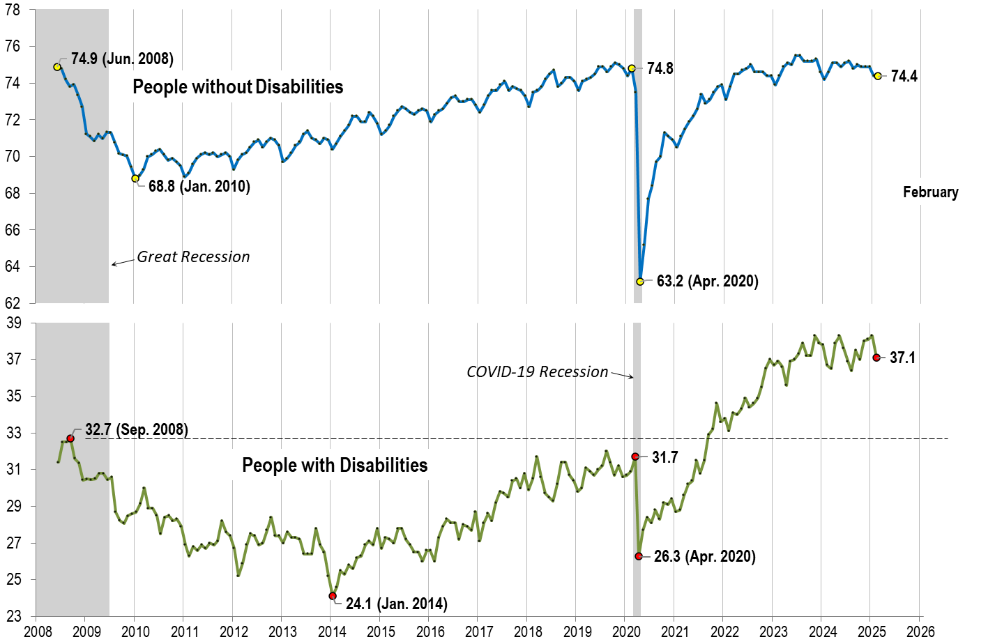
Employment- to-Population Ratio: February
Notes:
Chart Details:
The data series starts in June 2008 during the Great Recession which lasted until Mid-2009. The COVID-19 Recession started in April 2020 and last for two months
Visible Data points (highlights start of the series, the lowest point pre-covid, the points right before and after the Covid-19 recession hit, and the current Employment-to-Population Ratio
People without Disabilities:
June 2008 74.9
January 2010 (lowest point pre-covid) 68.8
February 2020 74.8
April 2020 (Covid-19 Recession hits) 63.2 (lowest point)
August 2024 74.8
September 2024 75.0
February 2025 74.4
People with Disabilities:
September 2008 32.7
January 2014 (lowest point pre-covid) 24.1 (lowest point)
March 2020 31.7
April 2020 (Covid-19 Recession hits) 26.3
August 2024 38.4
September 2024 37.5
February 2025 37.1

Slide 14
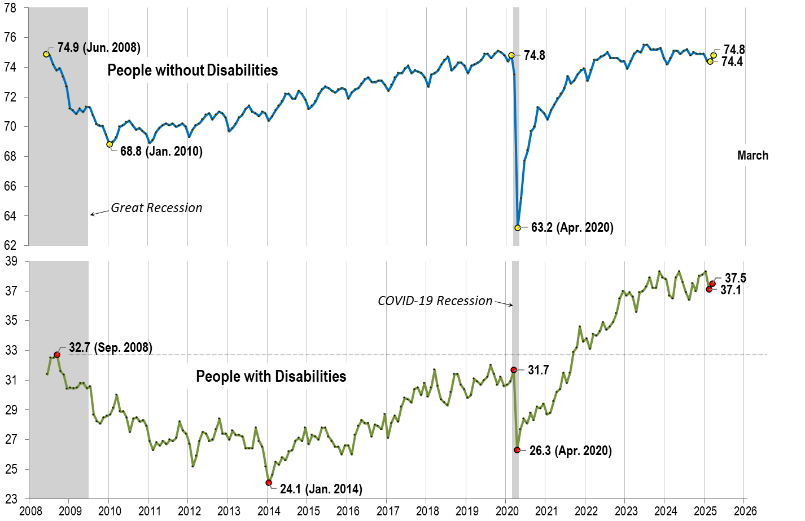
Employment- to-Population Ratio: March
Notes:
Chart Details:
This chart adds another month to the previous chart.
People without Disabilities:
June 2008 74.9
January 2010 (lowest point pre-covid) 68.8
February 2020 74.8
April 2020 (Covid-19 Recession hits) 63.2 (lowest point)
August 2024 74.8
September 2024 75.0
February 2025 74.4
March 2025 74.8
People with Disabilities:
September 2008 32.7
January 2014 (lowest point pre-covid) 24.1 (lowest point)
March 2020 31.7
April 2020 (Covid-19 Recession hits) 26.3
August 2024 38.4
September 2024 37.5
February 2025 37.1
March 2025 37.5

Slide 15
Labor Force Participation Rate:

Slide 16
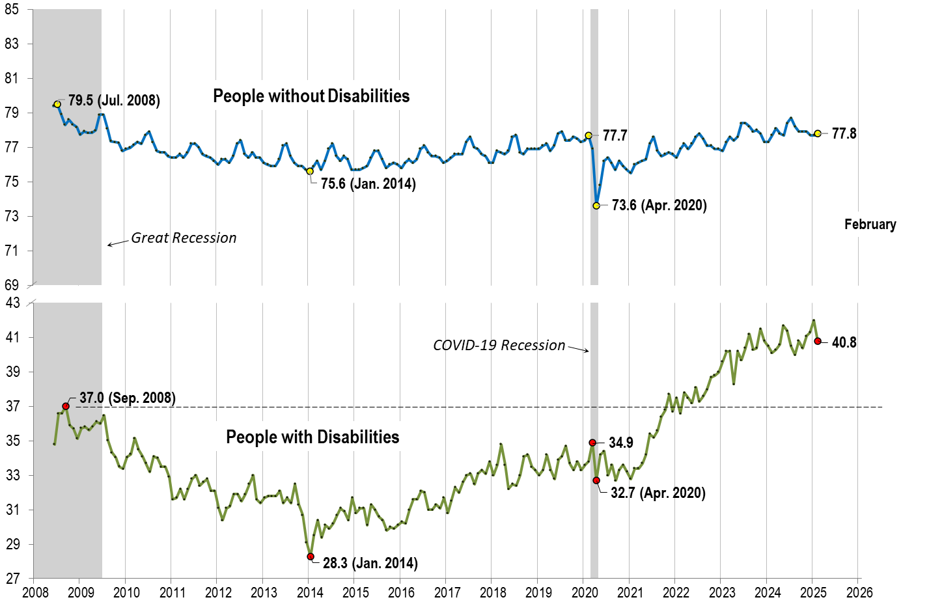
Labor Force Participation Rate: February
Notes:
Chart Details:
The data series starts in June 2008 during the Great Recession which lasted until Mid-2009. The COVID-19 Recession started in April 2020 and last for two months
Visible Data points (highlights start of the series, the lowest point pre-covid, the points right before and after the COVID-19 recession hit, and the current labor force participation rate.
People without Disabilities:
July 2008 79.5
January 2014 (lowest point pre-covid) 75.6
February 2020 77.7
April 2020 (Covid-19 Recession hits) 73.6 (lowest point)
February 2025 77.8
People with Disabilities:
September 2008 37.0
January 2014 28.3 (lowest point)
March 2020 34.9
April 2020 (Covid-19 Recession hits) 32.7
February 2025 40.8

Slide 17
Labor Force Participation Rate: March
Notes:
Chart Details:
This chart adds another month to the previous chart.
People without Disabilities:
July 2008 79.5
January 2014 (lowest point pre-covid) 75.6
February 2020 77.7
April 2020 (Covid-19 Recession hits) 73.6 (lowest point)
February 2025 77.8
March 2025 78.0
People with Disabilities:
September 2008 37.0
January 2014 28.3 (lowest point)
March 2020 34.9
April 2020 (Covid-19 Recession hits) 32.7
February 2025 40.8
March 2025 40.9

Slide 18
Government Employees
Still too soon for the reductions in federal workers to influence nTIDE numbers …
The CPS survey was conducted typically in the second week of month.
Bureau of Labor Statistics (BLS) publishes “class of worker” statistics of First Fridays in …
Table A-8, https://www.bls.gov/news.release/empsit.t08.htm
Current Population Survey (CPS)
Asks about federal, state, and local governments, separately.
Need the raw data (which comes out later in the month) to separate.

Slide 19
Part 2 nTIDE News
Denise Rozell
Association of University Centers on Disabilities (AUCD)

Slide 20
Federal Policy Update
Executive Orders
Department of Education
NTACT-C
Department of Health and Human Services
Reconciliation
Medicaid
Voting

Slide 21
Medicaid Work Requirements
Bazelon Center for Mental Health Law - Medicaid Work Requirements Harm People with Mental Health Disabilities
KFF (Kaiser Family Foundation) -
5 Key Facts About Medicaid Work Requirements
Understanding the Intersection of Medicaid and Work
Health Law Project –
“Unfit” to Work? How Medicaid Work Requirements Hurt People with Disabilities https://healthlaw.org/resource/unfit-to-work-how-medicaid-work-requirements-hurt-people-with-disabilities-2/
Protect Medicaid Funding Issue #13: Medicaid Work Requirements Hurt the U.S. Workforce (Sep., 2024), https://healthlaw.org/wp-content/uploads/2024/09/013-PMF-Low-Wage-Workers.pdf.
Protect Medicaid Funding Issue #14: Medicaid Work Requirements Hurt State Economies (Sep., 2024), https://healthlaw.org/wp-content/uploads/2024/09/014-PMF-State-Budgets.pdf.

Slide 22
TACQE Research Database
The TACQE (Technical Assistance Center for Quality Employment) Research Database:
Evidence-based insights to support quality employment for people with disabilities
Find research tailored to your interests, including:
Disability types served
Populations served
Types of interventions
Employment characteristics and outcomes
Research design
Publication date… and more!
Use TACQE’s Research Database to enhance your work and support competitive, integrated employment.

Slide 23
Apprenticeship Learning Community
Rumrill S, Austin B, Knauf J, Kosciulek J. Processes and outcomes of a 14-month apprenticeship learning community: Toolkit development and practice implications. Journal of Vocational Rehabilitation. 2025;62(1):67-75.
14-month apprenticeship learning community facilitated by the authors and the toolkit for practitioners and key stakeholders that it produced.
Members shared problems, solutions, and insights related to apprenticeships
The Apprenticeship Toolkit covers topics such as basic knowledge of apprenticeships, steps for entering, navigating, and completing an apprenticeship program, tips for successful interagency collaboration, and guidance on disability disclosure.

Slide 24
VR Counselor Turnover
Landon TJ, Phillips BN, McKnight M, et al. Insights on turnover intent in state vocational rehabilitation agencies. Journal of Vocational Rehabilitation. 2024;62(1):82-87.
Chronic issues of counselor turnover through the years
Synopsis of causes
Direct cost of turnover = cost of replacement, lost productivity, lost knowledge = 5x salary
Indirect costs of turnover

Slide 25
Webinar: ABLE Accounts
ABLE Accounts: A Pathway To Financial Empowerment For People With Disabilities - National Financial Capability Month Webinar
Disability Employment TA Center (DETAC) National Community of Practice Webinar
Tuesday, April 8 at 3PM ET
Presentations by:
The ABLE National Resource Center (ABLE NRC) - overview about eligibility requirements, contribution limits, and how ABLE funds can be used.
Innovative strategies from Kansas to increase public awareness and adoption of ABLE accounts
An individual with lived experience on how she uses her ABLE account to help her succeed at work and live independently in the community.

Slide 26
Disability Policy Seminar
April 7-9, 2025, Washington, D.C.
Cosponsored by the Arc, AUCD, TASH, AAIDD, NDSC, SABE, UCP, NADSP, Caring Across Generations, Respectability, Autism Society
2 days of breakout and general sessions on issues affecting people with disabilities: Education/IDEA, federal funding, Medicaid, Social Security, updates from Congress and Capitol Hill, disability support workforce and more.
Includes 101 sessions for those just learning, including how to do meetings with policymakers, and more in depth sessions for others.
Wednesday Advocacy Day on Capitol Hill.

Slide 27
National Symposium on Quality Employment 2025
Hosted by the Vocational Rehabilitation Technical Assistance Center for Quality Employment (VRTAC-QE)
May 21-22, 2025 Madison WI or virtually
Theme - Evidence-based practices leading to Quality Employment of Persons with Disabilities
Targeted to VR practitioners, academics, researchers, administrators, and policymakers

Slide 28
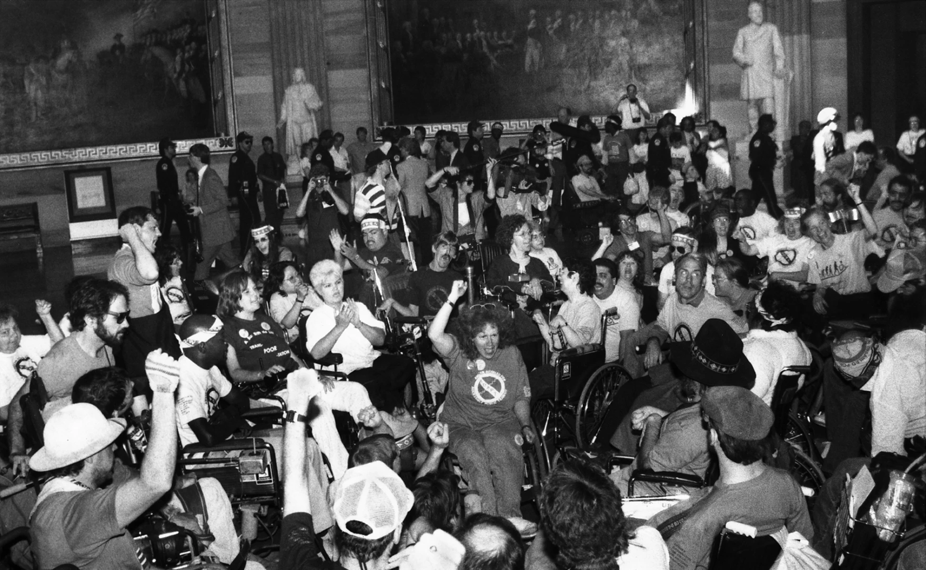
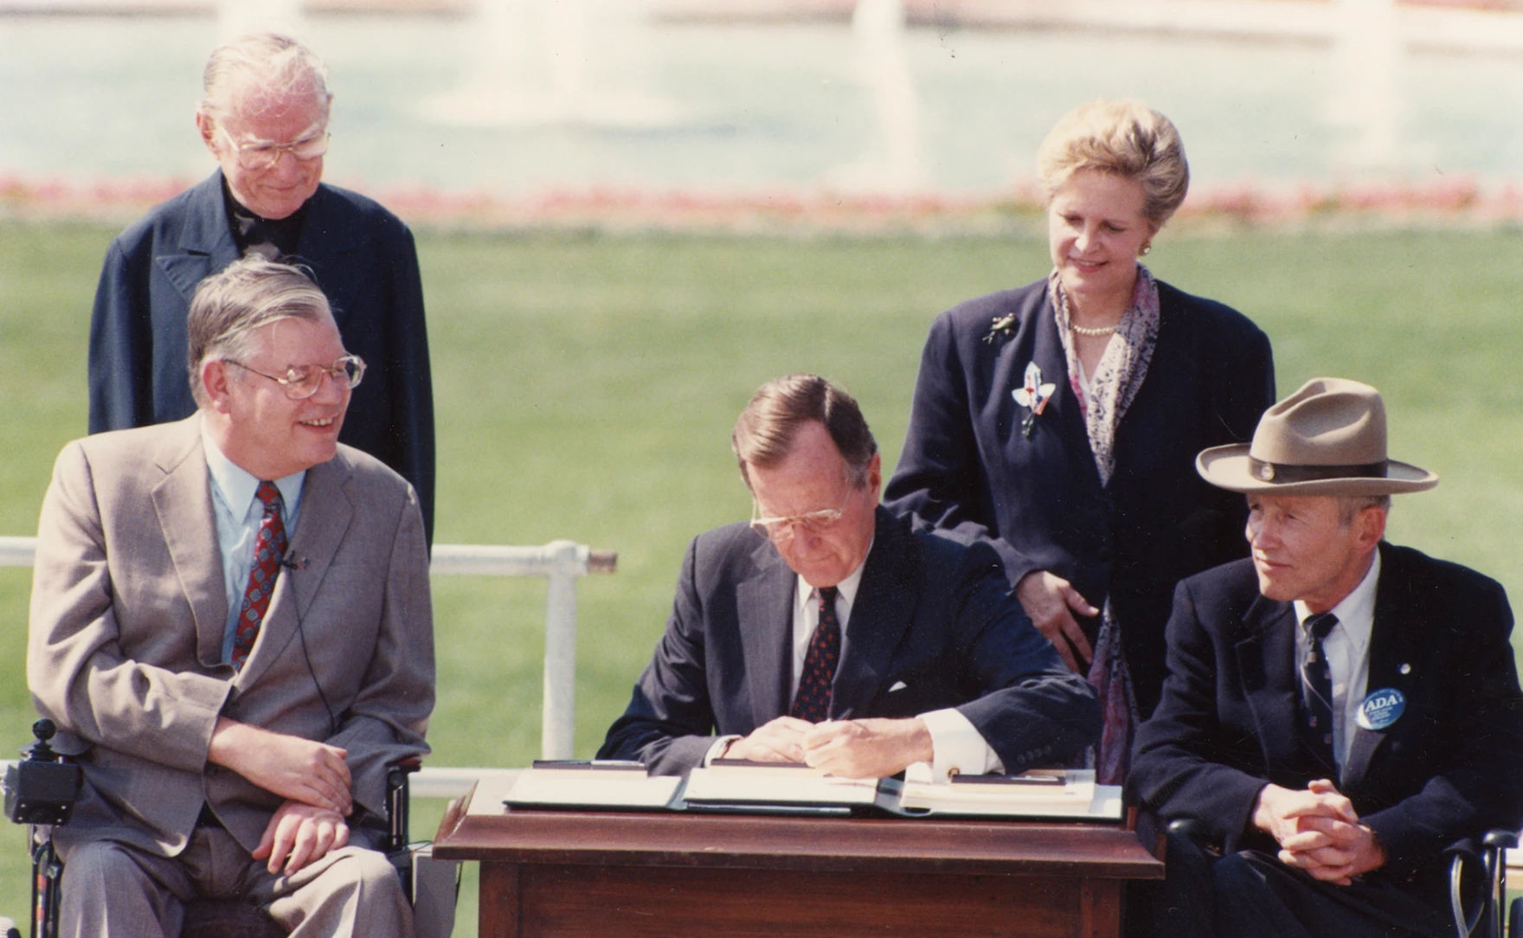
“Change not Charity”
American Experience – New documentary streaming on PBS NOW!!
Focusing on the decades-long push for equality and accessibility- from Willowbrook in the 1970’s to the passage of the ADA in 1990
Told through the voices of key participants and witnesses
A testament to the power of coalition building and bipartisan compromise

Slide 29
Part 3: Guest Speaker
Lindsay DuBois and Dorothy Hiersteiner
Human Services Research Institute (HSRI)

Slide 30
Using National Core Indicators Data to Explore Unemployment, Underemployment, and Competitive Integrated Employment among People with IDD
Notes:
Laura

Slide 31
National Core Indicators (NCI)
NCI tools collect data on performance and quality of life indicators directly from:
people who use disability and/or aging services systems;
families; and
those who deliver services
Participating states:
NCI-IDD IPS and Family Surveys: 48
NCI-AD: 26
State of the Workforce: 30 states for the NCI-IDD SoTW, and 6 states for NCI-AD SoTW
Notes:
Laura
NCI was initially developed as partnership between HSRI, NASDDDS and NASDDDS member states (State DD Agencies)

Slide 32
NCI-IDD In-Person Survey (IPS)
Sampling: States design their samples with guidance from HSRI. Final samples should be representative of the population that uses services.
Inclusion criteria:
IDD: Person receiving at least one service in addition to case management
Consent: Surveyors follow state specific consent requirements
Those who are surveyed are informed that their services will not be impacted directly by their responses
Surveyor training: All surveyors complete standardized training. IPS uses peer-surveyors as well.
Survey features:
May be conducted in-person or remotely
Includes detailed Background Information section that primarily comes from existing records
Surveys are available in multiple languages
Questions may be rephrased or reworded
Allows for use of proxy for select questions
Notes:
Laura

Slide 33
2022-2023 Sample
25,424 total respondents
33 states
60% male
Average age 40.0
Race/ethnicity
63% White; 17% Black; 14% Latino
Diagnosis
84% ID; 31% ASD, 6% Down syndrome
Notes:
Majority live with family or in group residential settings:
Parents/relatives' home: 44%
Group residential setting: 33%
About half have a guardian

Slide 34
Employment among NCI-IDD respondents
17%
44%
have a paid
job in the community
of those who do not have a community
job want one
Notes:
Another 9% of those who aren’t working respond “in-between” when asked if they want a job in the community
46% say they don’t want a job

Slide 35
Hours and Wages
Average hours worked over two-week period at individual job in community-based settings
Average hourly wages for those working an individual job in community-based settings
Notes:
Laura
mention that we are sometimes missing information on these, but when we have information, this is what we know...

Slide 36
What is competitive integrated employment (CIE)?
Work that is performed on a full-time or part-time basis and:
Pays at or above minimum wage (and comparable to peers without disabilities)
Provides the same level of benefits to other employees without disabilities
At a location where the employee interacts with others without disabilities
Presents opportunities for advancement similar to other employees without disabilities
Notes:
Lindsay
So, when we talk about employment data from NCI, it’s not really enough to just look at those who have a paid job in the community. We want to know if those jobs are quality jobs. So, we use this definition from the Department of Labor for Competitive Integrated Employment, or CIE.
They define CIE as work that is performed on a full-time or part-time basis and:
Pays at or above minimum wage (and comparable to peers without disabilities)
Provides the same level of benefits to employees with disabilities and without disabilities
The work is performed at a location where the employee interacts with others without disabilities
Presents opportunities for advancement similar to other employees without disabilities
With NCI data, we can look at the pieces here that are bolded – so we can look at whether people are paid minimum wage and if they are working in integrated environments or more segregated environments.

Slide 37
NCI-IDD data on unemployment, underemployment and CIE
Among those who are working or want to work:
49% are unemployed
32% are underemployed
19% are in competitive integrated employment
Notes:
State range from 1% to 53%

Slide 38
People in CIE have an employment goal at rates 2x higher than those who are unemployed
Notes:
Lindsay
So, what are some of the things that are connected to having competitive integrated employment? Well, one of the biggest things that ties to employment is whether or not there is a goal for employment in a person’s service plan. And this makes a lot of sense, because if a provider agency writes down that a person wants a job, and needs supports to get a job, they can then work to deliver those supports. But if the opposite is true, and there isn’t a goal in the service plan to work, then the provider agency may not deliver those supports.
So, if we look at NCI data on service plans and employment, we see that people in CIE have employment goals in their service plan at rates that are 2 times higher than those who are unemployed, and almost 1.5 times higher than those who are underemployed.
Among those who are unemployed and want to work, just 35% have employment as a goal in their service plan
Among those who are underemployed, 50% have employment as a goal in their service plan
Among those who are in competitive integrated employment, 69% have employment as a goal in their service plan
Laura will talk about this a bit more later in the solutions, but I just want to emphasize how important we think it is to have a conversations with a service coordinator and your staff each year about employment, and to make sure that’s part of the service plan if you want it to be.

Slide 39
Regression results
Having an employment-related goal in one’s service plan was associated with 4.7X higher odds of having competitive integrated employment relative to unemployment.
Notes:
In a multivariate regression, after adjusting for variables such as age, race, ethnicity, guardianship, level of ID, mobility, and where people live…
having an employment-related goal in one’s service plan was associated with 4.5 (95% CI: 3.6–5.5) times higher odds of competitive integrated employment relative to unemployment.

Slide 40
Strengths and Limitations of NCI-IDD data and analysis
Strengths
NCI-IDD sample is robust, and tools are psychometrically sound
Sample comprised of people in variety of settings, states, and who receive a different set of services
Analysis methods accounts for state variation in policy
Limitations
Findings are generalizable to those who use state-funded DD services, but not clear if they are generalizable to all with IDD
The group that is categorized as unemployed but who wish to work may be an underestimate
Accuracy and missing information related to hourly wages
Data is cross-sectional so causal inferences are not possible
Notes:
NCI is a valid and reliable tool for assessing state-level performance of DD systems, and findings are generalizable to people with IDD who use state-funded DD services of participating states; however, we do not know if these findings are generalizable to all people with IDD.
Further, although missing data on paid community employment and having an employment goal in one’s service plan was small, there were 4146 people who did not respond to section I questions (mostly due to use of proxy respondents) and who do not have paid community jobs. It is possible the sample who are “unemployed,” and the impact of having an employment-related goal in one’s service plan on employment outcomes may represent a slight underestimate

Slide 41
Conclusions and implications
Case managers should ensure that preferences for employment are written into the person-centered service plan. This small action could pay major dividends.
System levels changes should continue to be explored to complement these more individual level enhancements, such as:
Expansion of benefit eligibility considerations
Elimination of subminimum wage certificates
Increased funding and support to employment support professionals

Slide 42
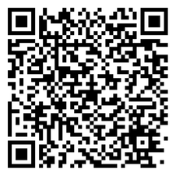
Stay connected for updates!
NCI updates newsletter
NCI facebook page:
www.facebook.com/nationalcoreindicators
NCI website:
www.nationalcoreindicators.org
Contact us:
ldubois@hsri.org

Slide 43
Thank You!
Information about the nTIDE partners may be found at
Kessler Foundation (www.kesslerfoundation.org)
UNH/Institute on Disability (www.ResearchOnDisability.org)
AUCD (www.AUCD.org)
Contact us at
Email: Disability.Statistics@unh.edu
Call: 866-538-9521 (toll free)
Twitter at #nTIDELearn

Slide 44
Bye!

